Slide 1
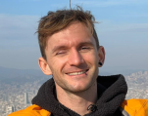
Optimal Joint Reconstruction of CMB Secondaries for CMB-S4
CMB-S4 spring meeting 2025
Sebastian Belkner
Uni Geneva
Julien Carrons postdoc
$$T^{unl}$$
$$T^{len}$$
Background powered by: cunuSHT 2406.14542, the GPU version of lenspyx 2304.10431

Slide 2
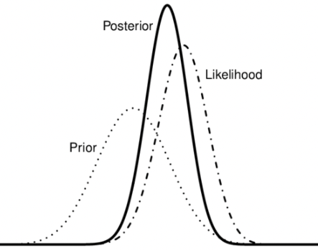
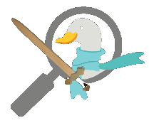
maximum a-posteriori (MAP) lensing reconstruction
optimally remove imprint of gravitational pull
data: lensed CMB, parameter: deflection field
lensing log-likelihood,
$$−2\log\left(ℒ\left(\tilde{X} | α\right)\right)$$
Bayesian’s theorem $→$ posterior $→$ MAP point
general procedure (the delensalot way):
Take likelihood, define data model: $\tilde{X}=BD_{α}X+n$
calculate gradient
Follow the gradient
This is map-level reconstruction (not forecasting)
$${\hat{α}}^{MAP}$$
$${\hat{α}}_{N+1}$$
$${\hat{α}}_{N}$$
2

Slide 3
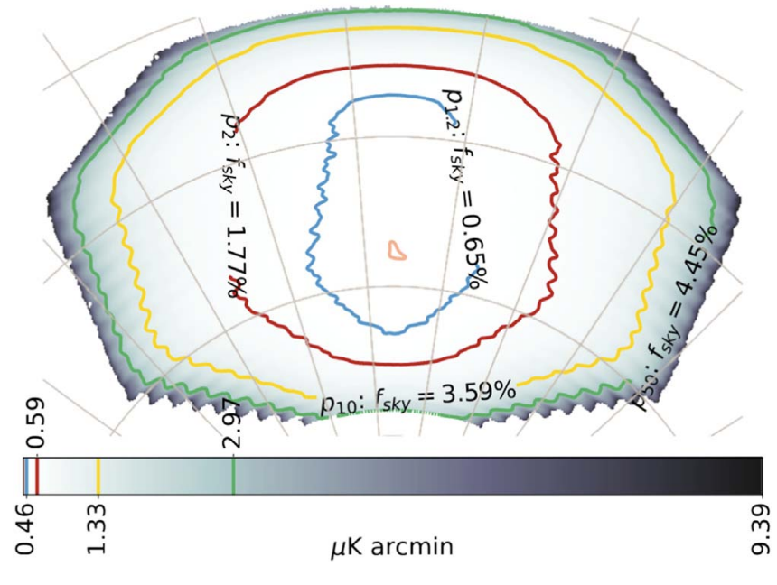
status and motivation
Curved sky, r-constraint pipeline on a small patch
Gradient-search Bayesian method works on the curved and masked sky
2310.06729
pioneers
0306354
The patch,
Fsky = 5%
Flat sky
1704.08230
A talk I saw in Shanghai by Hongbo Cai and Yilun Guan about birefringence sparked an idea:
Even if we can’t reach r, what else is there to find?
Is the delensalot-way applicable to other secondaries?
Can we reconstruct jointly?
Can we study cross-correlation between secondaries?

Slide 4
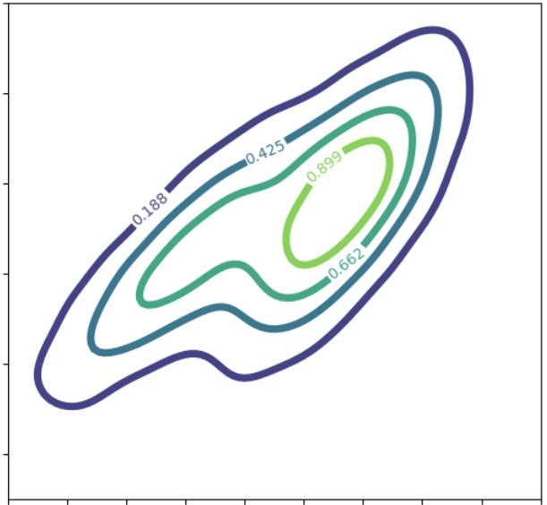
jMAP – joint maximum a-posteriori point
Start with likelihood across various secondaries $γ$,
$$−2\log\left(ℒ\left(\tilde{X} | γ_{i},…,γ_{S}\right)\right) .$$
Data model,
$$\tilde{X}=B\prod_{i}{U_{γ_{i}}}X+n ,$$
$U_{γ_{i}}$ = operator of the secondary $γ_{i}$.
Collect all gradients,
$$g_{γ}^{Σ,tot}=⨁_{i}{g_{γ_{i}}^{tot}}$$
Follow the gradient, $${α_{N+1}=α_{N} +λH_{N}g}_{γ_{N}}^{Σ, tot}$$ $H_{N}$ is the likelihood curvature.
A gradient wrt $γ$ is, $$g_{γ}^{tot}= \frac{δ\ln{ρ\left(γ_{i},…,γ_{S}\right|X^{dat})}}{δγ_{a}(n)} =g_{γ}^{QD}−g_{γ}^{MF}+g_{γ}^{PR}$$
Schematically,
$$g_{γ}^{QD}=\sum_{s=(−2,0,2)}{{_s\overline{X}}_{γ} sG_{γ} sX_{γ}^{WF}},$$
I implemented this, and added flexibility to work with custom gradients
and any combination
inverse variance filtered residual
wiener-filtered CMB
“inner derivative” of cov matrix

Slide 5
jMAP – reconstruction biases
$$N^{\left(0\right)}$$
present even in absence of a secondary
QE
“what is response of P from A”. For pot, curl, and bire, cross responses are zero. (even-odd parity)
MAP
Iteratively. Assuming that,
$$C_{L}^{φφ,MAP}=\left(1−ρ_{L}\right)C_{L}^{φφ,fid}, ρ_{L}= {C_{L}^{φφ,fid}}/{C_{L}^{φφ,fid}+N^{\left(0\right)}}$$
Obtain residual lensing potential ${\overline{C}}_{L}^{φφ,MAP}$ and partial delensed CMB spectra, calculate $N_{γ}^{\left(0\right),MAP}$ from this.
$$N^{\left(1\right)}$$
Proportional to the power spectrum of the secondary itself
QE
Each secondary injects a $N^{\left(1\right)}$ contribution to all other fields.
$$N_{}^{\left(1\right),ζζ}=\sum_{γ}{N_{}^{\left(1\right),ζζ,γ}}$$
MAP
Iteratively. Obtain all ${\overline{C}}_{L}^{ζζ,γ}$ and calculate $N_{}^{\left(1\right),ζζ}$

Slide 6
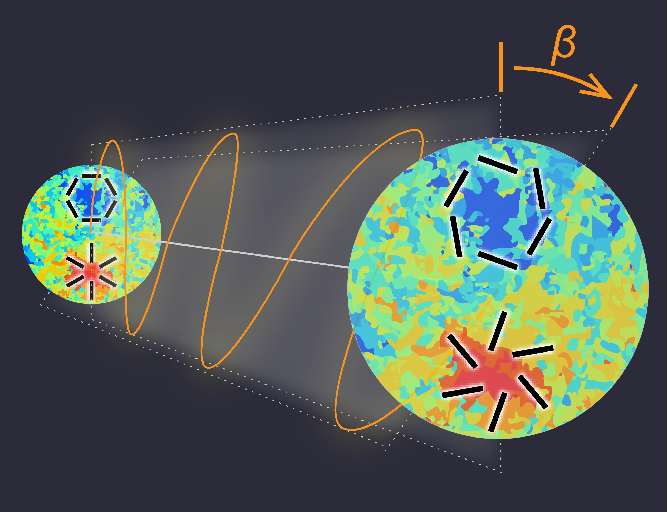
jMAP use case and setup – lensing curl and cosmic birefringence
Curl
$$ω\left(\hat{n}\right)=−4\int_{0}^{χ_{∗}}{dχ\left(\frac{χ_{∗}−χ}{χχ_{∗}}\right)dχ^{′}}\left(\frac{χ−χ^{′}}{χ^{′}χ}\right)⋅\left[γ_{1}γ_{2}^{′}−γ_{2}γ_{1}^{′}\right]$$
Setup | ”mid-way” | “low-noise”
Noise / muK-amin | 1.5 | 0.5
Beam FWHM | 1.5 | 1.0
idealized noise, polarization data, no foregrounds (no ILC or the like, no hits maps)
Non-aligned
shear distortions
Birefringence
$$C_{L}^{ββ}=\frac{{10}^{−A_{CB}}}{L(L+1)}$$
Reconstruction
Calculate QE / MAP estimates
Calculate $N^{\left(0\right)}$, $N^{\left(1\right)}$
Set constraint on birefringence toy model
Polarization rotation

Slide 7
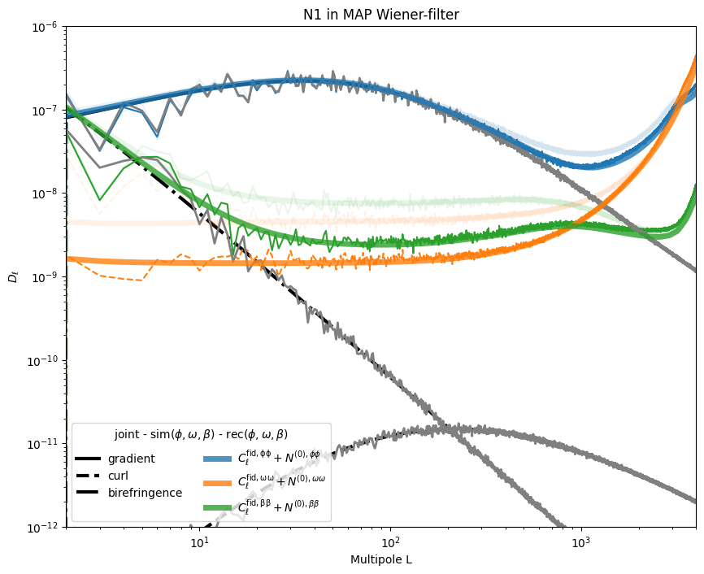
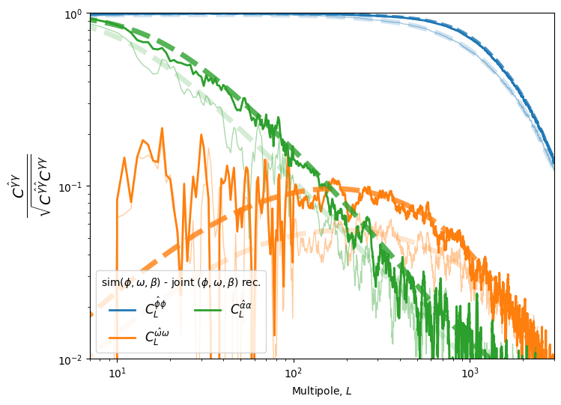
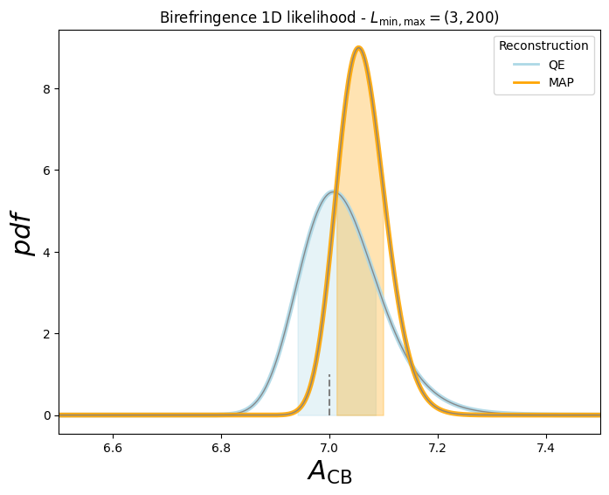
jMAP – 1.5 muK-arcmin - full sky
Reconstruction
Cross-correlation coefficient
Birefringence parameter estimation
Result (Target):
QE std: 0.08 (0.08)
MAP std: 0.04 (0.04)
Residual B-power from template lens+bire: 0.18077 lensing: 0.18080 birefringence: 1.00007
MAP reconstruction takes about 1h on an M3
- similar to potential-only reconstruction

Slide 8
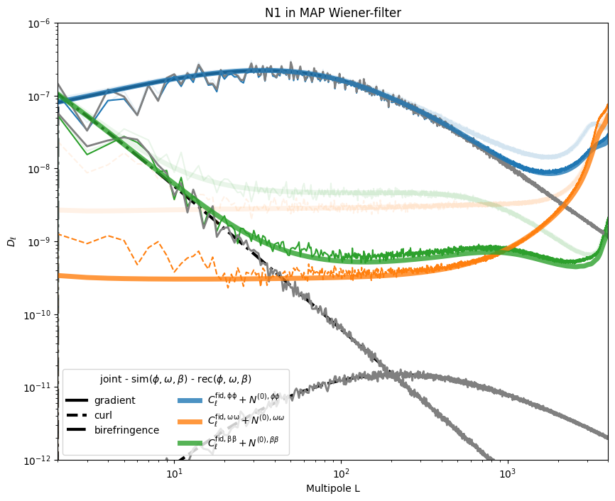
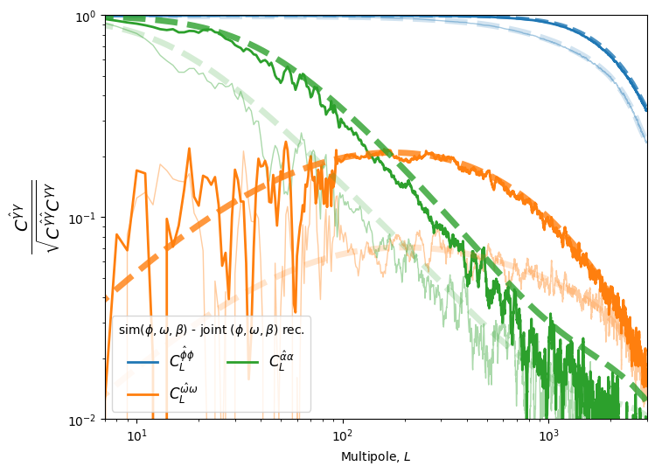
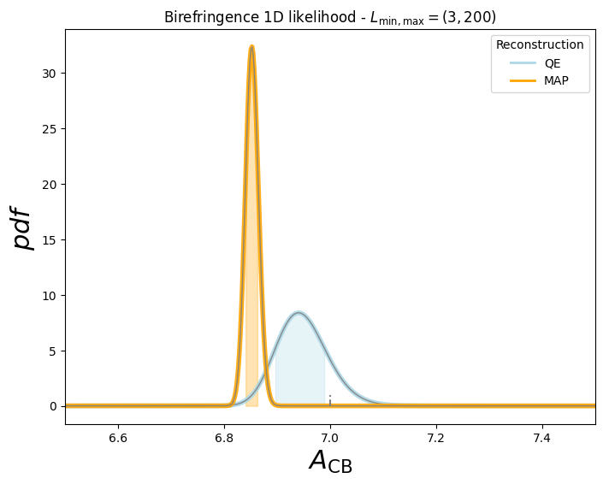
jMAP – 0.5 muK-arcmin - full sky
Reconstruction
Cross-correlation coefficient
Birefringence parameter estimation
Result (Target)
QE std: 0.06 (0.05)
MAP std: 0.02 (0.014)
Residual B-power from template lens+bire: 0.05470 lensing: 0.05479 birefringence: 1.00014
MAP reconstruction takes about 1h on an M3
- like potential-only reconstruction

Slide 9
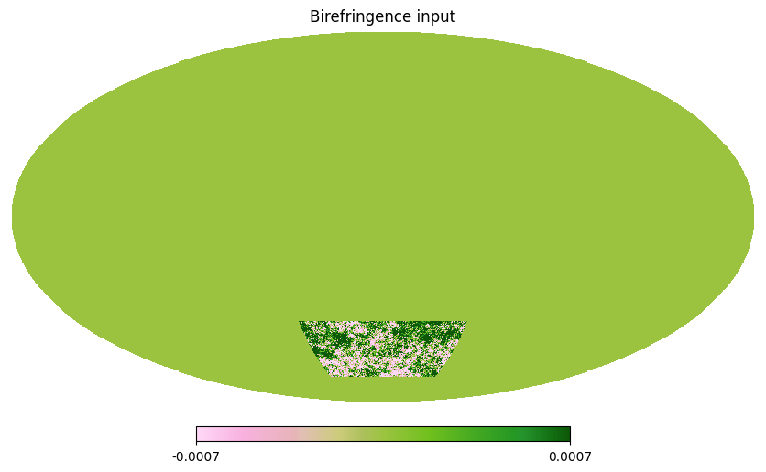
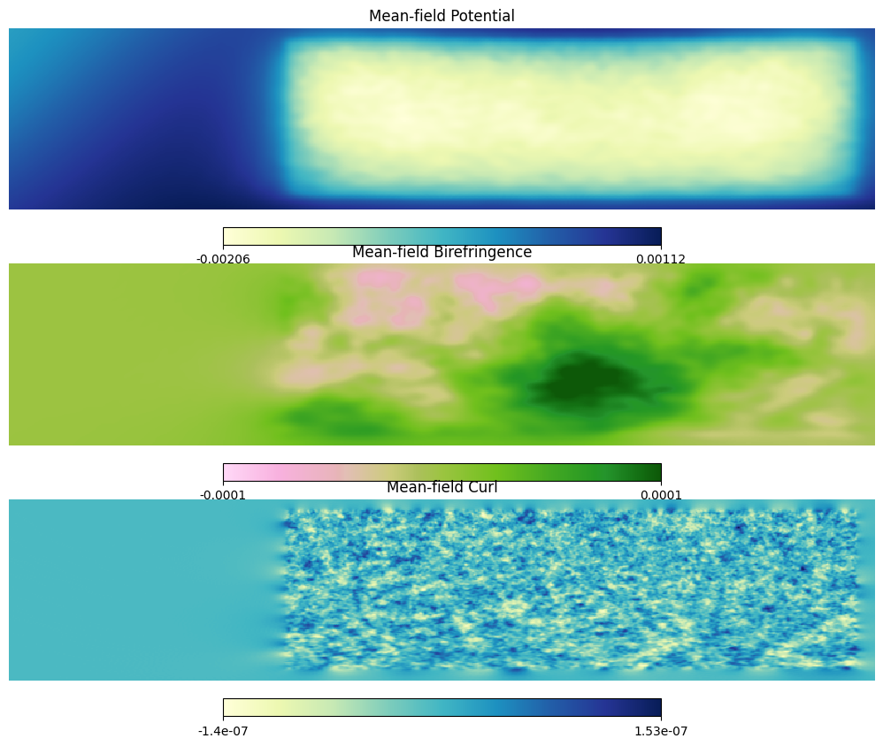
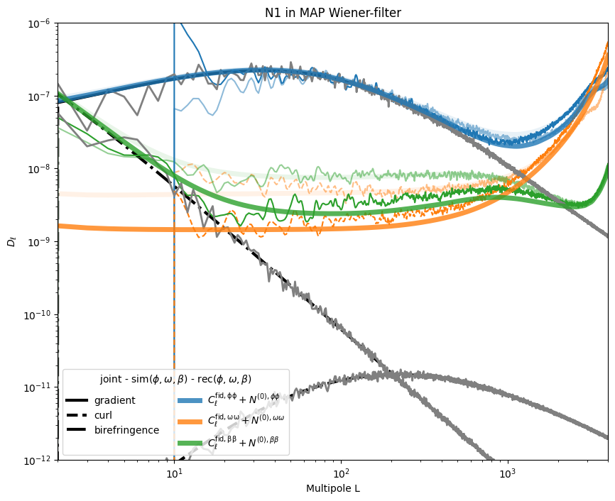
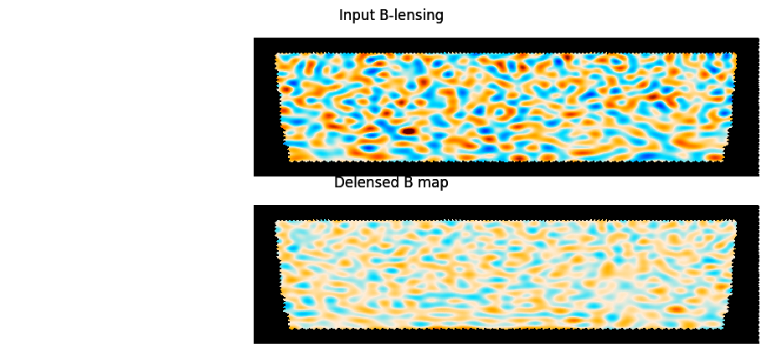
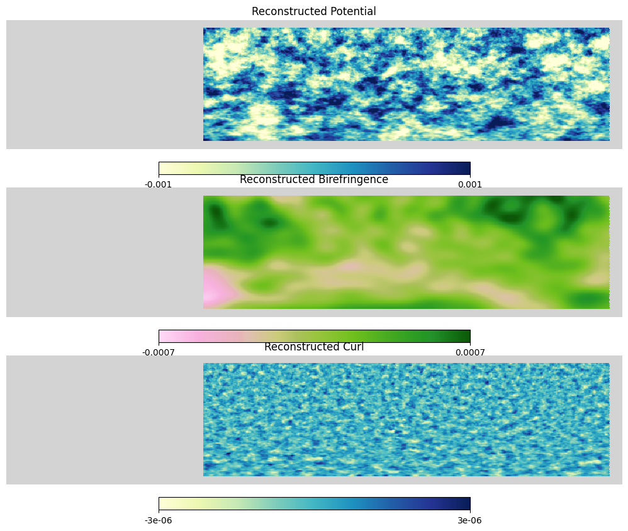
jMAP – masked sky – (First-Look, pre-preliminary)
“Mid-way”
MAP residual B: result: 0.20 target: 0.18
9

Slide 10
outlook and conclusion
I showed an optimal joint secondary reconstruction tool suitable for various secondaries. I demonstrated its performance on the lensing potential, curl and birefringence on the full/masked sky. Paper in preparation with Julien.
Findings (on 1 simulation) agree with expectation (within its low statistic)
Full data tuple (T,E,B) – currently validating
Masked sky – currently validating
Easy to add other (custom) gradients ok
Readily available in delensalot ok
/NextGenCMB/delensalot/
Optimal joint reconstruction opens new avenues to study CMB anisotropies (see also Federicos’ and Marius’ work)
Let’s chat about applying joint reconstruction to CMB-S4 sims and/or SPT/SO/ACT data

Slide 11
Backup

Slide 12
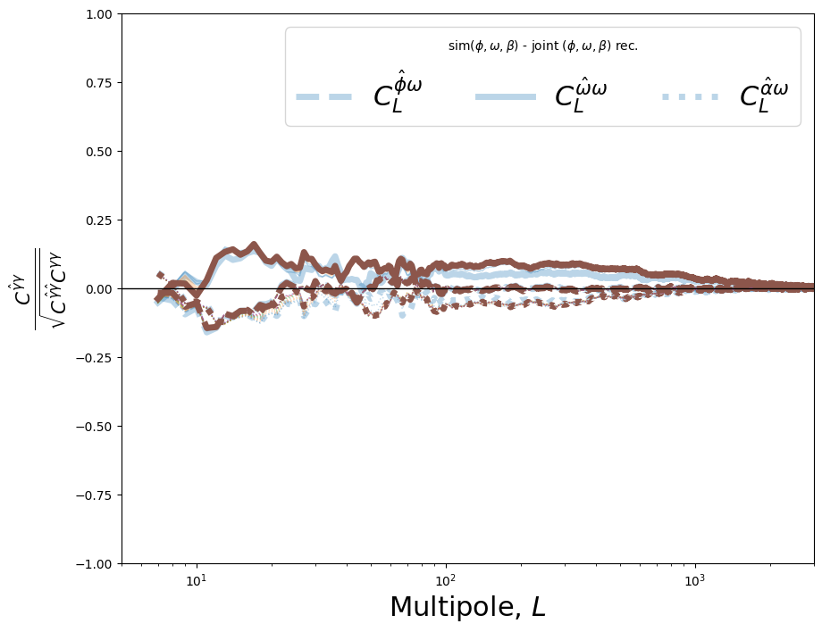
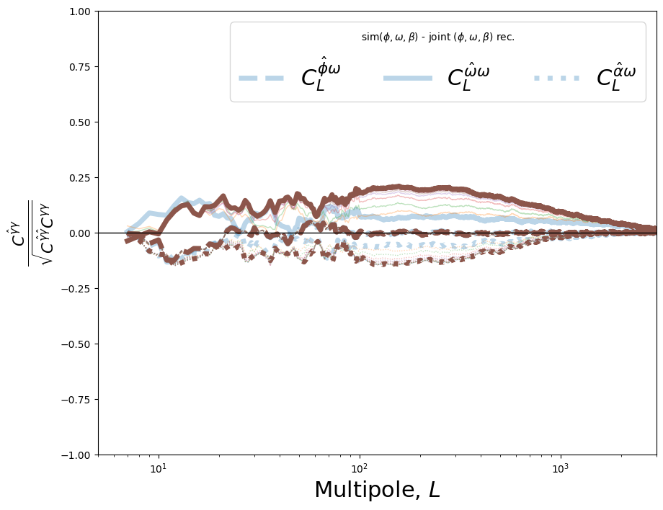
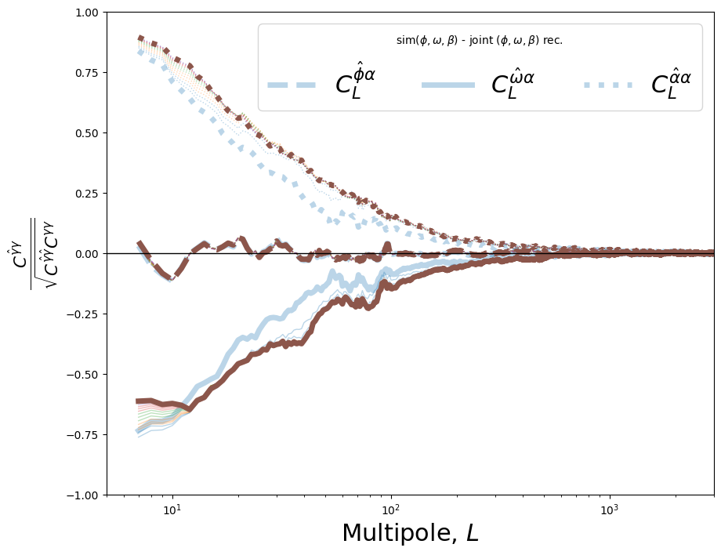
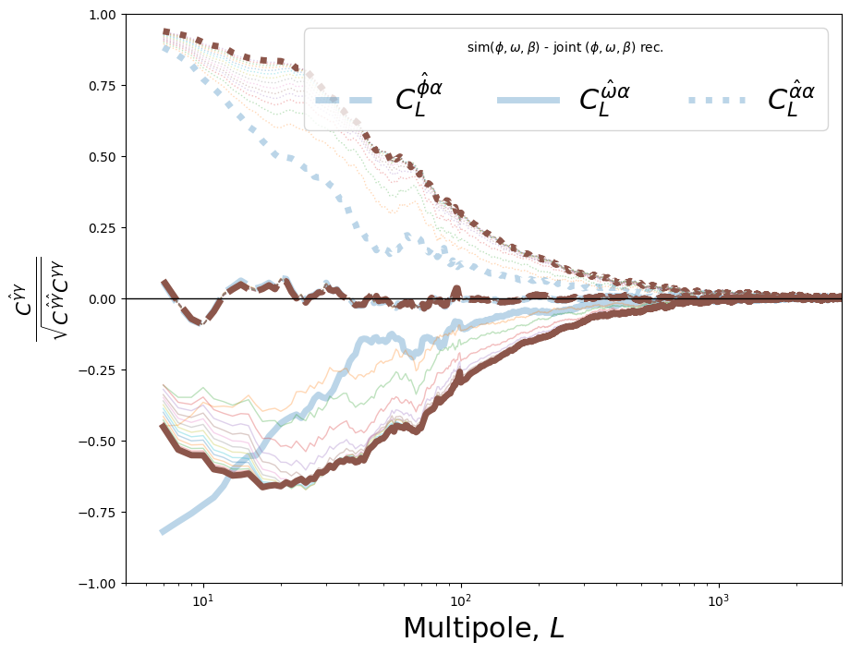
Cross
correlation
between
different
secondaries

Slide 13
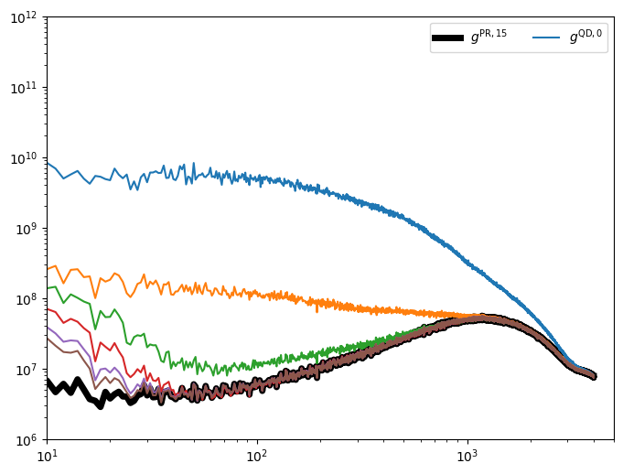
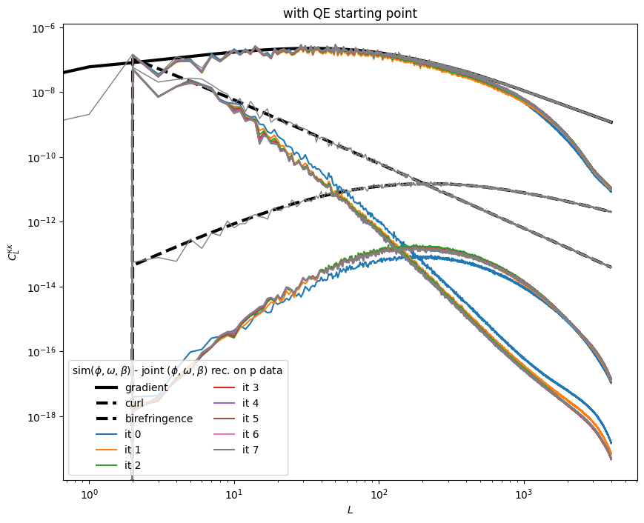
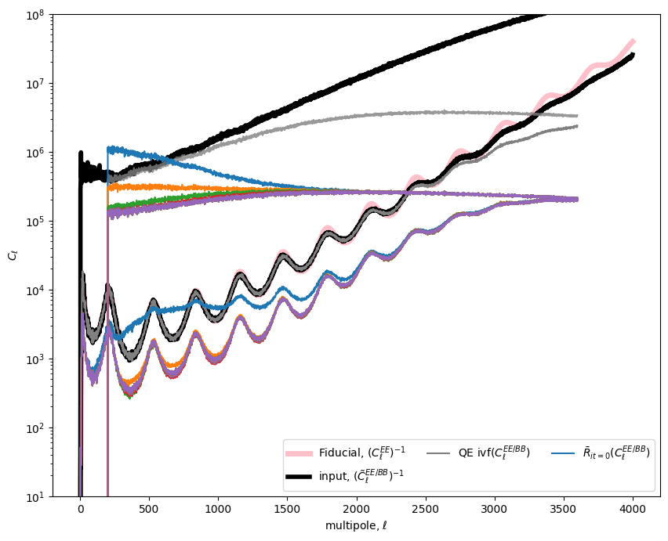
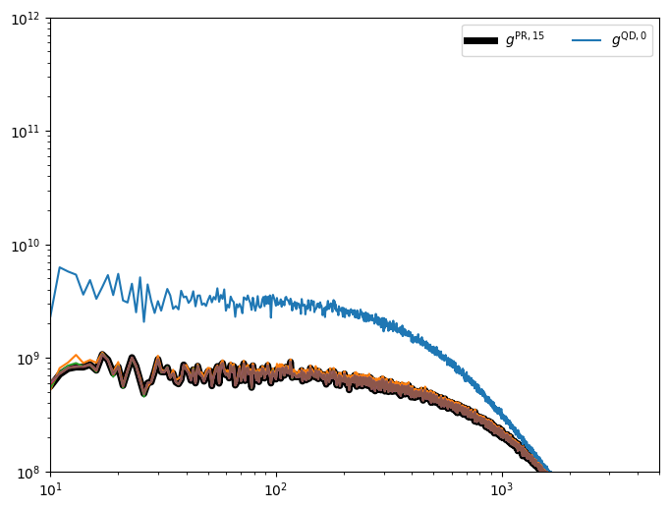
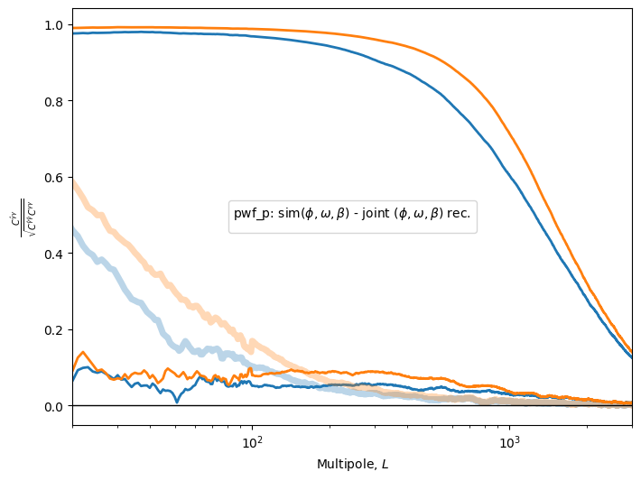
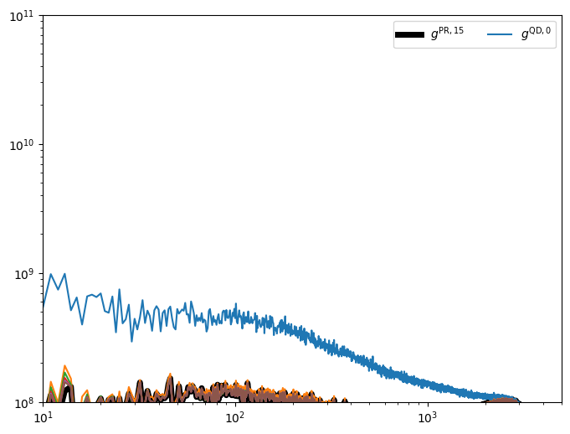
jMAP – mid-way - full sky

