Slide 1
Continuous Half-wave Plate Modulators
Adrian T. Lee
U.C. Berkeley and LBNL
7/31/24

Slide 2
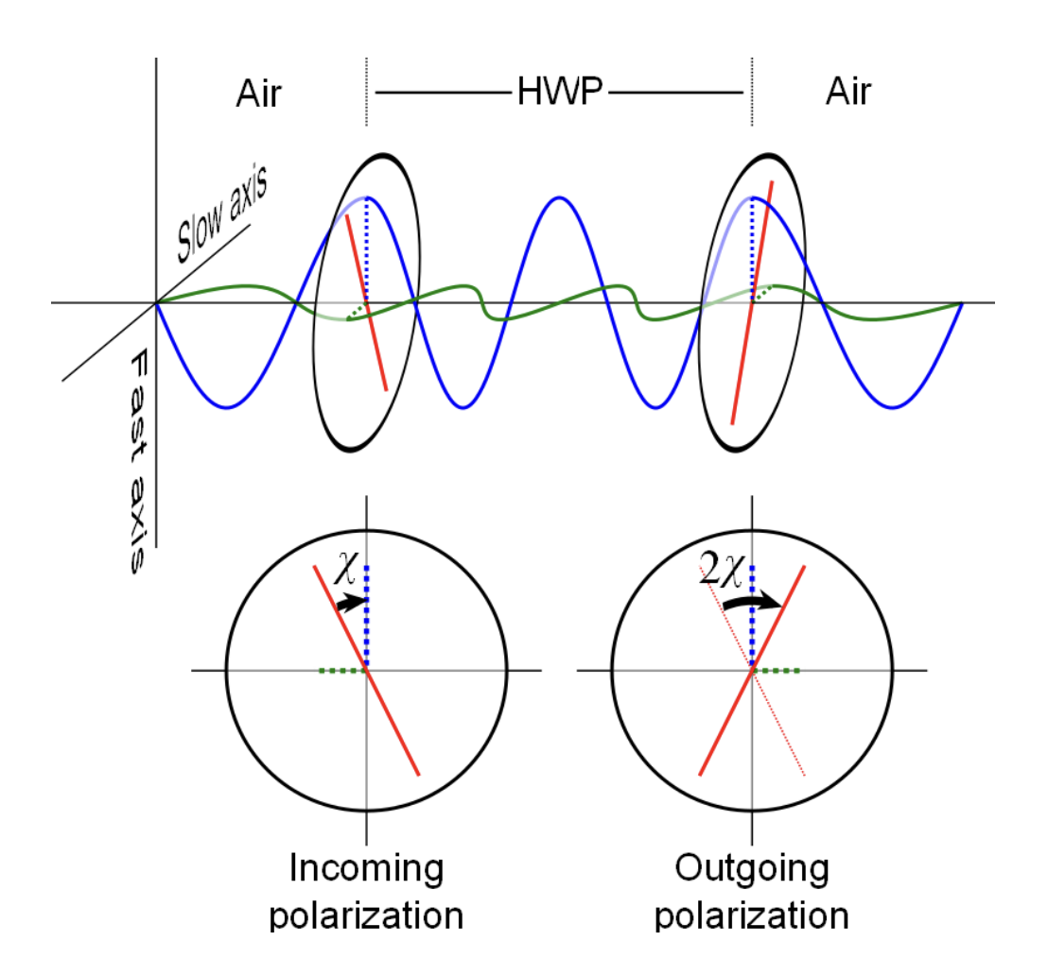
HWP Modulation
A HWP has “fast” and “slow” optical axes
The thickness is chosen so there is a 180 deg. phase shift of two orthogonal polarizations
Therefore, the polarization is flipped around the fast axis.
The polarization rotates at 2x the rotation frequency of the HWP and the signal is therefore modulated at 4x the rotation frequency

Slide 3
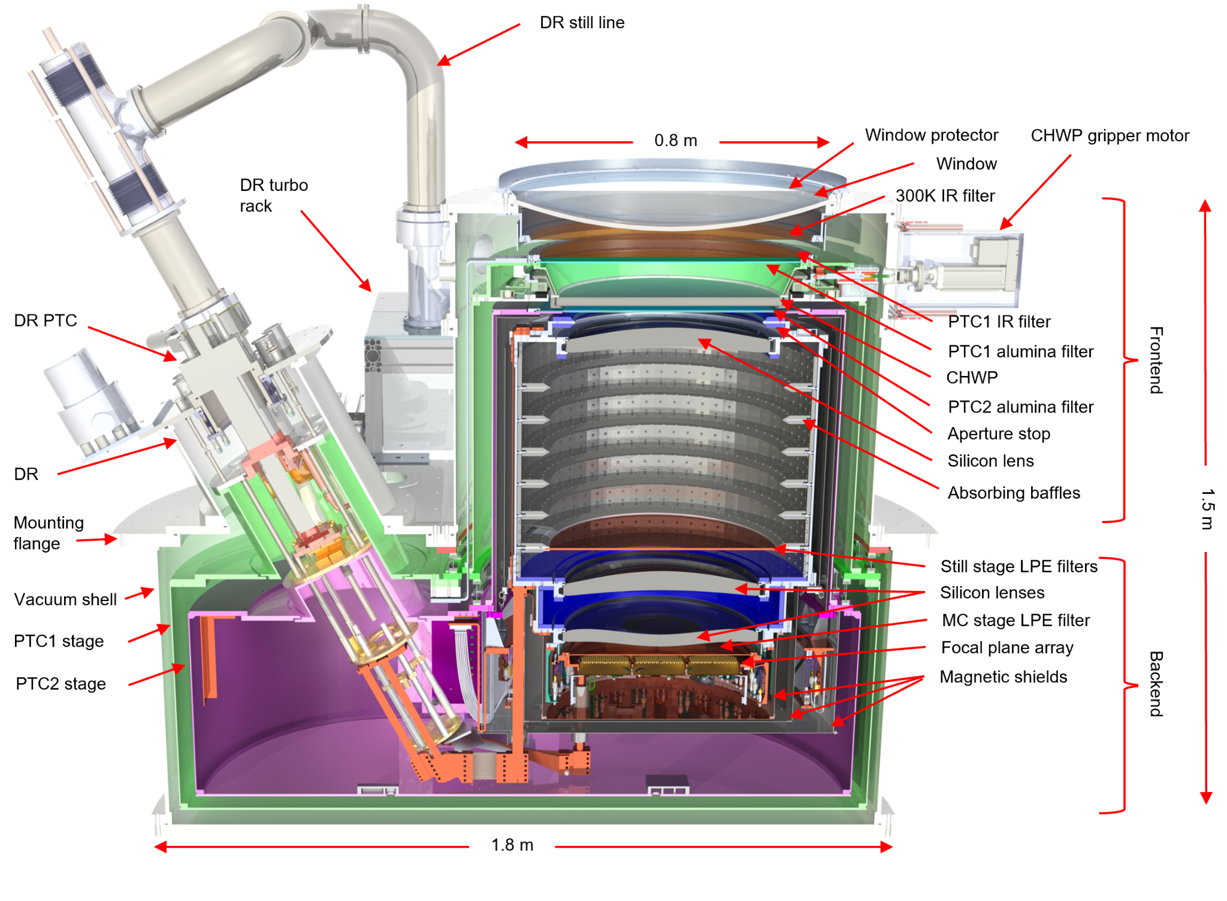
SO Small Aperture Telescope Cryostats
HWP on 40K stage
SAT I&T Paper (Galitzki et. al. https://arxiv.org/abs/2405.05550)

Slide 4
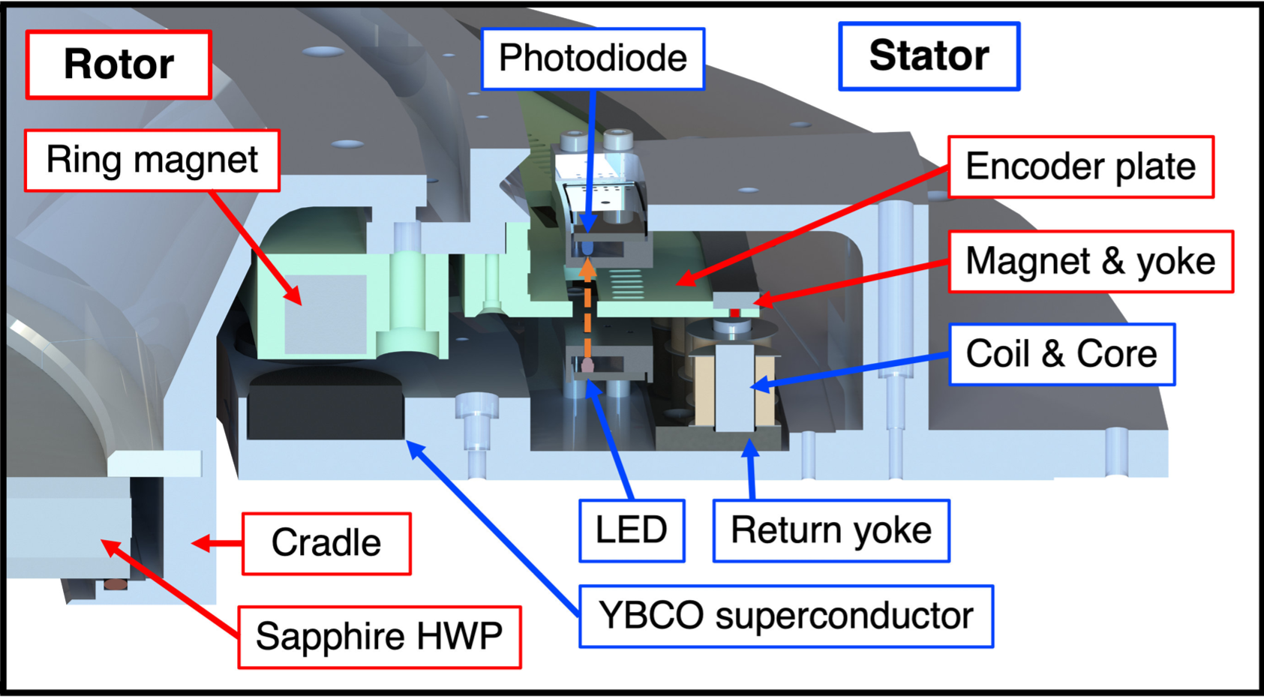
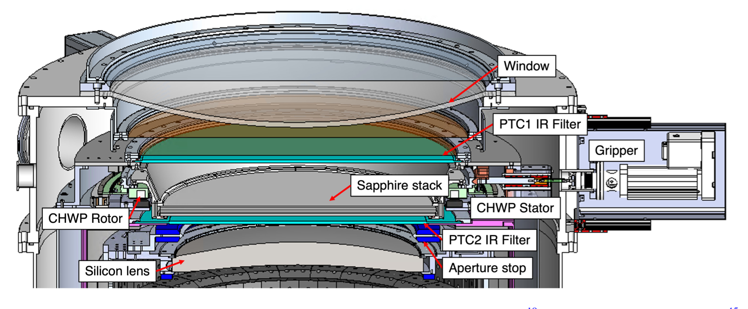
SO Cryogenic Half Wave Plates
HWP installed on the 40K frontend stage
CHWP Design and Integration Paper (Yamada, K. et. al. https://arxiv.org/abs/2309.14803)

Slide 5
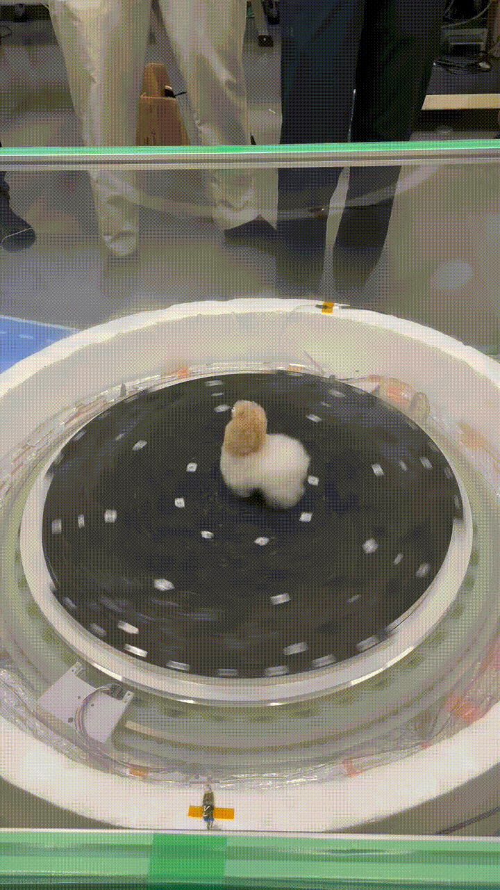
SO Superconducting HWP rotator

Slide 6
Polarization Differencing: HWP and Bolometer Differencing
HWP
Modulation
Bolometer
Differencing
Both Techniques can work well and have been demonstrated
Detailed systematic error estimates based on measured instrument models
SO will demonstrate HWP systematic error performance at lower noise levels than previous HWP experiments
Current experience: HWP modulation is better at rejecting atmospheric fluctuations
Possible reasons:
For differencing, a difference in bandpass shape for paired detectors will result in different gain for CMB and atmosphere, the HWP modulation uses the same bandpass filter for both polarizations
HWP modulation requires high gain stability due to HWP synchronous signal and differencing requires high differential gain stability

Slide 7
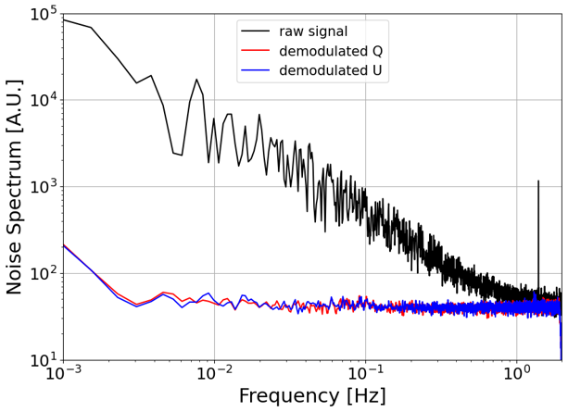
Atmospheric Rejection in SO SAT Data
Preliminary
Demodulation
Noise spectra from ~100 detectors with no additional filtering post-demodulation. Spectrum is white until very low frequencies.

Slide 8
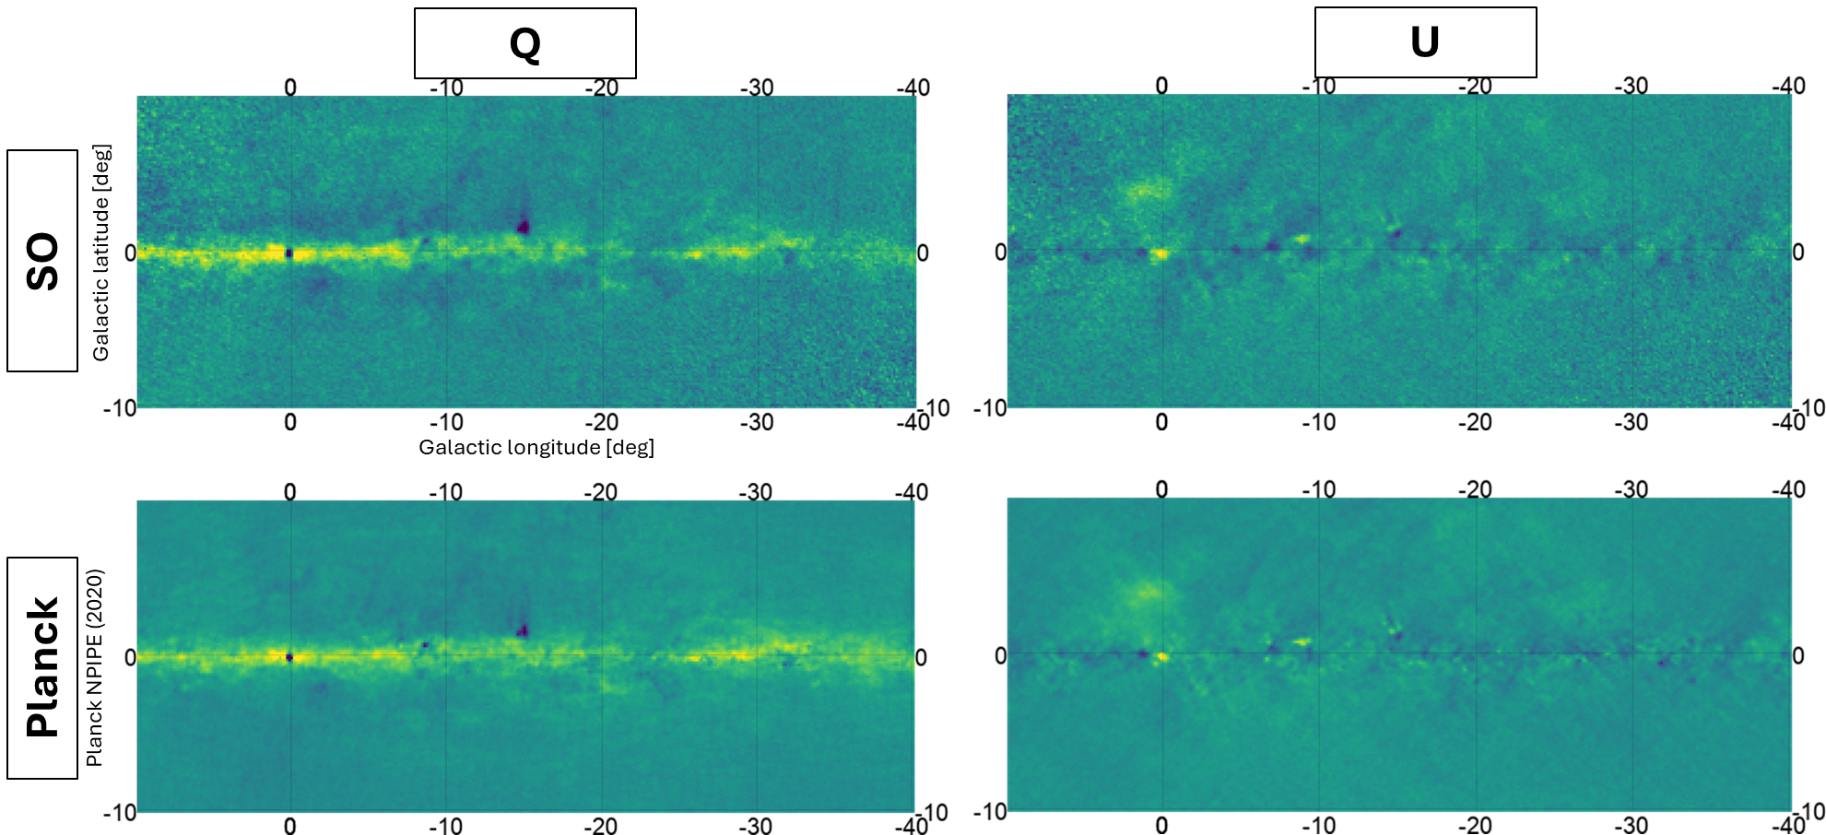
Galaxy Maps
Tomoki Terasaki
Affiliation: University of Tokyo
Preliminary
Preliminary
Galaxy center maps in comparison to Planck demonstrate instrument performance and larger scale recovery.

Slide 9
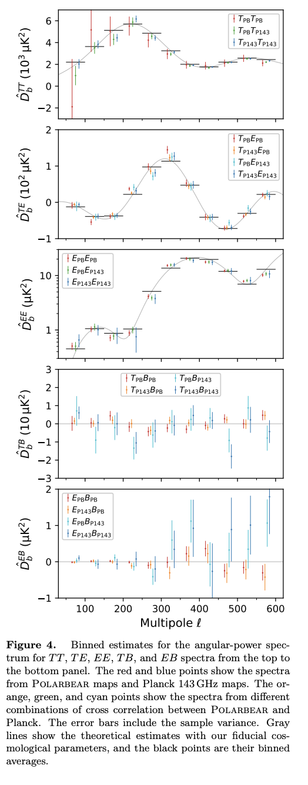
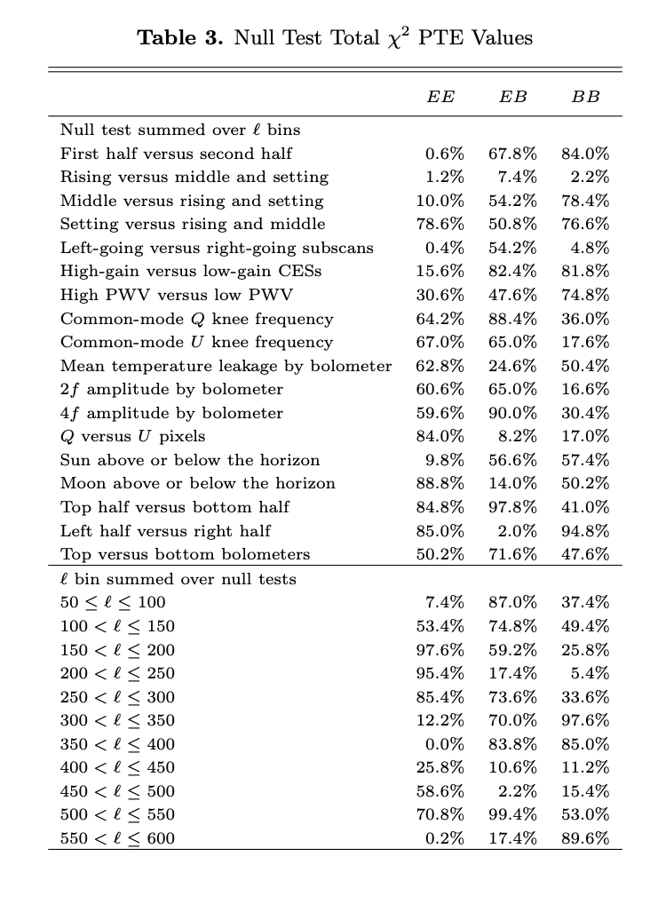
POLARBEAR-1
Ell knee = 90

Slide 10
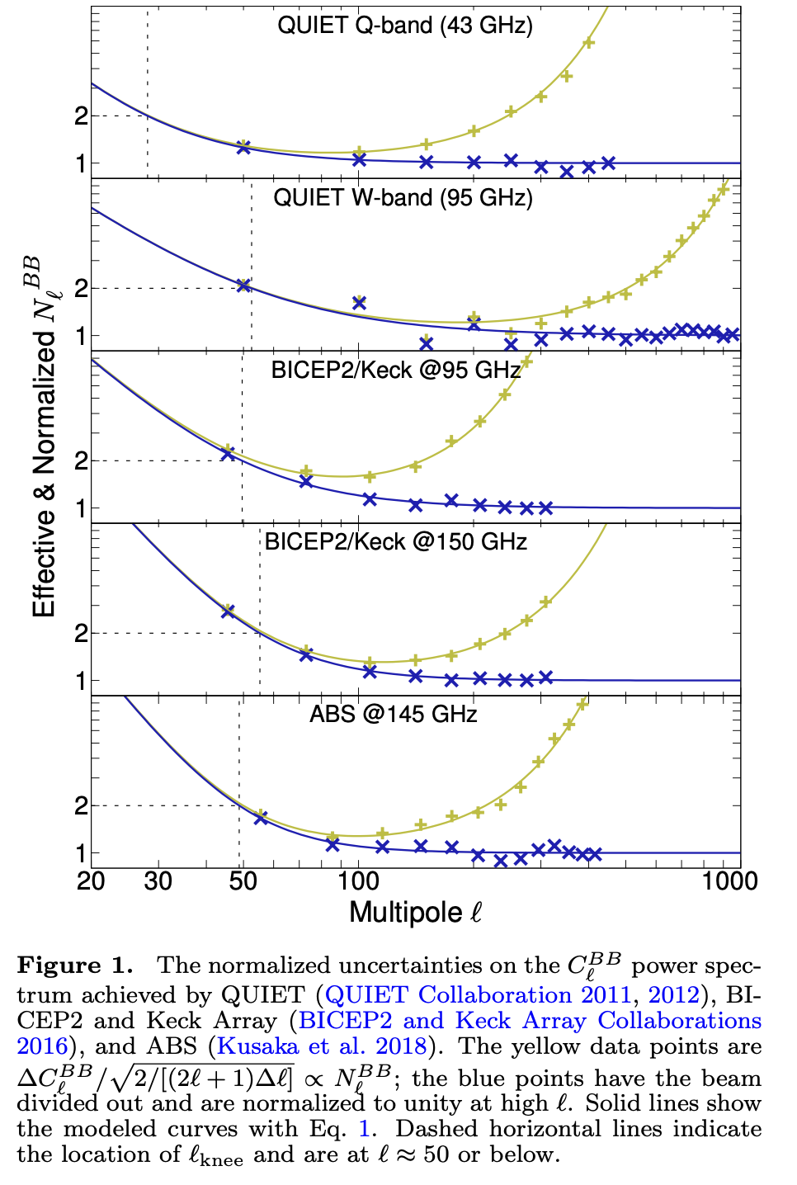
ABS Spectra
Ell knee
limited by Az scan range and not 1/f noise

Slide 11
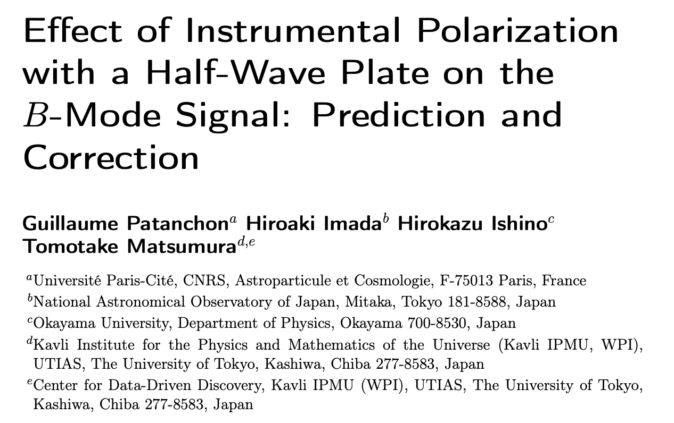
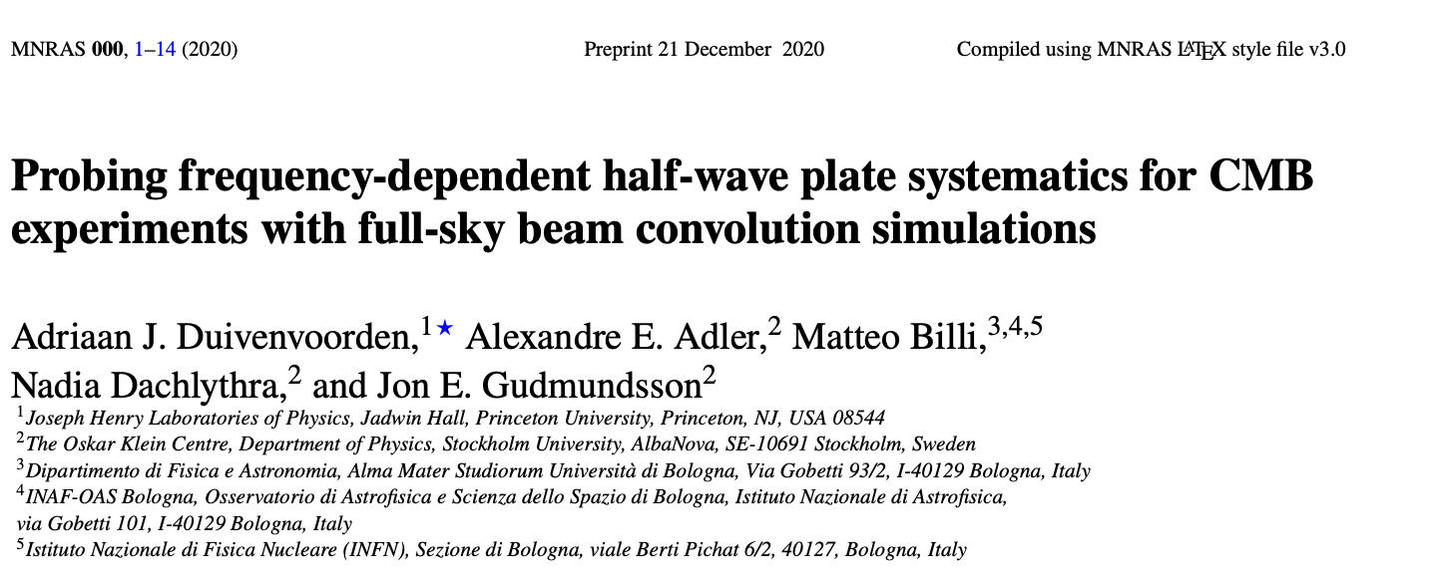
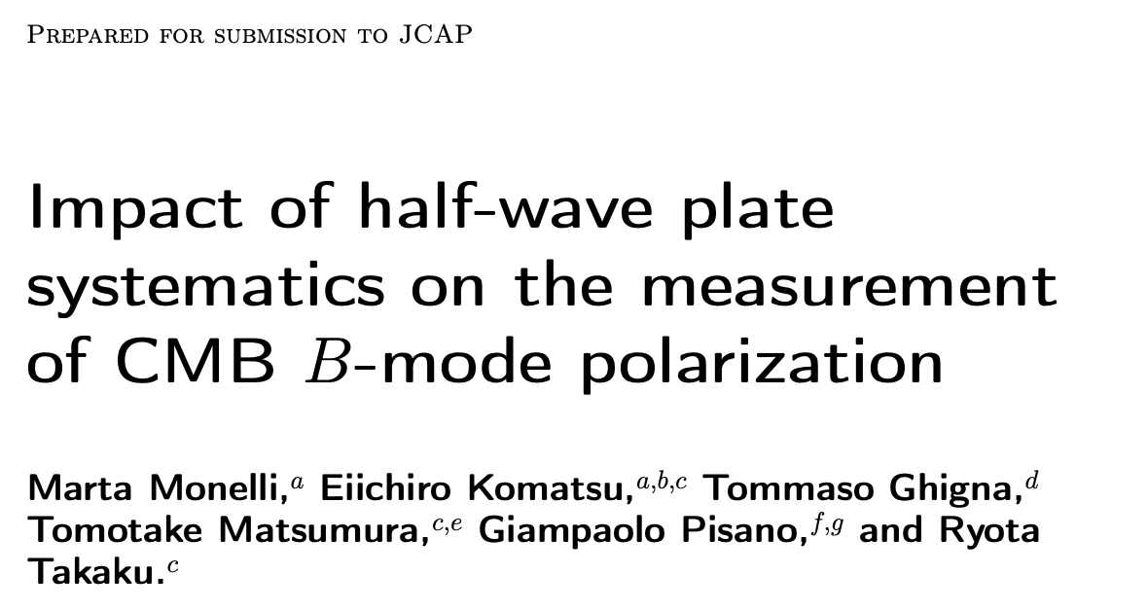
Studies on systematic errors due to HWP modulation

Slide 12
Conclusions
ABS and POLARBEAR
Show strong rejection of atmospheric fluctuations
Full set of null tests and estimates of systematic errors
Simons Observatory
Two 90/150 GHz SATs currently observing
Preliminary analyses are encouraging
Timescale is one to few years for data that is useful for CMB-S4 design process

