Slide 1

Large Scale Structure
Chapter 5
Simone Ferraro
(Lawrence Berkeley National Laboratory)
CMB-S4 collaboration meeting
March 26, 2024

Slide 2
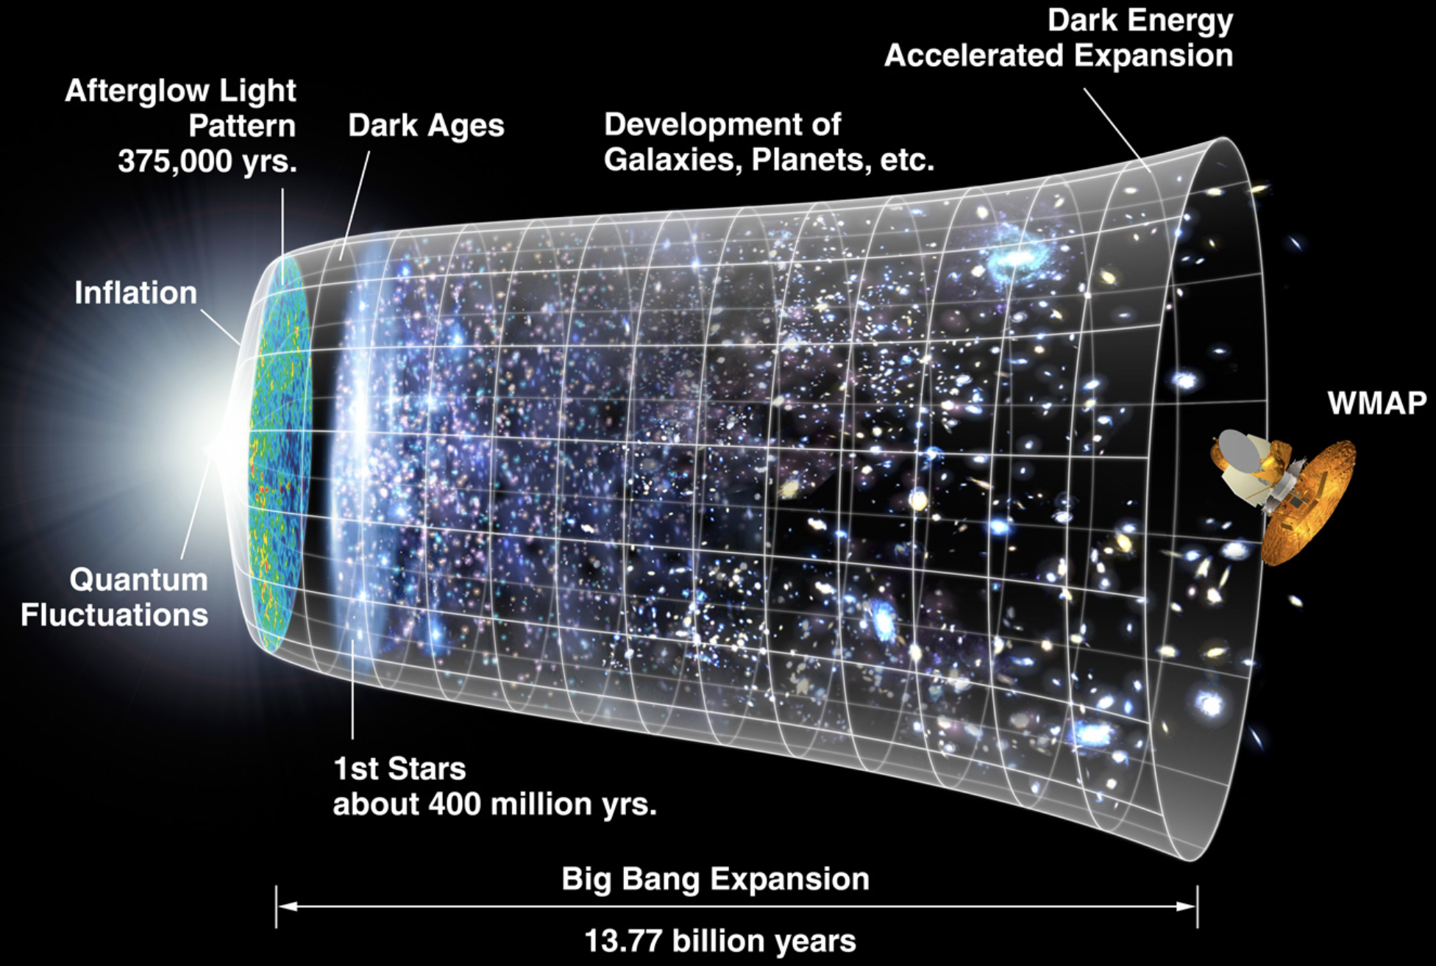

A brief history of CMB photons
94% of photons don’t
re-scatter (but are
lensed!)
6% scatter with matter
High-resolution CMB
experiments are
excellent probes of the Large-Scale Structure!
credit: WMAP
Notes:
While a small percentage of photons -> extremely large amount of information.
Only now are experiments beginning to probe this rich regime

Slide 3
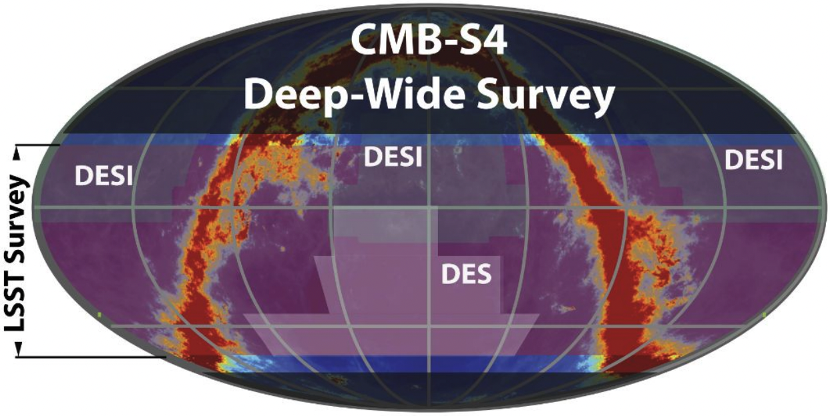
CMB-S4 Deep-Wide Survey
The Deep-Wide Survey will cover ~70% of the sky to unprecedented depth,
ensuring overlap with the majority of current and planned surveys
VRO/
+ “ultra-deep” survey from the South Pole LAT
CMB-S4 collaboration

Slide 4
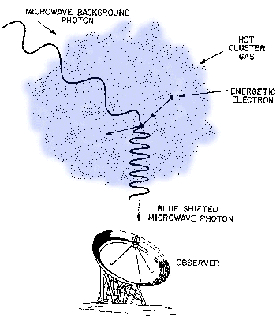
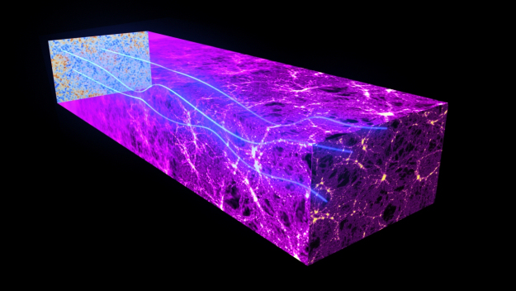
Photons interact with matter
Gravitational: lensing, gravitational redshift, Integrated Sachs-Wolfe effect, “moving cluster”, time delay, …
Scattering (Thomson/Compton scattering):
  Thermal Sunyaev-Zeldovich (tSZ),
  Kinematic Sunyaev-Zeldovich (kSZ),
  Patchy “blurring”, screening and scattering, ...
(Emission from late time matter): starlight, IR emission from dust, free-free, synchrotron, AME, …

Slide 5
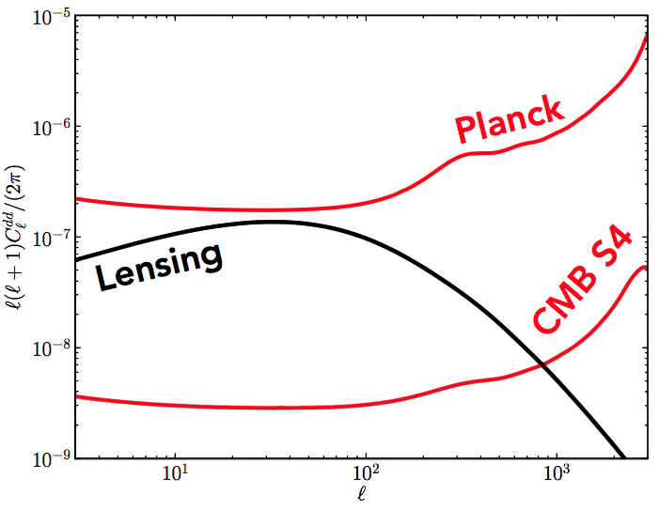
CMB lensing with CMB-S4
Lensing reconstruction over ~50% of the sky. Total S/N ~ 400.
Similar from SPLAT: deeper but from a smaller area.
mostly from
low z
larger contribution from high-z
→ “ultimate” mass map to z ~ 1100 on large and intermediate scales!
Figure credit: Manu Schaan
CMB-S4 lensing has comparable statistical power to VRO/LSST shear!
very different systematics
access to higher redshifts (& source very well understood)
Notes:
While we don’t think of it this way, it is a stage 4 LSS survey as well

Slide 6
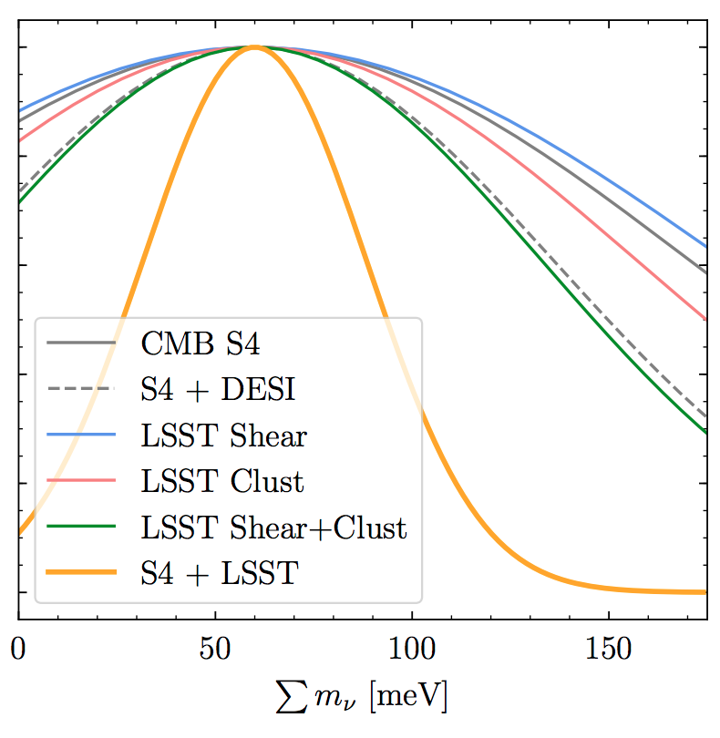
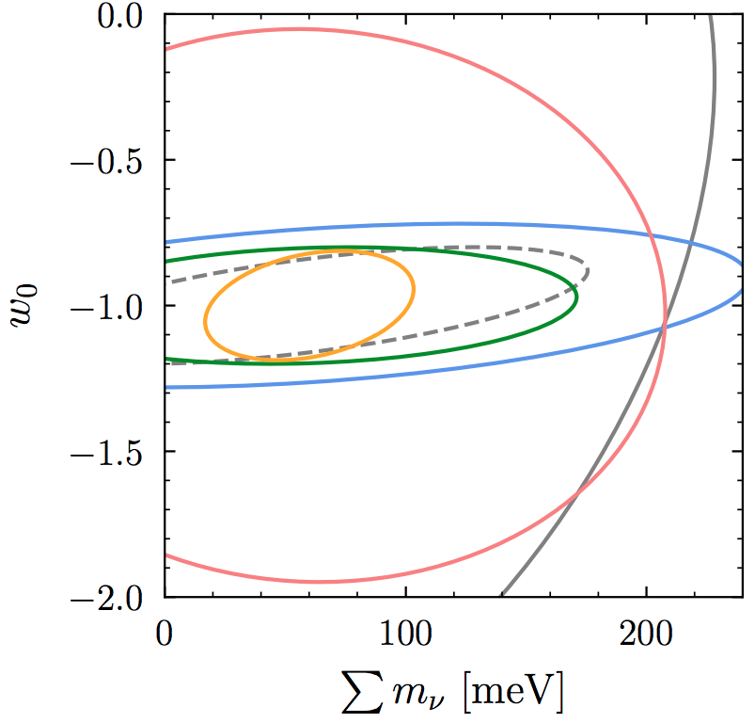
CMB lensing tomography
3 main goals:
  Growth of structure as a function of redshift
  Testing General Relativity
  Galaxy-halo connection
Cross-correlations are useful because:
  Convert noise bias into noise
  More robust to systematics (and can provide cross-calibration: shear bias, photo-z etc).
  Can isolate part of the signal (eg. from a particular redshift)
  Can enhance the S/N
Not only another measurement of the same parameters: parameter sensitivity evolves with redshift → breaking internal degeneracies
Also: robust measurements of local f_{NL}
Mishra-Sharma et al (2018)

Slide 7
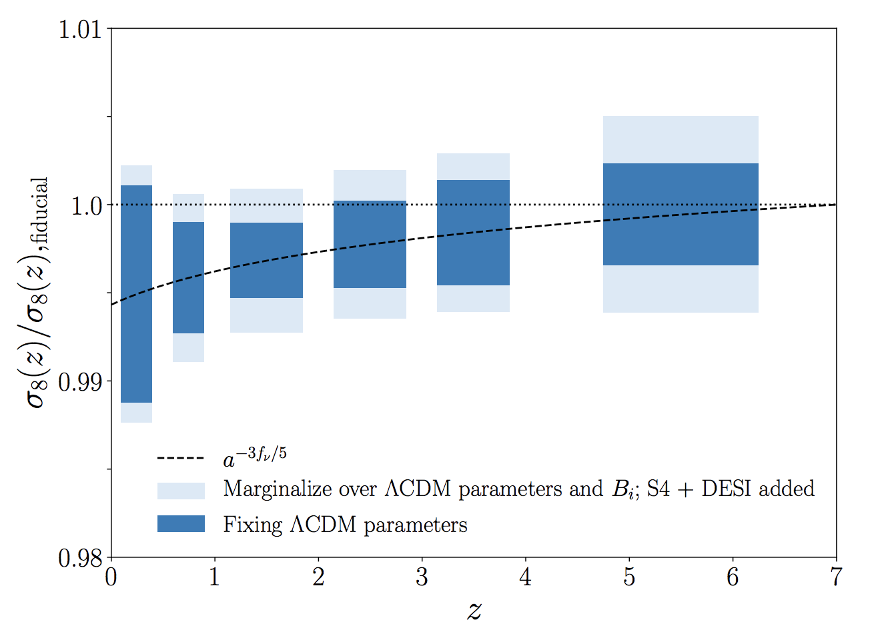
Eg: measuring the growth of structure
Examples:
”model independent” growth measurement
CMB lensing x VRO LSST: S/N ~ 400
In LCDM, improve neutrino mass measurements, while decreasing sensitivity to the optical depth
Distinguish the effect of neutrinos from dynamical dark energy
+ other opportunities: Lyman Alpha forest, HI, other lines, …
suppression due to massive
neutrinos
Yu++ (2018)

Slide 8
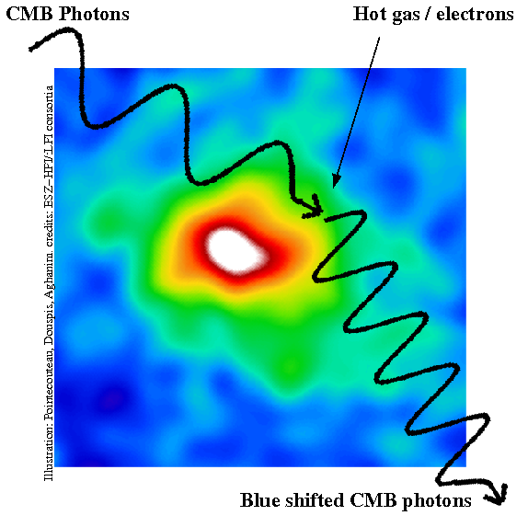
The Sunyaev-Zel’dovich effect(s) in temperature
kinematic SZ
column density
of electrons
radial
velocity
thermal SZ
patchy screening
Baryons are ~16% of the mass → major
systematic for weak lensing + rich physics for galaxy formation & halo thermodynamics.
Also equivalent effects in from screening and scattering in polarization
Notes:
Before I talked how kSZ gets us access to velocities
but it can also get us access to column density
Large scales fundamental physics. Now I will focus briefly on what we can learn by looking at N_e (theta)
Remove baryon form stars
Theta arrow
LSST is going to be a transformative lensing which is going to be severely limited by baryon effects

Slide 9
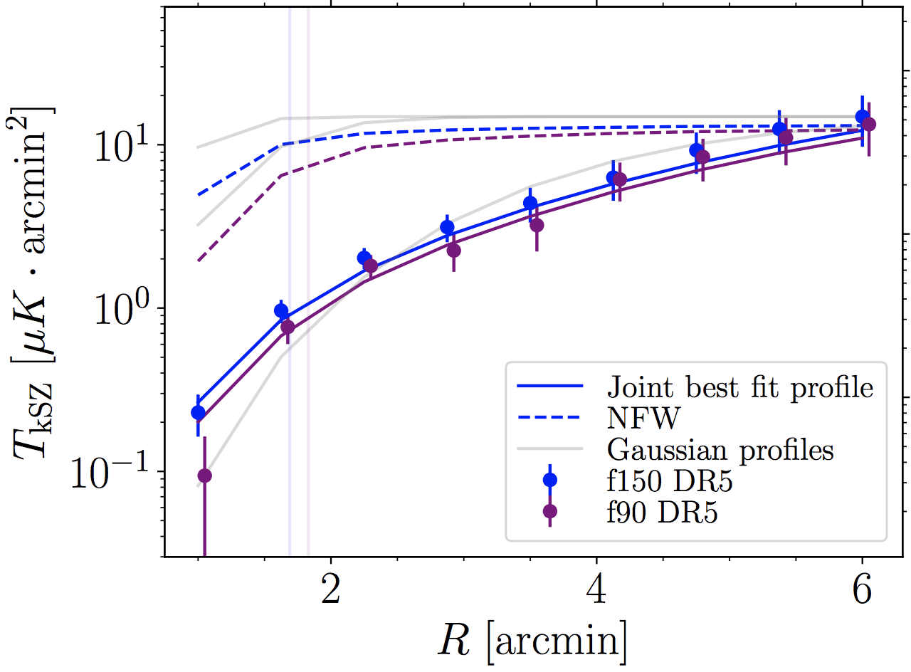
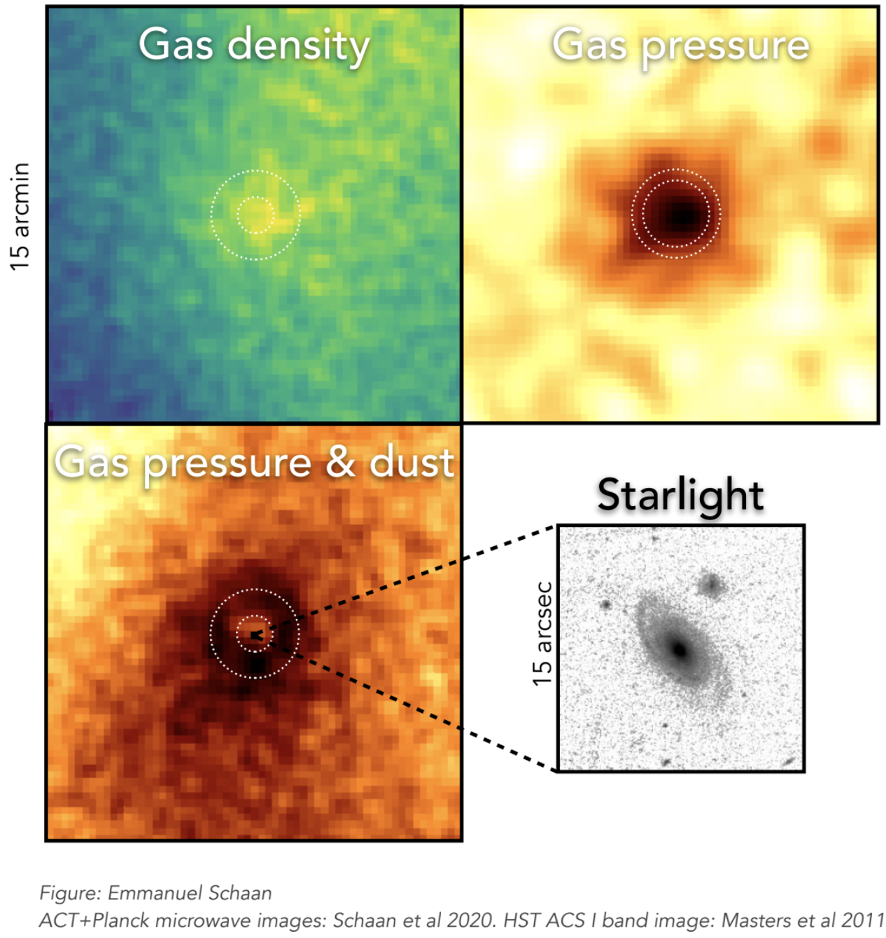
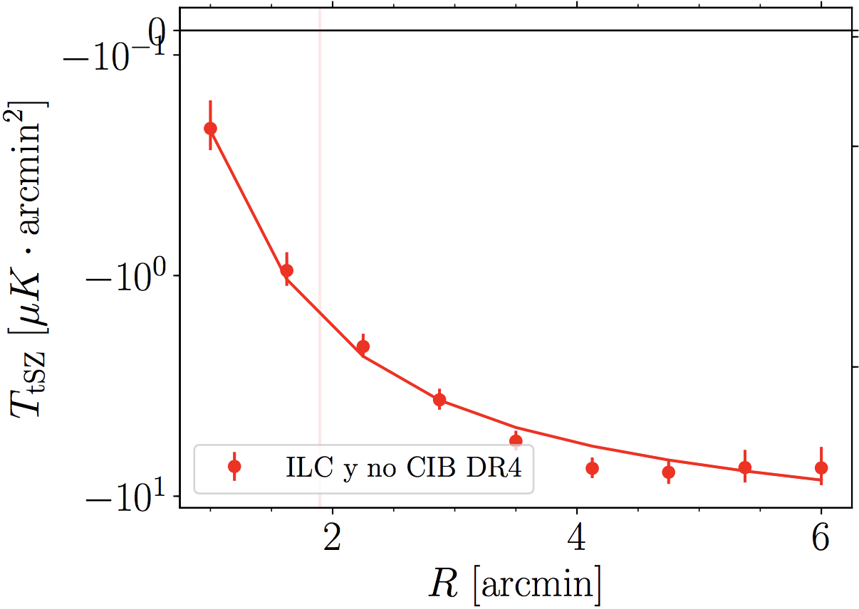
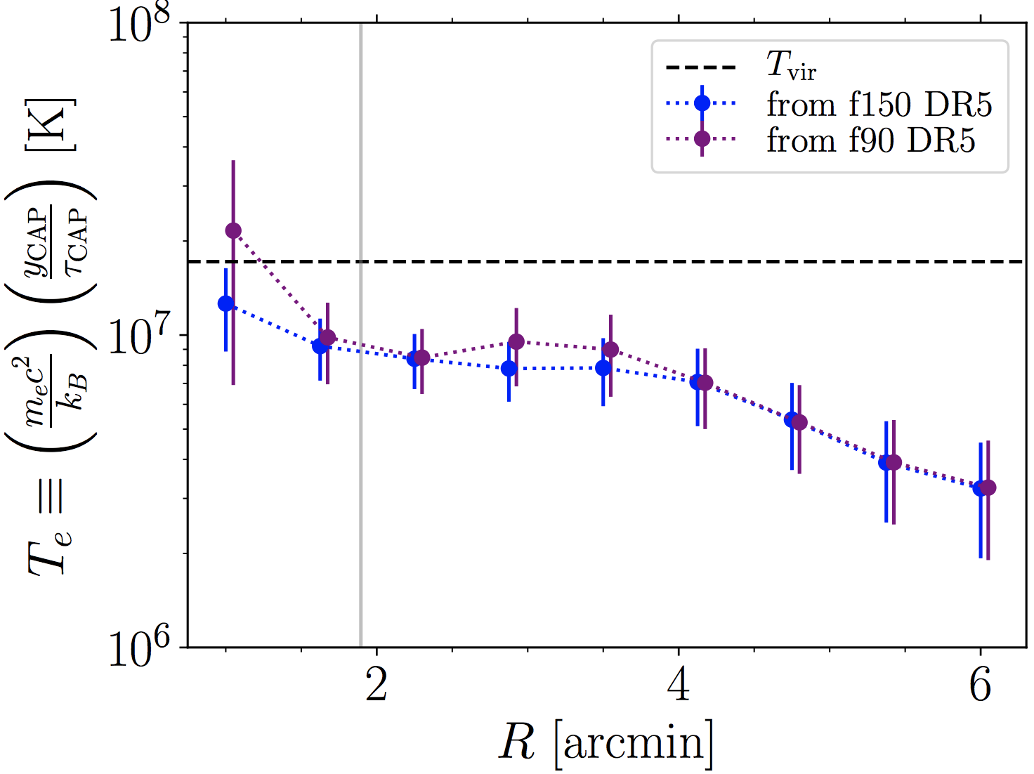
A modern view of galaxy groups
cosmological
abundance
NFW
kSZ or
patchy
screening
(density)
baryons
tSZ
(pressure)
temperature
Schaan, Ferraro., Amodeo, Battaglia + ACT (2021)
Amodeo, Battaglia, Schaan, Ferraro + ACT (2021)
Coulton et al (ACT) 2024
Also (not shown here): Vavagiakis et al (2021), Soergel et al (SPT) 2016
Calafut et al + (2021), Kusiak et al (2021) + previous literature!

Slide 10
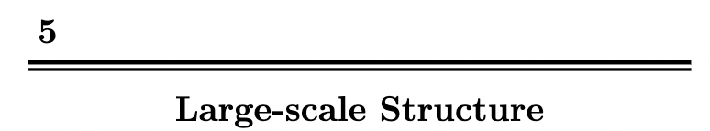
Coordinated by Alex Van Engelen and Simone Ferraro
Discussed in the ”Maps to Other Statistics” (Maps2Stats) calls.
Contribution from many you!
For this meeting:
What are we missing?
We are looking for volunteers to help write the chapter!

Slide 11
LSS Chapter Outline – pt 1
Introduction
Science from CMB Lensing
  CMB Lensing power spectrum
  CMB Lensing tomography
  Galaxy lensing - CMB lensing cross-correlations
Sunyaev-Zel’dovich effects
  Introduction to the various effects in T & P
  Probing the gas in and around galaxies
  Polarized SZ from galaxies (remote quadrupole)
  Velocity reconstruction (remote dipole). AKA “kSZ tomography”
  Rotational kSZ

Slide 12
LSS Chapter Outline – pt 2
Other Cross-correlations
  CMB x Intensity Mapping (both CIB and Line IM)
  CIB science & measurement
  Higher point functions
  ISW & Rees-Sciama effects
  Moving lens
Reionization
  Introduction to reionization (both H and He)
  kSZ 2pt function
  kSZ 4pt function
  Reconstructing optical depth fluctuations from patchy screening and scattering

Slide 13
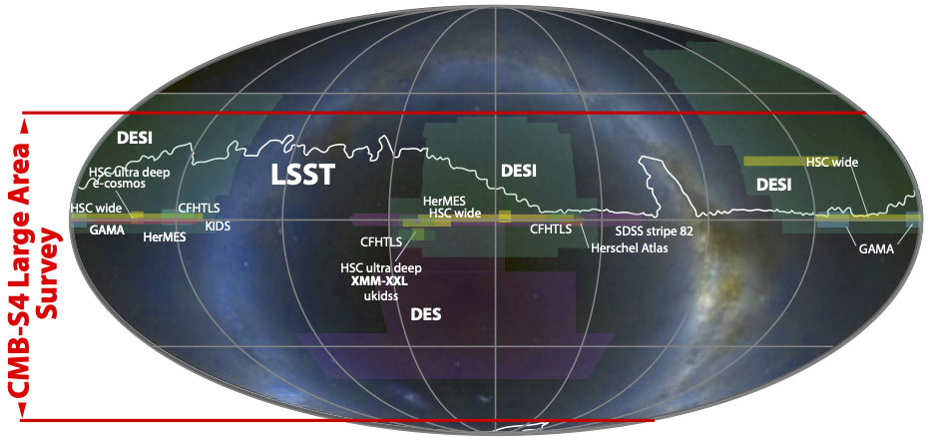
Thanks!
VRO/

Slide 14
BACKUP SLIDES

Slide 15

kSZ and tSZ cosmology
Measuring velocities:
Tests of gravity / scale dependence of growth
Access to very large-scale modes: “no shot noise”
Sample variance cancellation and ~50% improvement on f_{NL}
Achieve σ(f_{NL}) < 1, beyond primary CMB cosmic variance
Cosmology with the tSZ power spectrum/PDF/higher point functions:
simultaneously constrain (g)astrophysics and cosmology
Large-scale overdensity

Slide 16
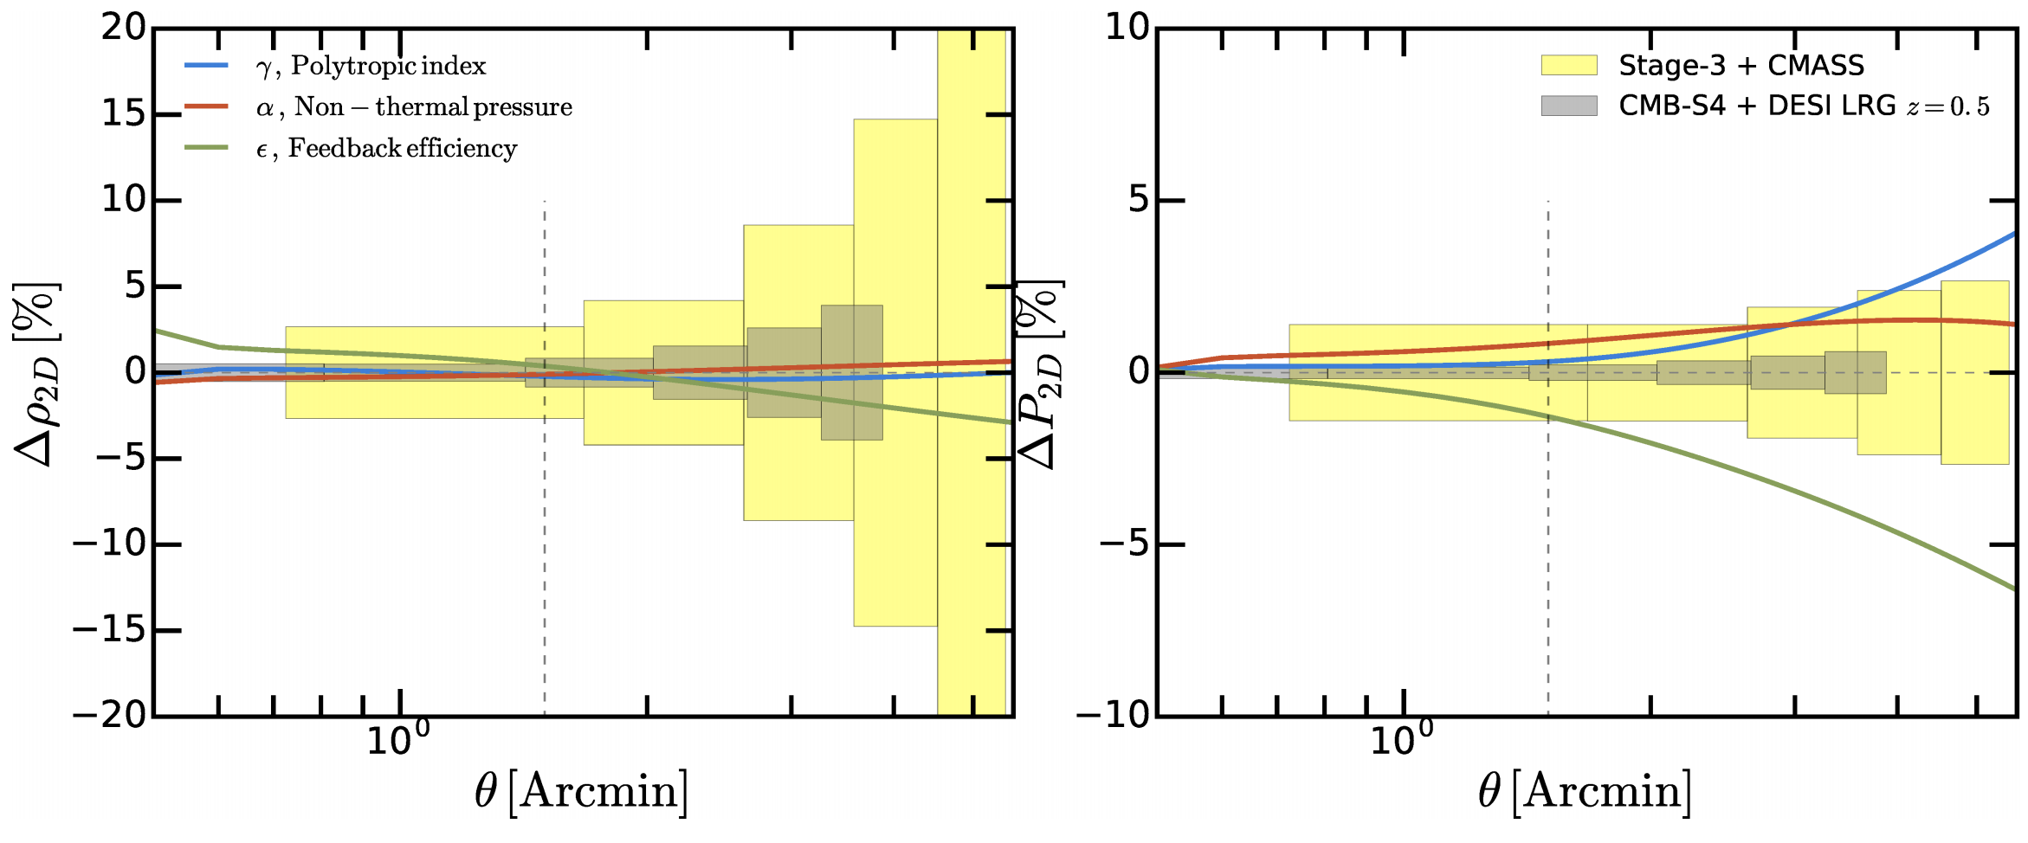
Halo thermodynamics
Emmanuel Schaan & Eve Vavagiakis’ talks
“Direct” measurement of density, pressure and LOS velocity
of the gas in galaxies/clusters
Very rich physics! One order of magnitude improvement with CMB-S4, especially within the virial radius,
Battaglia, S.F., Schaan, Spergel, 2017
Also: Amodeo et al (2021), Moser et al (2021)

Slide 17
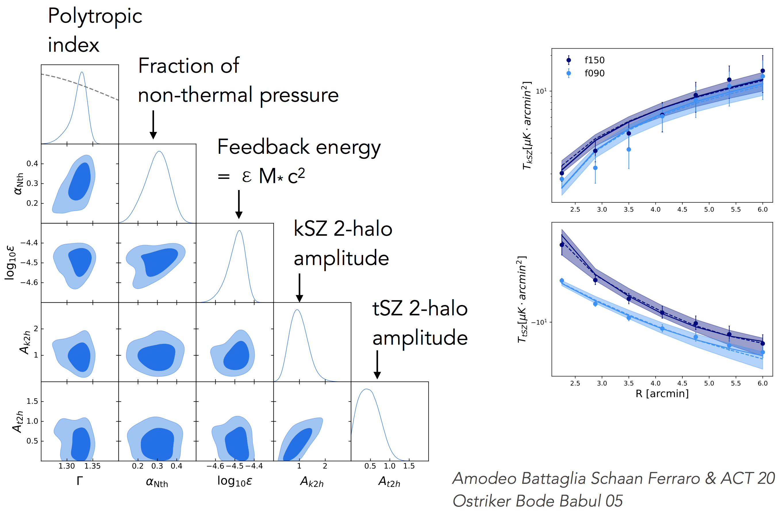
Thermodynamic information
~30% non-thermal pressure support
Energy injected ~ 30% of binding energy
Very rich physics! One order of magnitude improvement with CMB-S4, especially within the virial radius,
Battaglia, S.F., Schaan, Spergel, 2017

Slide 18
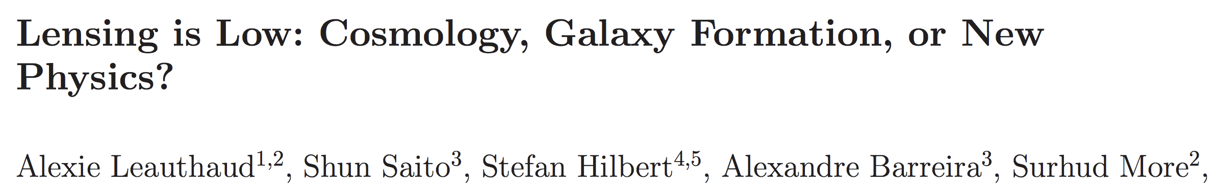
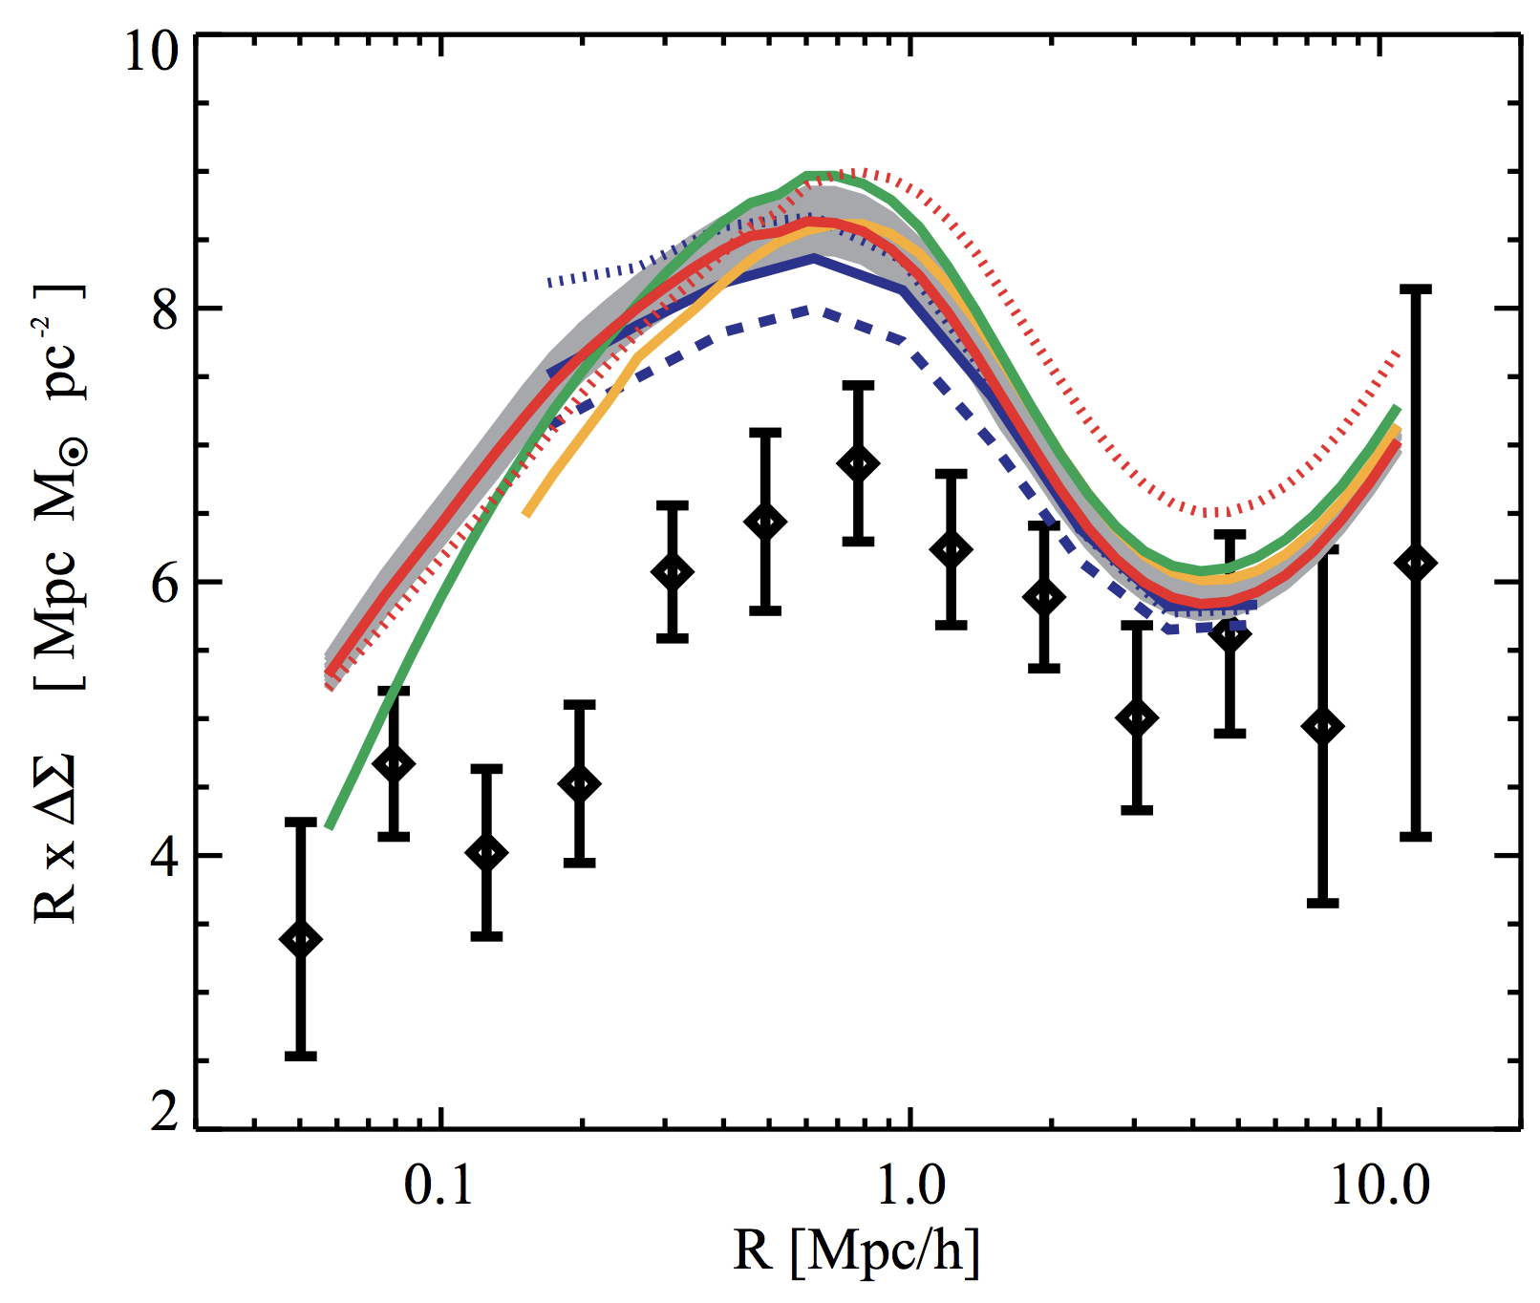
Baryon effects in weak lensing
Calibration of baryon effects in weak lensing:
Baryons are ~16% of the mass: statistically “large” effect on weak lensing
CMB lensing cross-correlations & galaxy lensing amplitude often “lower” than expected.
Larger discrepancy on small scales, the most affected by baryons.
Surface density of BOSS CMASS galaxies
Can this be explained
(at least in part)
by baryon effects?
our
range

Slide 19
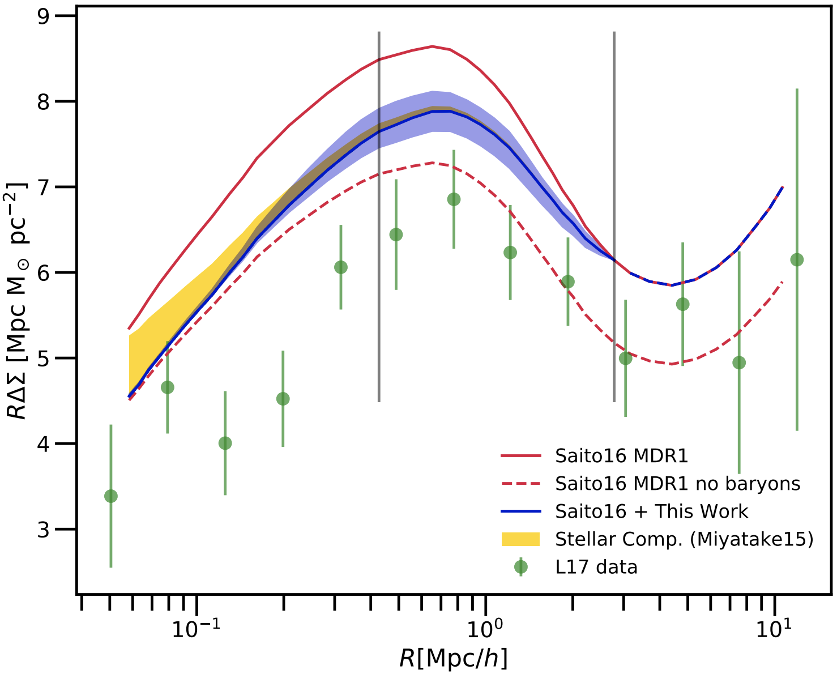
Baryon effects: first direct SZ calibration
Direct SZ calibration:
Use SZ measurements of gas
on the same sample to directly
calibrate
First example on BOSS CMASS with ACT data. Explain ~half of the discrepancy
+ work in progress with A. Leauthaud, J. DeRose, A. Amon and many others!
our prediction
baryons trace DM
Amodeo, Battaglia, Schaan, Ferraro, Moser + ACT (2021)

Slide 20
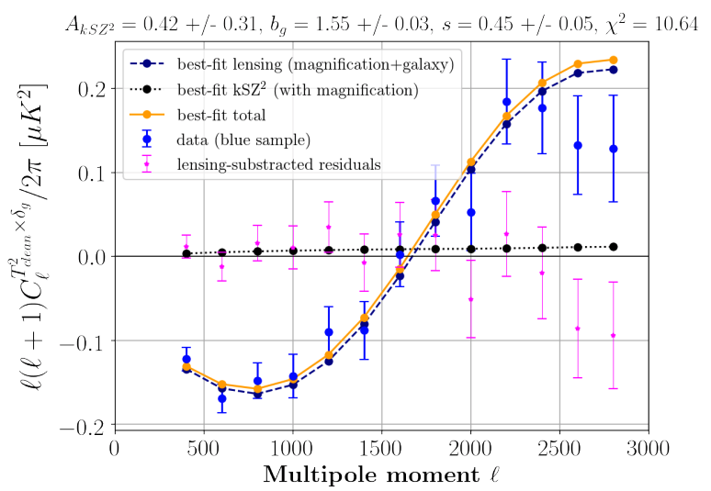
Projected kSZ²
For photometric redshifts (eg. DES, Rubin Observatory, …), usual techniques are suboptimal.
Solution: projected fields kSZ!
Estimator kSZ² x (galaxies, shear, 21cm etc…) .
Sensitive to halo parameters, just like traditional methods.
Potentially very large S/N, but more sensitive to foregrounds
Experiment | SNR
Planck x unWISE (current) | 5
Simons Obs. x unWISE (~2023) | ~ 300
CMB-S4 x Rubin Obs. | > 600
Kusiak et al (2021).
Ferraro et al (2016), Hill et al (2016)

Slide 21
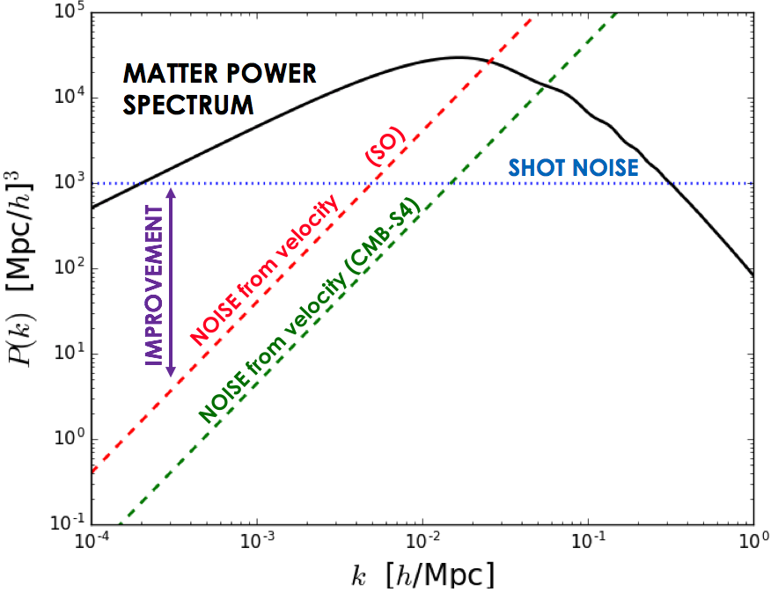
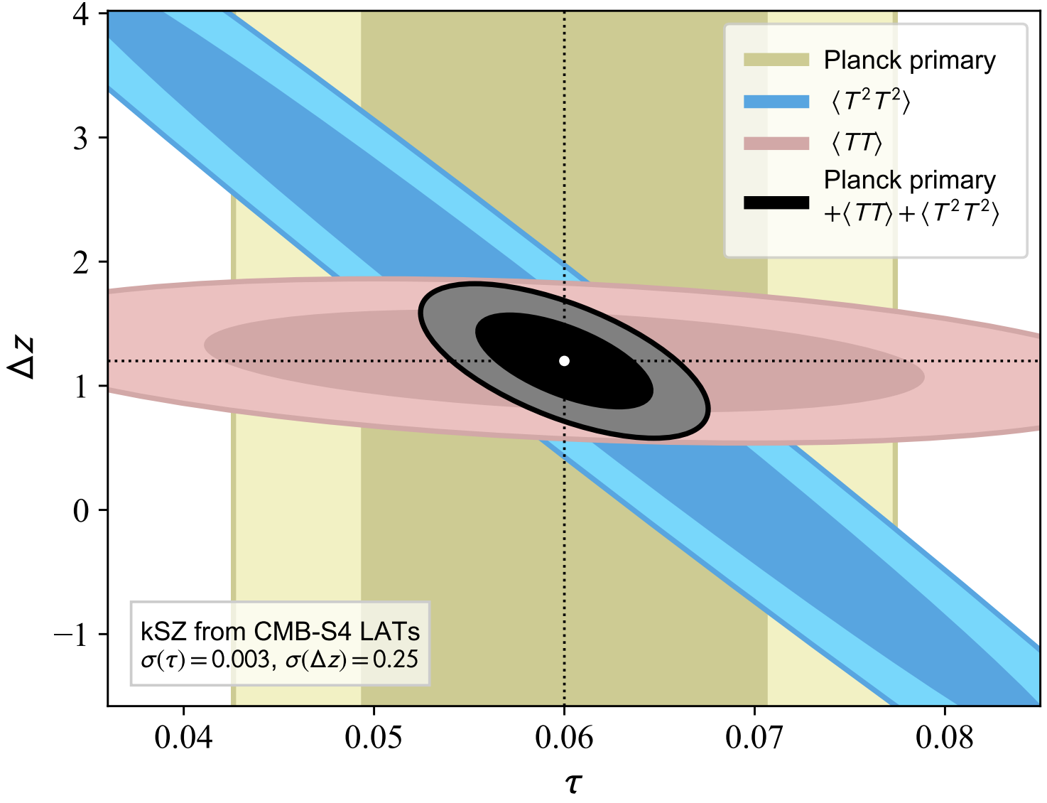
Other applications
Measuring velocities:
Tests of gravity / scale dependence of growth
Sample variance cancellation and ~50% improvement on f_{NL}
Access to very large-scale modes: “no shot noise”
Smith et al (2018)
Münchmeyer et al (2018)
Patchy Reionization:
kSZ: large imprint on high-ell T power, and largest non-Gaussianity.
Use 4-pt (Smith & Ferraro) to separate reionization from late-time component.
2-pt + 4-pt very effective at breaking degeneracies!
Alvarez, Ferraro, Hill, Hlozek, Ikape (2021)
Recent limits from Raghunathan et al (SPT, 2024)

