Slide 1
B-Modes Beyond r
Cosmic Birefringence and Chirality
Robert Caldwell (he/him/his)

Slide 2
Cosmic Scalar
Chern-Simons coupling finds a potential role in various cosmological scenarios
  QCD Axion
  Quintessence
  Chromo-Natural Inflation
  Warm Inflation
… with implications for B-mode polarization

Slide 3
Cosmic Birefringence
Cosmic scalar coupled to EM via axion-like coupling
Time / Space dependence causes linear polarization rotation,
Quintessence evolution: isotropic ( ), anisotropic ( )
Signals:
See talk by Clara Verges

Slide 4
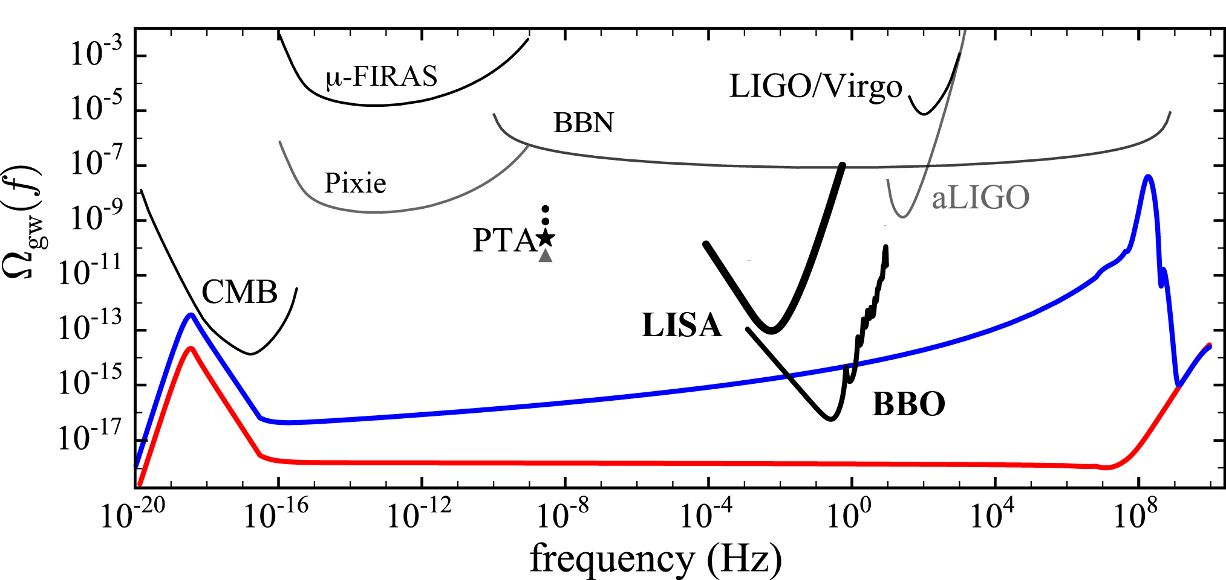
“Gravitational Birefringence”
Mechanism: Inflaton coupled to SU(2) vev via axion-like coupling
  Chromo-Natural: Inflate on a steep potential
  Amplify chiral GWs with tensor excitations of vector field, produce EB, TB correlations
  Are B-modes due to QM fluctuations of gravitational or vector field?

Slide 5
Cosmic Scalar
Some References:
Cosmic parity violation: Gluscevic et al, 1002.1308
Chromo natural inflation: Adshead et al, 1202.2366
Minimal warm inflation: Berhaus et al, 1910.07525
CMB birefringence from ultra-light axion strings: Jain et al, 2103.10962
Chiral GWs figure: RC et al, 1706.03765
Review: RC, IJMPD 25 (1640011) 2016

