Slide 1
Welcome to Inflation
Search for Primordial Gravitational Waves
Robert Caldwell (he/him/his)

Slide 2
Inflation – Very Early Universe
The QM origin of structure
L
“ ’’
L’
M
“ ’’
M

Slide 3
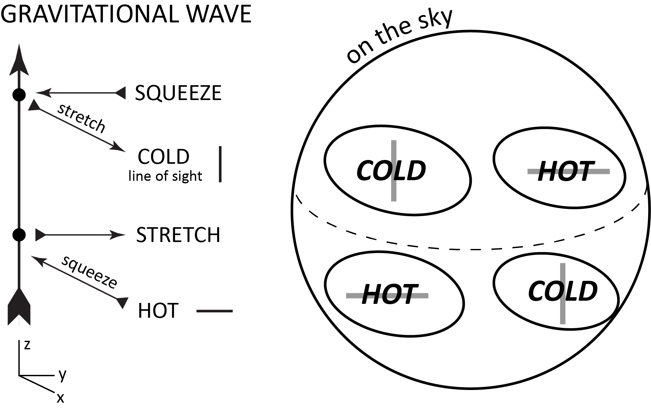

Slide 4
Inflation
Goal: Detect, or constrain, the large-scale B-mode pattern due to primordial GWs – the smoking gun of inflation
Detection…
Null result…

Slide 5
Inflation
Single field, slow-roll inflation produces a spectrum of Gaussian, adiabatic, nearly scale-invariant, super-horizon perturbations of QM origin.
Characterize spectra by A_{s} , n_{s} , A_{t} , n_{t} , r = A_{t} / A_{s} ; map out the r-n_{s} parameter space.

Slide 6
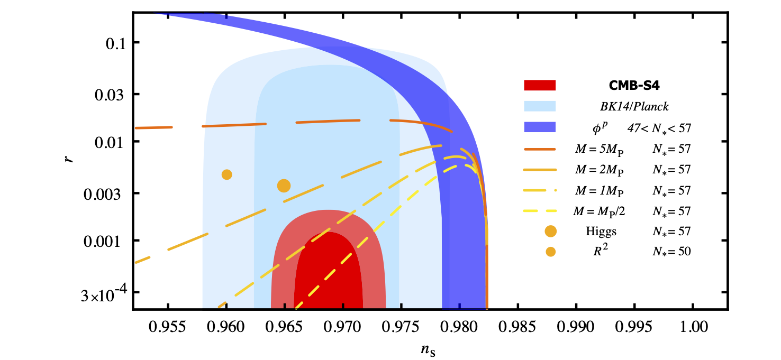
Landscape
SFSR
Convex, Concave
Simple:
Super-Planckian

