Slide 1
Transient Signals Expected from CMB-S4: Stellar Flares
Rachel Osten
Space Telescope Science Institute & Johns Hopkins University
CMB-S4 summer collaboration meeting
SLAC, Aug. 1, 2023

Slide 2
Outline
Start with the Sun
Commonality of flaring in the lower half of HR diagram
Flaring in the optical, UV, X-ray, radio
What is unique about mm wavelengths
Physics of particle acceleration in stellar flares
What we are seeing from ALMA, SPT and ACT
What can we do to enhance the transient capability for CMB-S4
Space weather on other worlds
End with other Suns

Slide 3
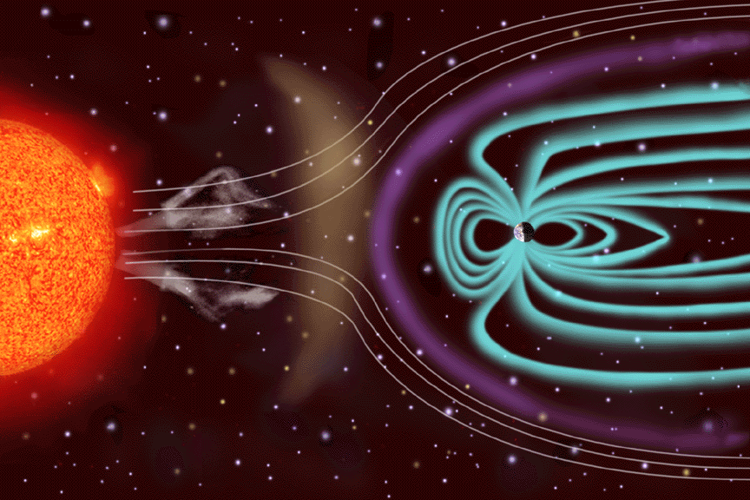
A star’s magnetic field helps to set the environment for planets and life by:
Heating plasma to a range of temperatures, from ~10⁴ K up to ~10⁷ K (chromosphere, corona)
Expelling material (wind, coronal mass ejection)
Accelerating particles to very high energies (energetic particle events)
Influencing the inner edge of the traditional habitable zone

Slide 4
Space Weather -- Solar Eruptive Events -- is made of
solar flares
Notes:
We’re familiar with solar flares: these occur as the result of magnetic reconnection occurring in the tenuous solar corona, seen here. Flares are only one part of what’s now recognized as an eruptive event. Biggest solar flare energies are 1032 ergs, big difference in scale between the flare brightenings (close to the Sun) and the CME (extends to the Earth).

Slide 5
Space Weather -- Solar Eruptive Events -- is made of
coronal mass ejections
Notes:
We’re familiar with solar flares: these occur as the result of magnetic reconnection occurring in the tenuous solar corona, seen here. Flares are only one part of what’s now recognized as an eruptive event. Biggest solar flare energies are 1032 ergs, big difference in scale between the flare brightenings (close to the Sun) and the CME (extends to the Earth).

Slide 6
Space Weather -- Solar Eruptive Events -- is made of
solar energetic particles
Notes:
We’re familiar with solar flares: these occur as the result of magnetic reconnection occurring in the tenuous solar corona, seen here. Flares are only one part of what’s now recognized as an eruptive event. Biggest solar flare energies are 1032 ergs, big difference in scale between the flare brightenings (close to the Sun) and the CME (extends to the Earth).

Slide 7
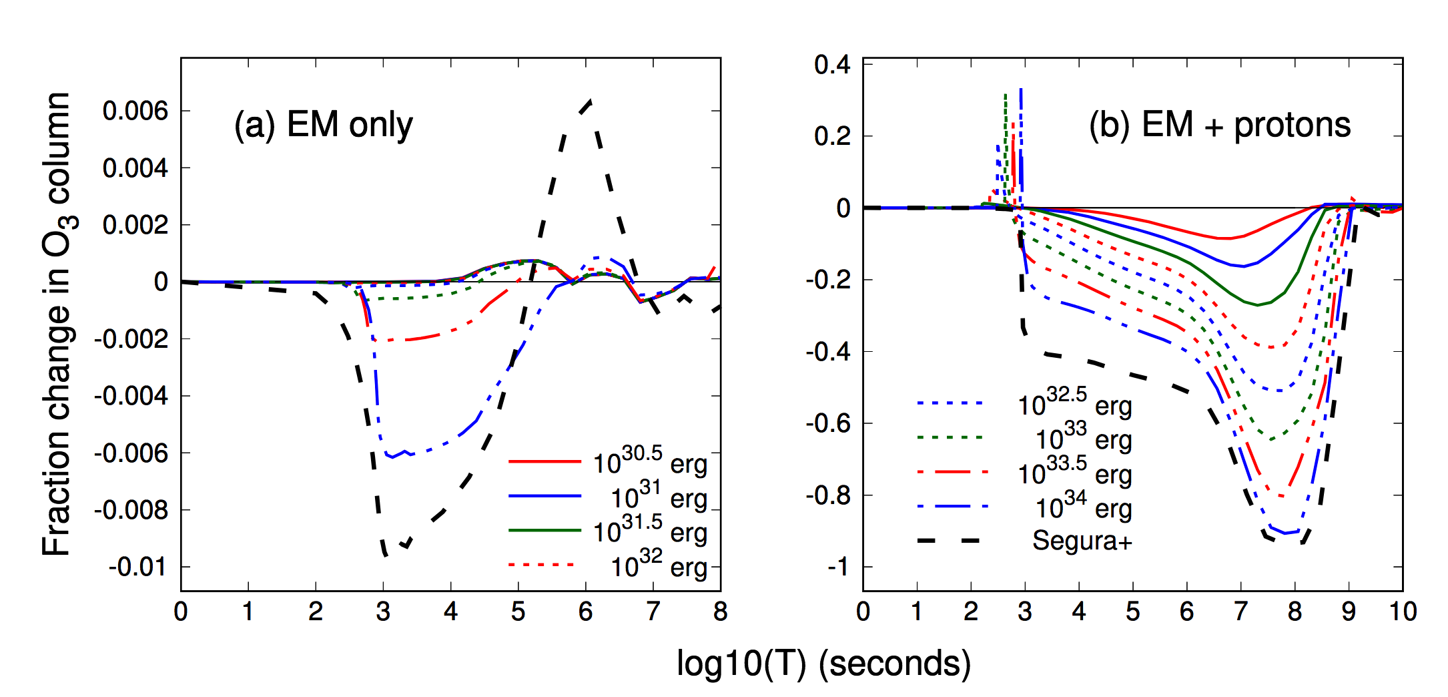
Exo-space weather & exoplanet habitability depend on stellar magnetic fields and eruptive events
Tilley et al. (2018)
Notes:
mention that this was called out in NASA’s astrobiology roadmap from 2014(?)

Slide 8
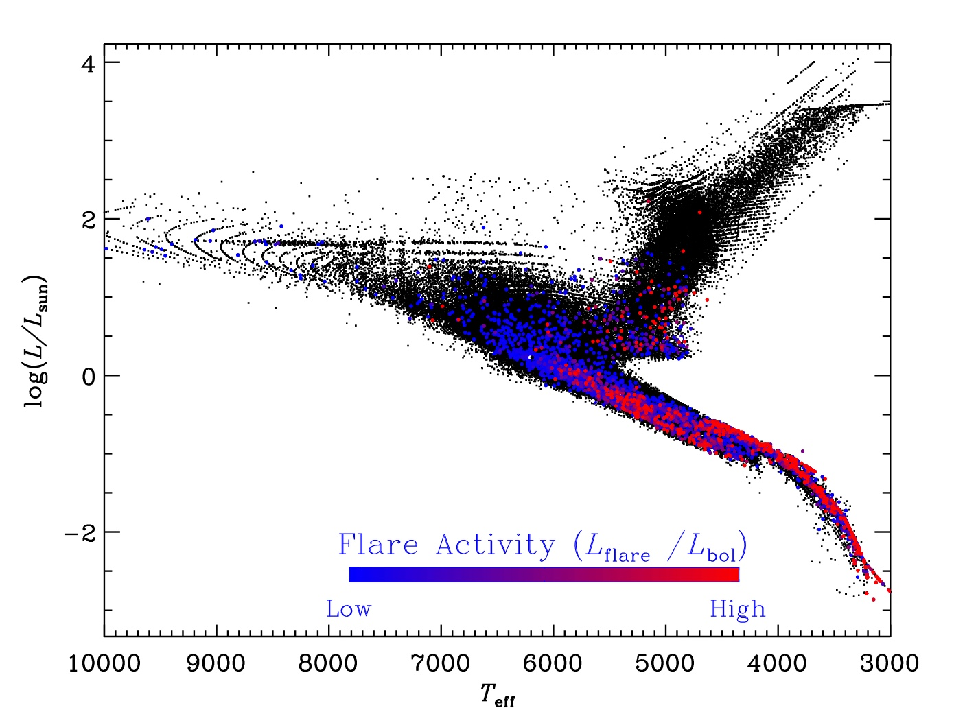
Why study flaring and space weather in other stars?
White light flaring from the Kepler mission
Yang & Liu (2019)
Stellar flares can be orders of magnitude more energetic than the largest solar flares
Solar & stellar flares involve all layers of the stellar atmosphere, processes of plasma heating, particle acceleration, mass flows
Flares are a common occurrence on stars in the cool half of the HR diagram
Often accompanied by ejections of mass which can have space weather/habitability effects

Slide 9
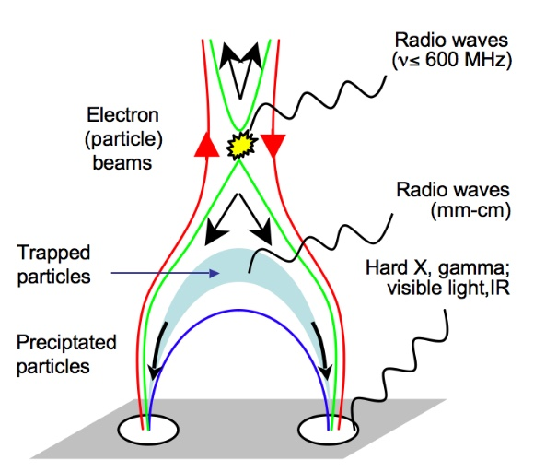
The Multi-wavelength Perspective
Observational Flare Signature | Solar | Stellar*
nonthermal hard X-ray emission | ✔ | ?
radio gyrosynchrotron/synchrotron, dm-cm-mm wavelengths | ✔ | ✔
coherent radio emission, m-dm-cm wavelengths | ✔ | ✔
FUV emission lines (transition region) | ✔ | ✔
optical/UV continuum (photosphere) | ✔ | ✔
EUV/soft X-ray emission (corona) | ✔ | ✔
optical emission lines (chromosphere) | ✔ | ✔
Klein & Dalla (2017)
*across different cool stars
Osten (2016) in Heliophysics: Active Stars and their Astrospheres

Slide 10
Radio/mm observations constrain the dynamics and characterization of keV-MeV particles
changing high E cutoff
changing low E cutoff
Flux
from Dulk (1985)
Frequency
White & Kundu (1992)
optically thin emission: direct constraint on index of accelerated particles
spectral shape: high/low energy cutoffs of the accelerated particle distribution

Slide 11
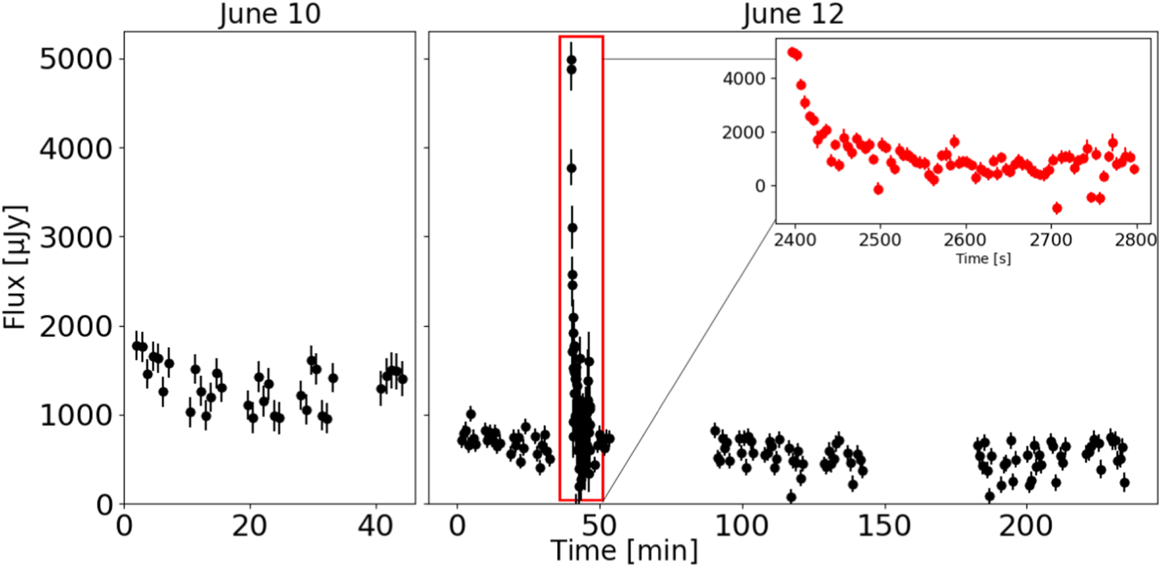
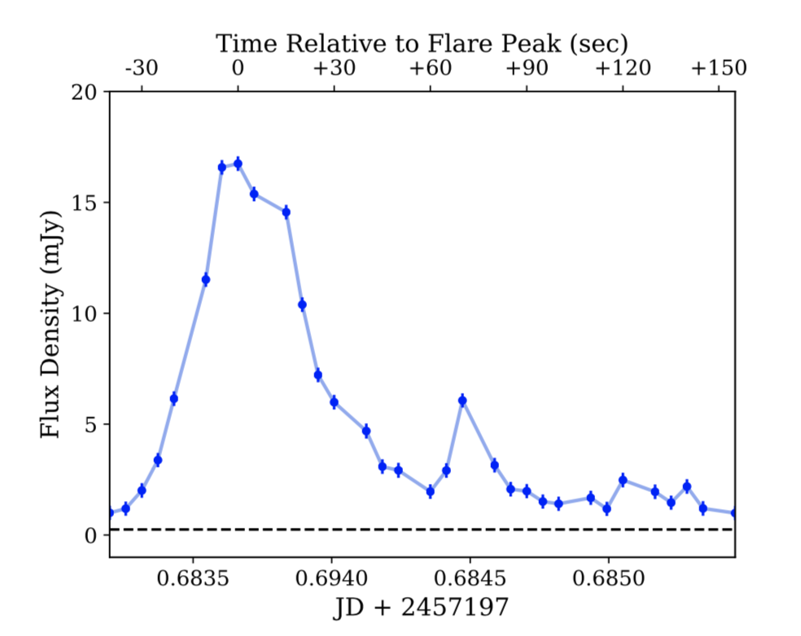
New Science: Serendipitous Millimeter Flaring in Nearby Magnetically Active Stars
MacGregor et al. (2018)
Proxima – M dwarf and planet host
MacGregor et al. (2020)
AU Mic – M dwarf and planet host
Burton et al. (2023) Eps Eri – K dwarf and planet host
Hughes et al. (2021) NLTT 33370, an ultracool dwarf (97.5 GHz)

Slide 12
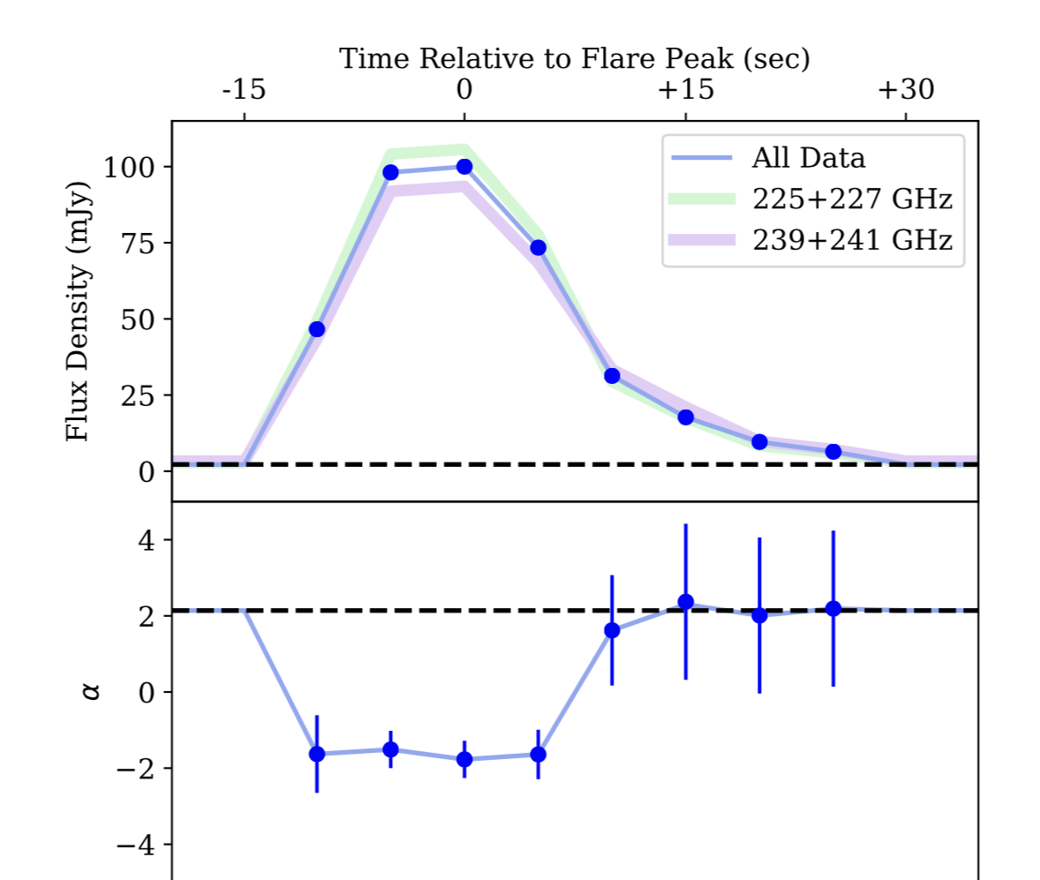
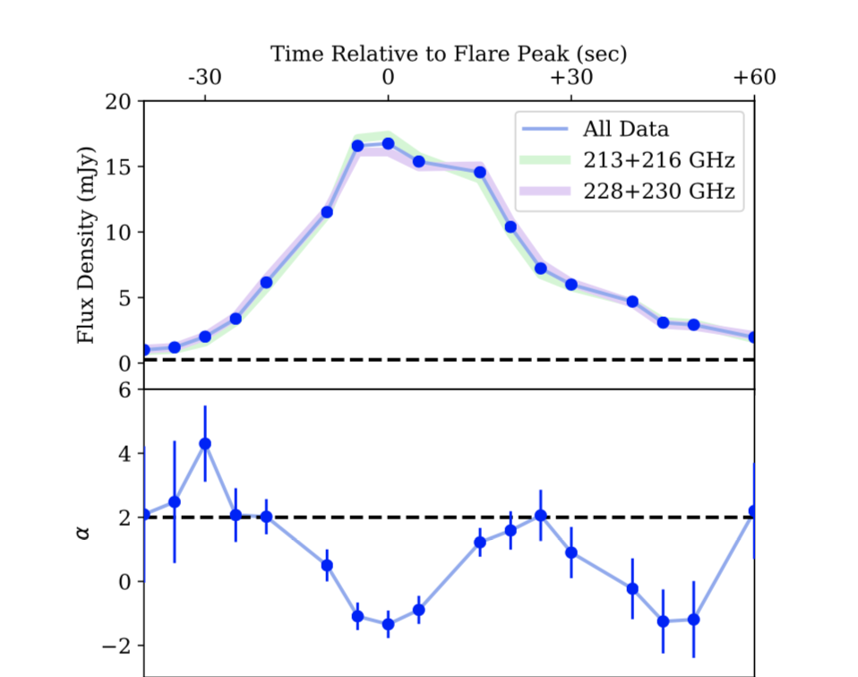
New Science: Serendipitous Millimeter Flaring in Nearby Magnetically Active Stars
AU Mic
Proxima

Slide 13
New Science: Serendipitous Millimeter Flaring in Nearby Magnetically Active Stars
Common characteristics of mm stellar flares seen with ALMA:
Very short durations (tens of seconds to minutes in length)
Single frequency detections. In-band frequency indicates optically thin emission
Potentially linearly polarized (currently only upper limits)
Question of emission mechanism: gyro synchrotron (mildly relativistic electrons, continuation of trends seen in microwave region?) or synchrotron (different population of accelerated particles?)

Slide 14
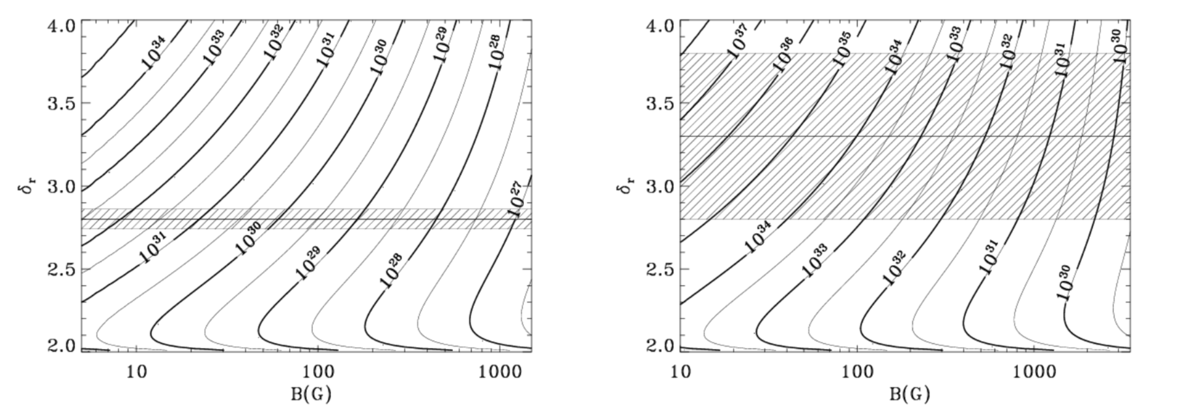
Exciting Implications about Flare-accelerated Particles
Nonthermal energy (erg)
MacGregor, RAO, Hughes (2020)
index of accelerated electrons
Magnetic field strength in the radio-emitting source
Direct constraints on distribution of electrons from the observations
Field strengths/nonthermal energies consistent with moderate to large flare energies IF gyro synchrotron, single radio spectral energy distribution

Slide 15
ACT, SPT Initial Results: Main Transient Population is Millimeter Flaring in Nearby Magnetically Active Stars
Observe a mix of cool stellar spectral types (Naess et al. 2020, Guns et al. 2021) for stars with serendipitous detections of variability at mm wavelengths. These have tended to be “the usual suspects” – young stars, rapidly rotating stars, M dwarfs – for enhanced magnetic activity

Slide 16
ACT, SPT Initial Results: Main Transient Population is Millimeter Flaring in Nearby Magnetically Active Stars
Observe a mix of cool stellar spectral types (Naess et al. 2020, Guns et al. 2021) for stars with serendipitous detections of variability at mm wavelengths. These have tended to be “the usual suspects” – young stars, rapidly rotating stars, M dwarfs – for enhanced magnetic activity
Common characteristics of mm stellar flares seen with ACT, SPT:
Longer durations (tens of minutes to hours)
Multiple frequency detections. Mix of rising and falling spectra
Some association with optical flares, no constraint on plasma heating of upper stellar atmosphere
Is this the same phenomenon seen at slightly higher frequencies with ALMA? Could be a continuum of size scales. Pointed observations bias our understanding of the range of particle acceleration experienced in stellar environments.

Slide 17
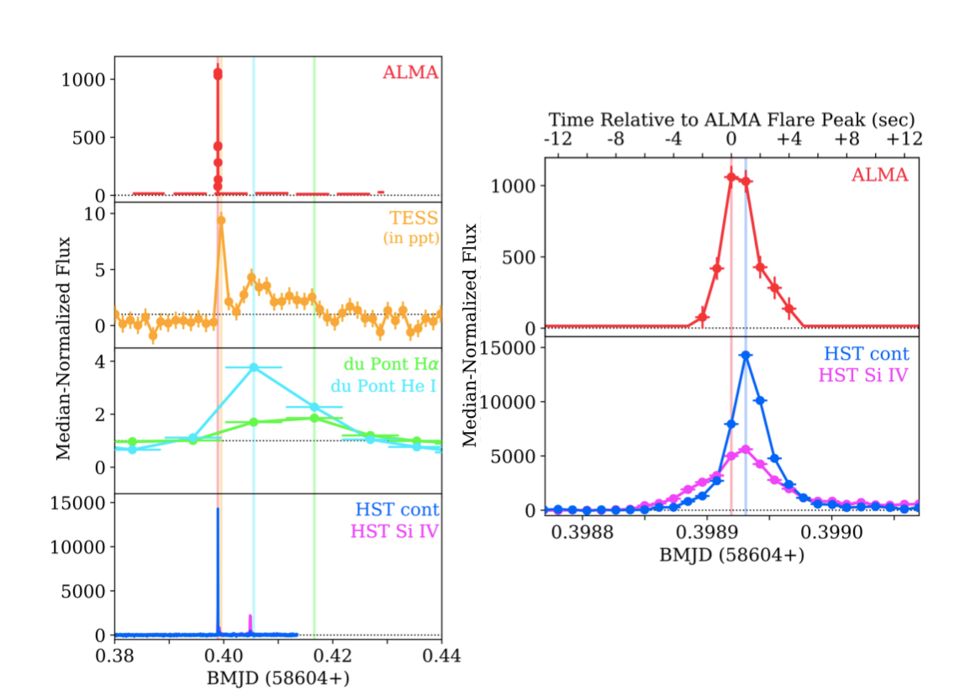
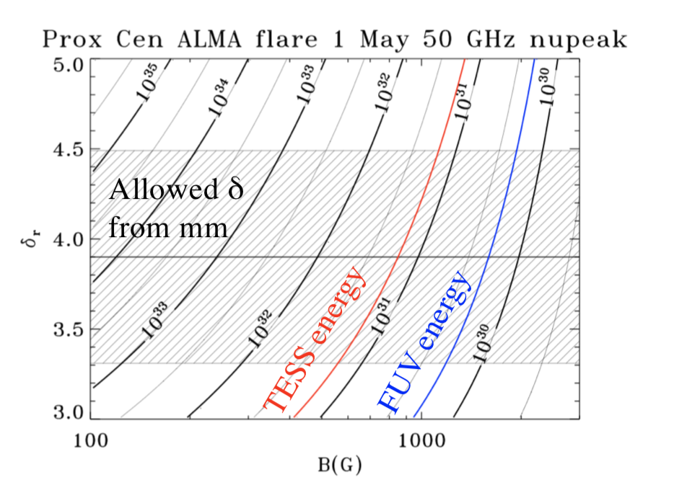
The Multi-wavelength Perspective from targeted observations of Proxima with ALMA++
Multi-wavelength campaign on Proxima
MacGregor et al. (2021)
ALMA flares (factor of 1000 increase) seem to be accompanied by FUV flares (14000 increase) and smaller optical brightenings
Short durations (<tens of seconds) ➜ simple structures are involved, or particle acceleration is very brief.
Daily occurrence rate suggests ~20 flares/day (AU Mic), 4/day (Proxima) ➜ common feature of stellar flares that has been missed up til now.
Optically thin spectra ➜ relatively hard electron distributions.

Slide 18
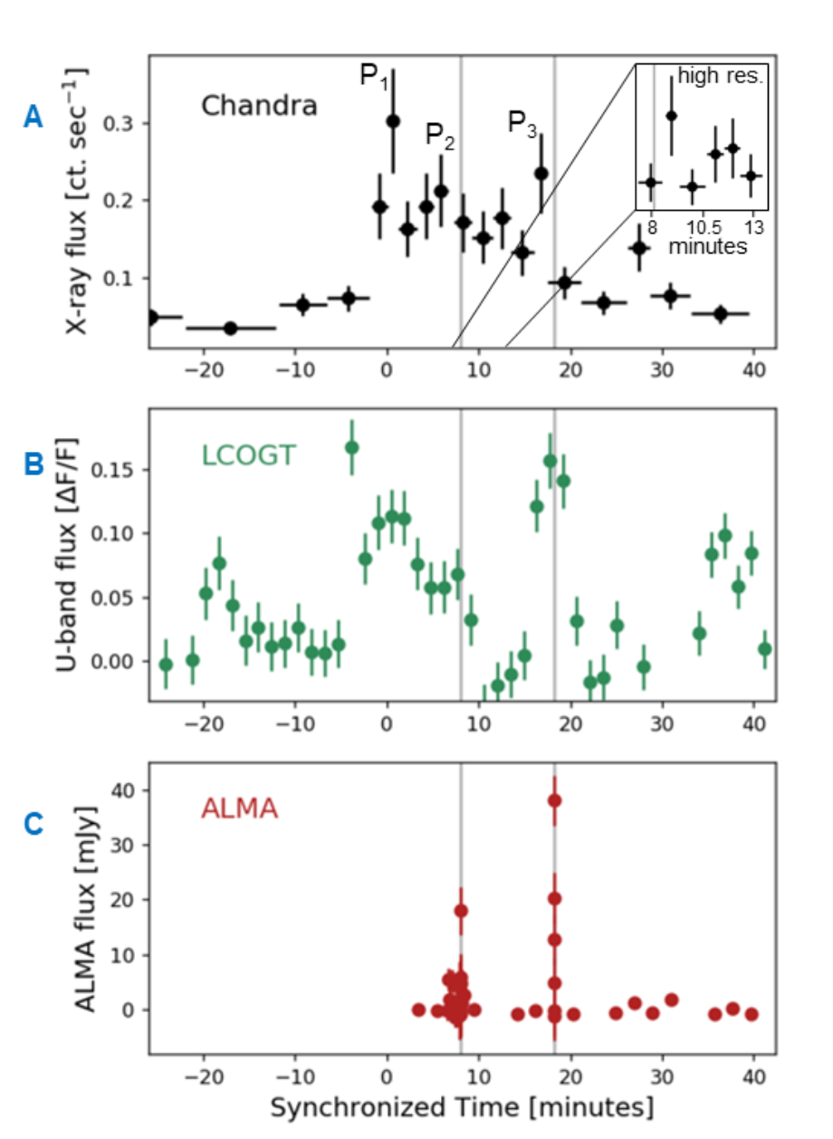
The Multi-wavelength Perspective from targeted observations of Proxima with ALMA++
White light flares are average in their properties
Coronal response indicates that plasma heating is taking place in at least one case.
Howard et al. (2022)

Slide 19
CMB-S4 Transient Response Timescale
Requirement is currently pinned to GRBs, “enable follow-up by issuing timely alerts to the community”
Stellar flares are the current known population of mm transient sources; CMB-S4 will probe further into the Galactic plane than ACT or SPT, thereby increasing the number of stars observed. This is more relevant for the wide survey.
Astro2020 found the idea of alerts about mm transients VERY appealing, fits in with the Time Domain/Multi-Messenger program and connects to New Messengers & New Physics science theme.
Sending out alerts on timescales of order the scan length would greatly improve our understanding of the nature of stellar mm flares, enable follow-up at other wavelengths (X-ray, optical), plus widen the parameter space of mm transients to be studied with CMB-S4

Slide 20
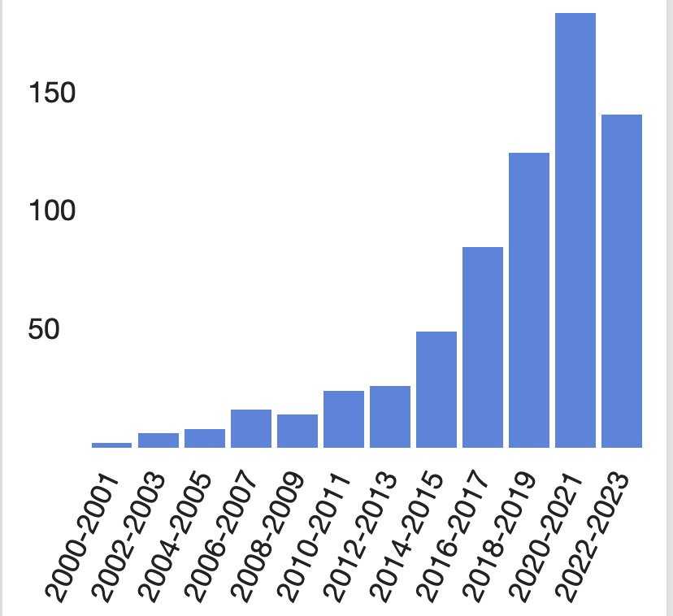
Worlds and Suns in Context
ADS search on “exoplanet” and “space weather” in refereed papers since 2000

Slide 21
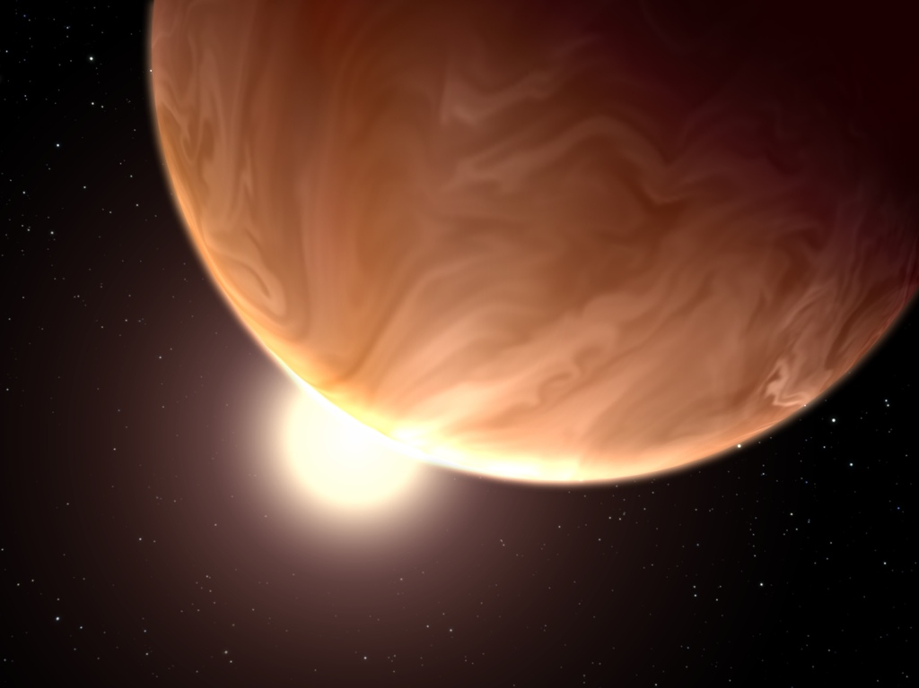
We Can Constrain the Particle Environment around Nearby Exoplanets, and Put Our World and Sun in Context

Slide 22
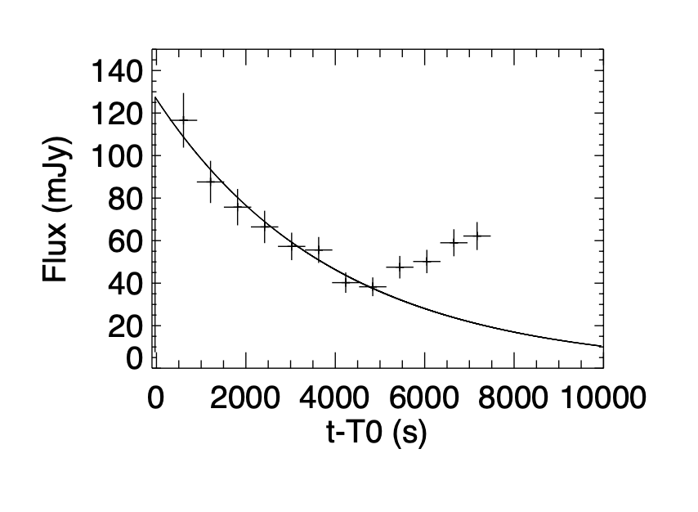
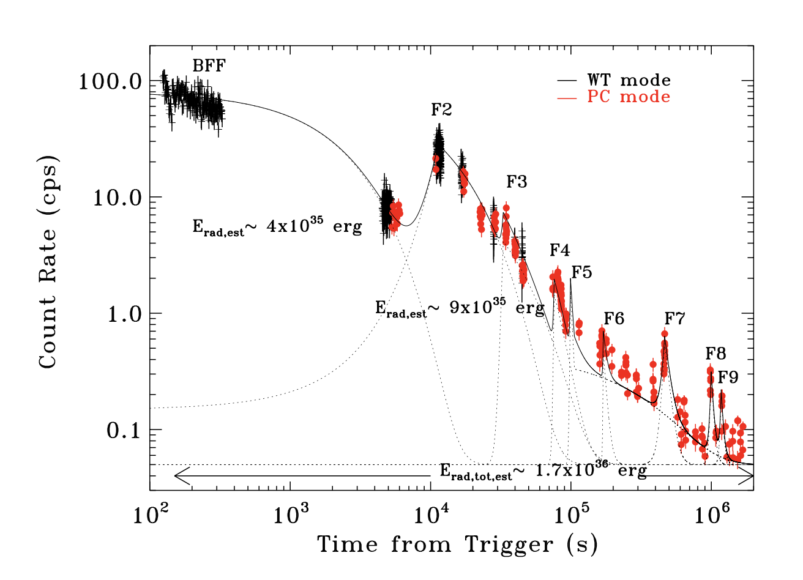
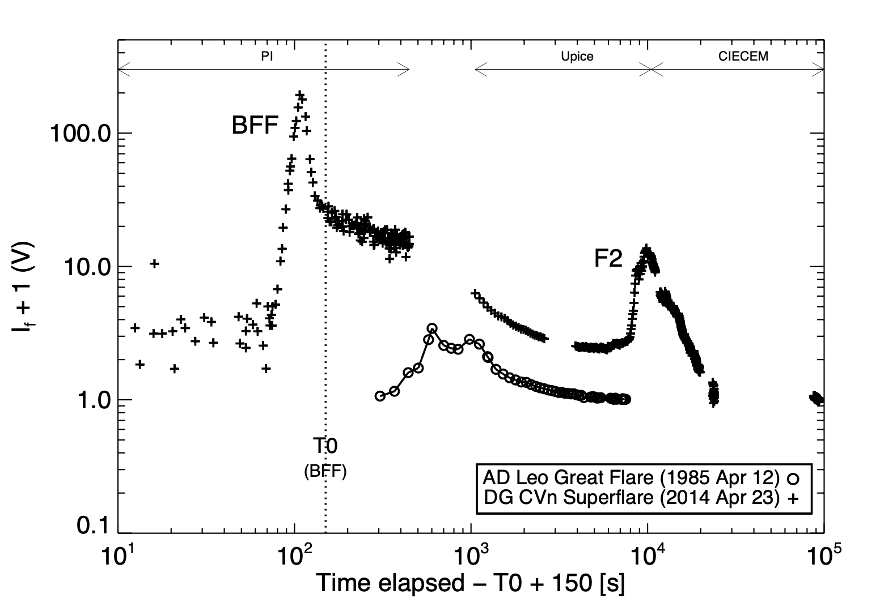
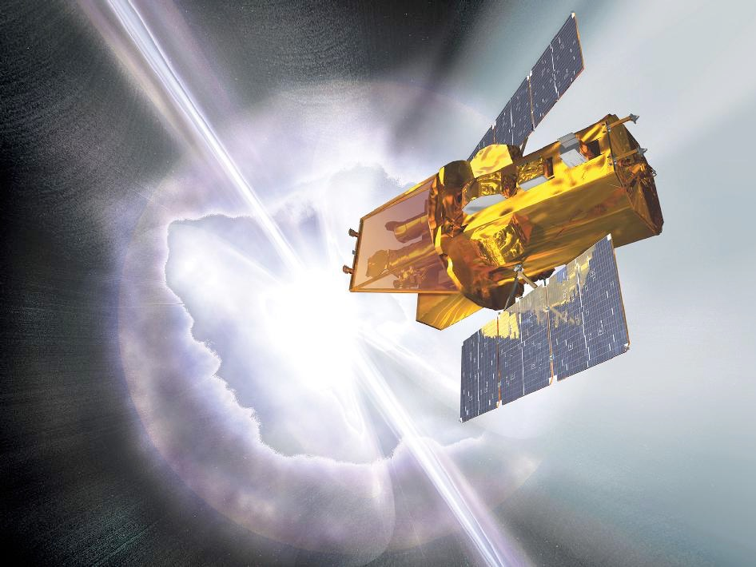
Some High Energy Perspective
Swift originally designed to study GRBs: detection and multiwavelength afterglow followup (HXR, SXR, UVOT)
These characteristics enable triggers on hard X-ray stellar flares (>15 keV): bright, rare events (~12 in the 19 years on-orbit)
Reveal extreme events:
Integrated flare energies 10³⁸ erg for binaries, 10³⁵-10³⁶ erg for M dwarf stars
Peak flare X-ray luminosities ≳ L_{bol} (!)
Peak temperatures 80 MK - 300 MK
Originate from “usual suspects” of extreme stellar magnetic activity: active binaries, M dwarfs, young stars
Give insights into stellar flare studies, especially with multi-wavelength observations and detailed study of the temporal-spectral characteristics
Swift-triggered event on M dwarf binary DG CVn (Osten et al. 2016)
15 GHz radio flare (Fender et al. 2015)

Slide 23
Exo-space weather & exoplanet habitability depend on stellar magnetic fields and eruptive events
Jakosky et al. (2015)
impact of an interplanetary coronal mass ejection on Mars
Coronal mass ejections and proton events have the biggest impact in determining the effect of reconnection events on planetary atmospheres, but require scaling from the Sun
Notes:
mention that this was called out in NASA’s astrobiology roadmap from 2014(?)

Slide 24
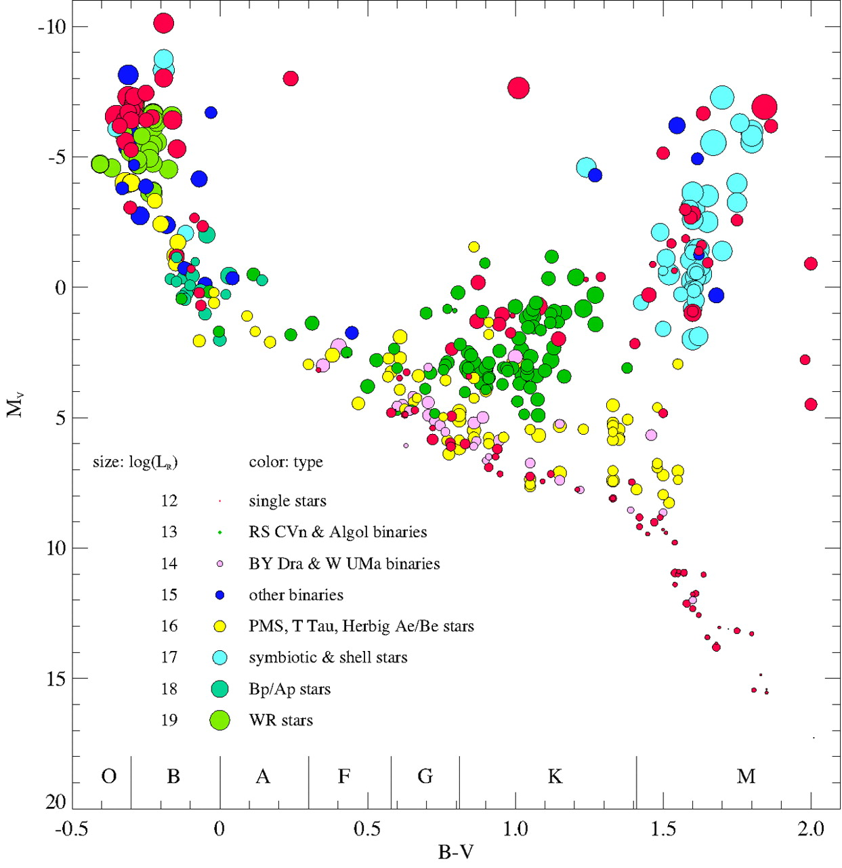
Constraining the particle environment around nearby exoplanets
+
+
White light flaring from the Kepler mission
Yang & Liu (2019)
HR diagram showing location of microwave-emitting stars

