Slide 1
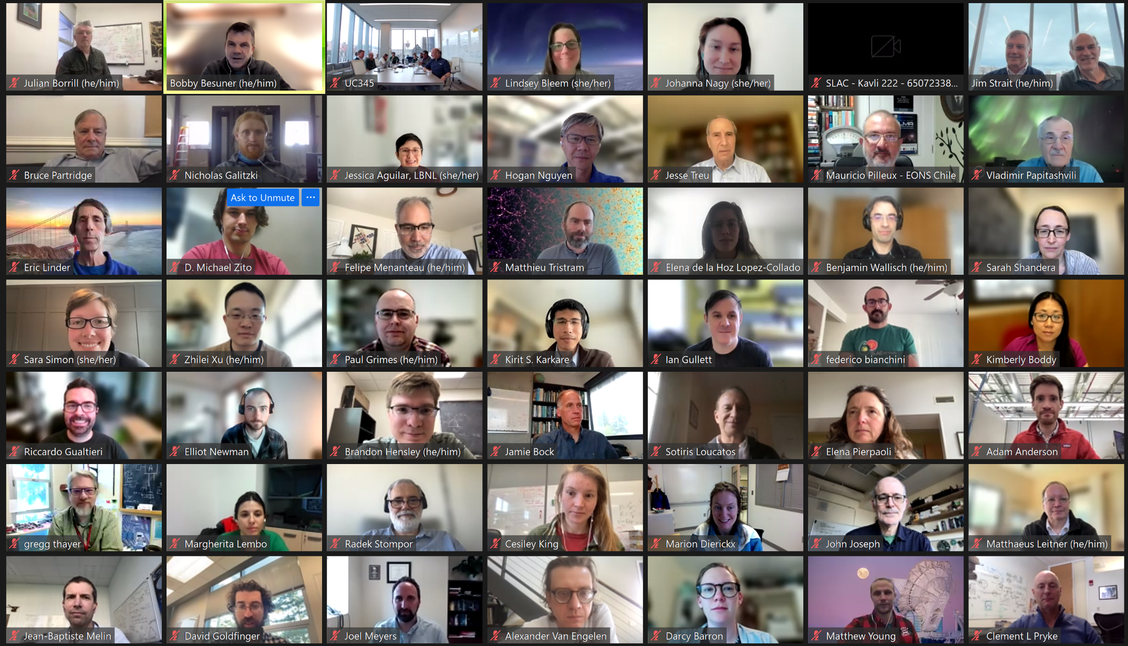
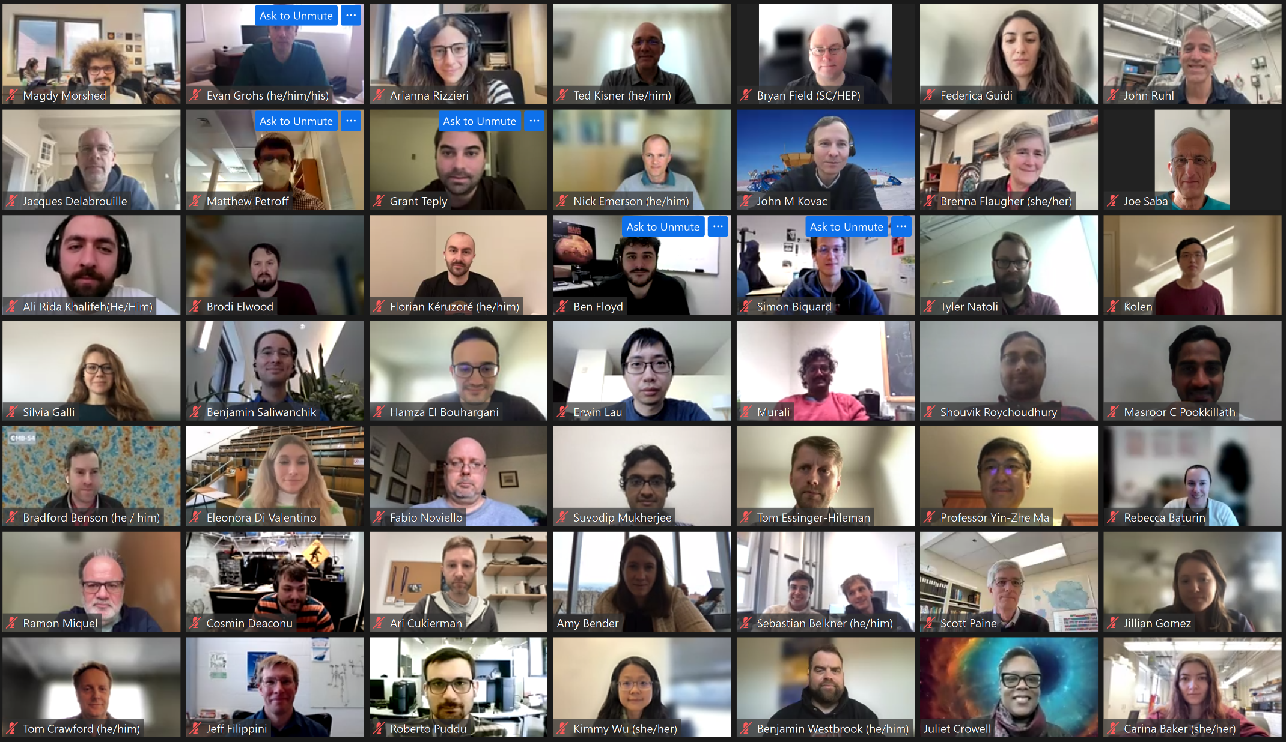
CMB-S4 SPRING COLLABORATION
MEETING
APRIL 3-6, 2023

