Slide 1
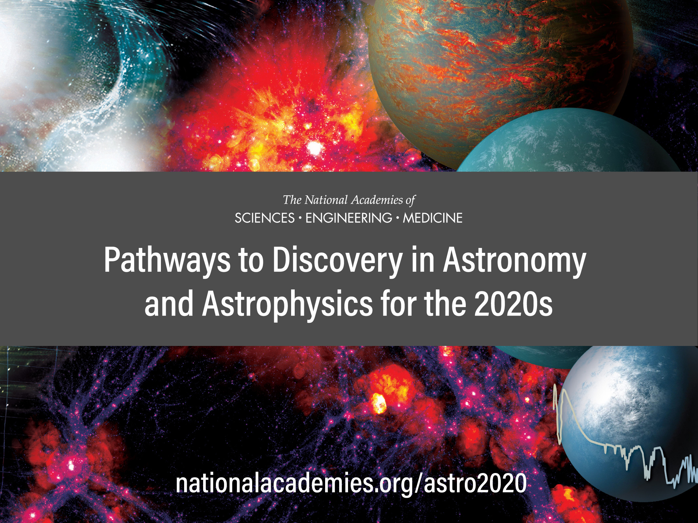
Complementary Astrophysics
Rachel Osten
Space Telescope Science Institute
and
Johns Hopkins University

Slide 2
Outline
Overview of Astro2020’s 3 science themes
Worlds and Suns in Context
Cosmic Ecosystems
New Messengers and New Physics
Where CMB-S4 facility fits within these themes
CMB-S4 in the landscape of decadal-recommended facilities

Slide 3
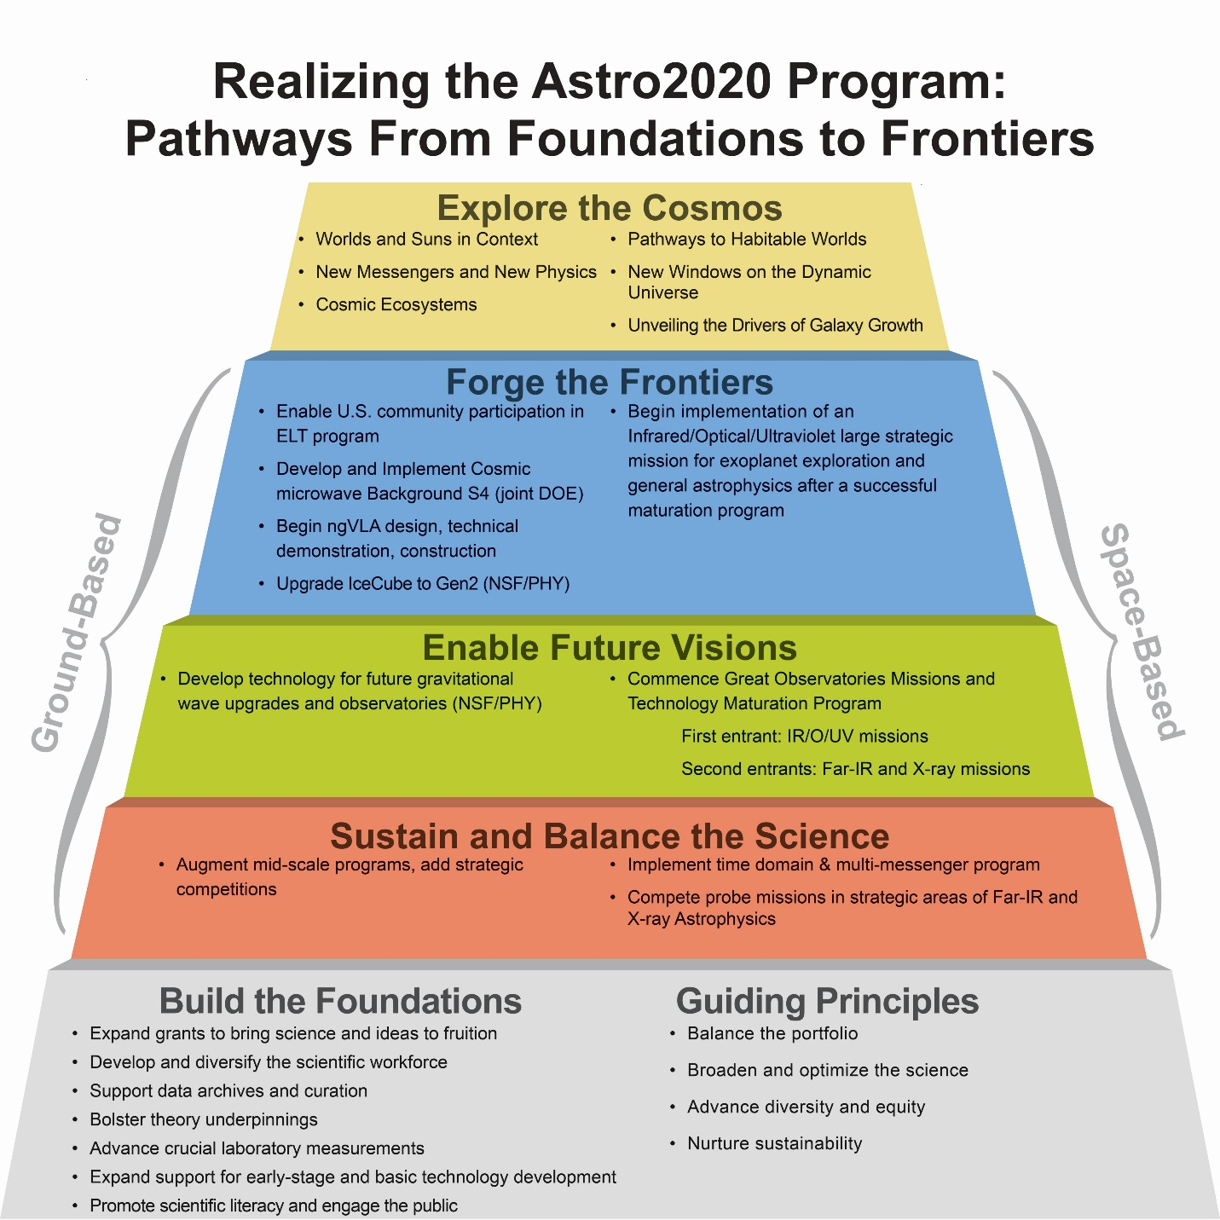
Notes:
Fiona

Slide 4
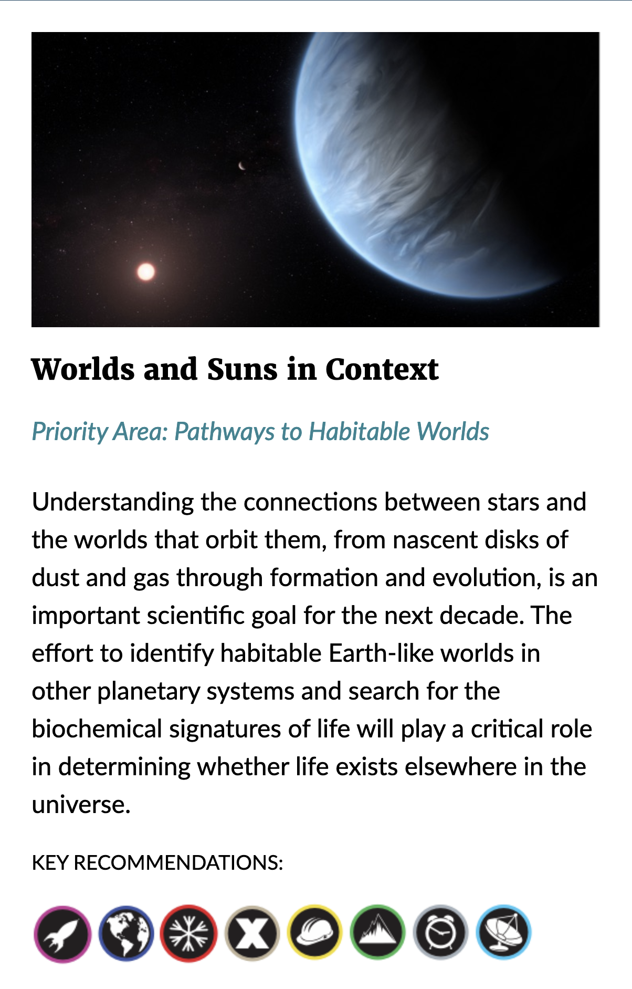
Worlds and Suns in Context
This theme is forefront because:
The extraordinary rate of discovery of new exoplanets– understanding the demographics and finding the nearest planets for detailed study
The promise of JWST to make pioneering observations of exoplanet atmospheres
The revolution DKIST will bring to understanding the Sun’s atmosphere
The revolution in studying planet formation by imaging protoplanets and their accretion disks using large ground-based telescopes (OIR and ALMA)

Slide 5
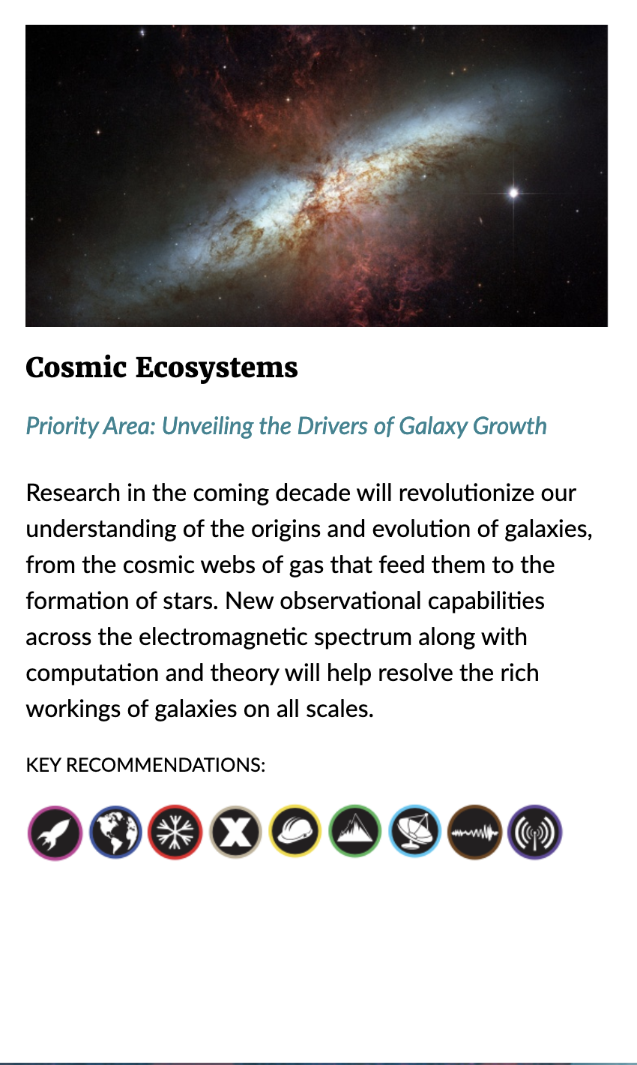
Cosmic Ecosystems
This theme is forefront because:
JWST will provide definitive observations of the earliest stages of galaxy formation and evolution
The Rubin Observatory, Roman, and Euclid will provide imaging and spectral energy information for millions of galaxies, complementing the in-depth observations from JWST
Progress in numerical simulations is evolving rapidly and is driving out understanding of the observations

Slide 6
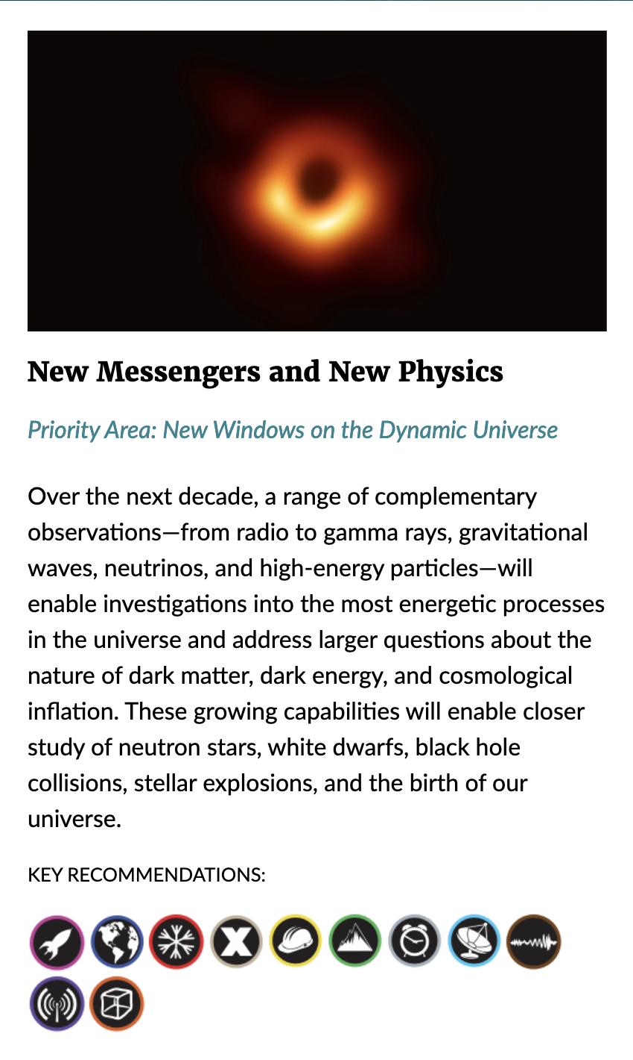
New Messengers and New Physics
This theme is forefront this decade because of:
Tremendous progress in observations of the Cosmic Microwave Background
Time domain surveys that have uncovered an astounding array of transient phenomena
The discovery of compact object mergers with LIGO, and the detection of electromagnetic counterparts
Ice Cube’s detection of high energy neutrinos of astrophysical origin

Slide 7
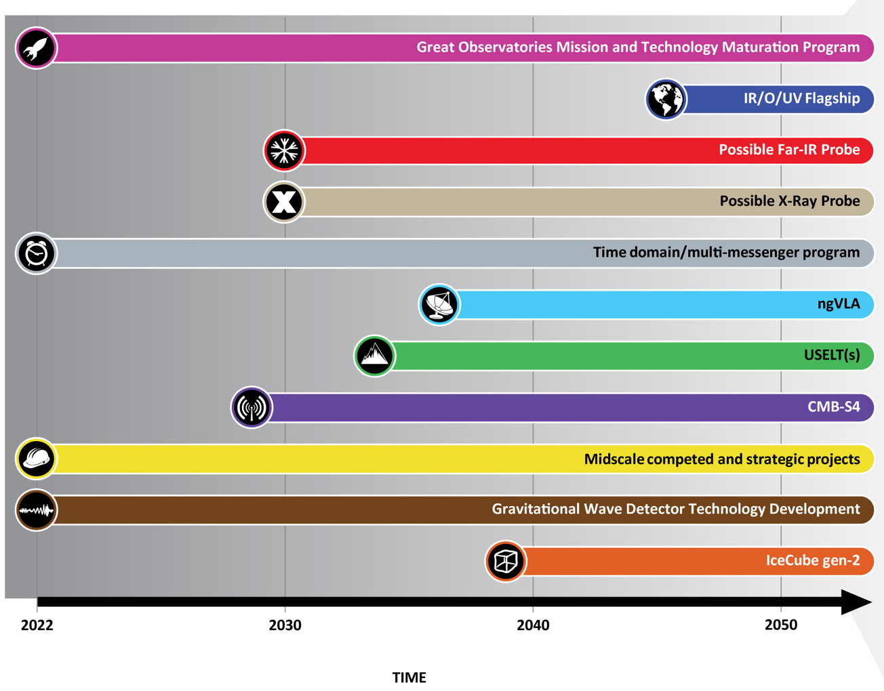
The time domain was called out as an explicit program on the space-based side, as well as a strategic priority area for NSF investment in mid-scale ground-based facilities
The next generation VLA, envisaged to cover the frequency range 1.2-116 GHz, is a complementary facility for CMB-S4’s time domain and complementary astrophysics capabilities

Slide 9
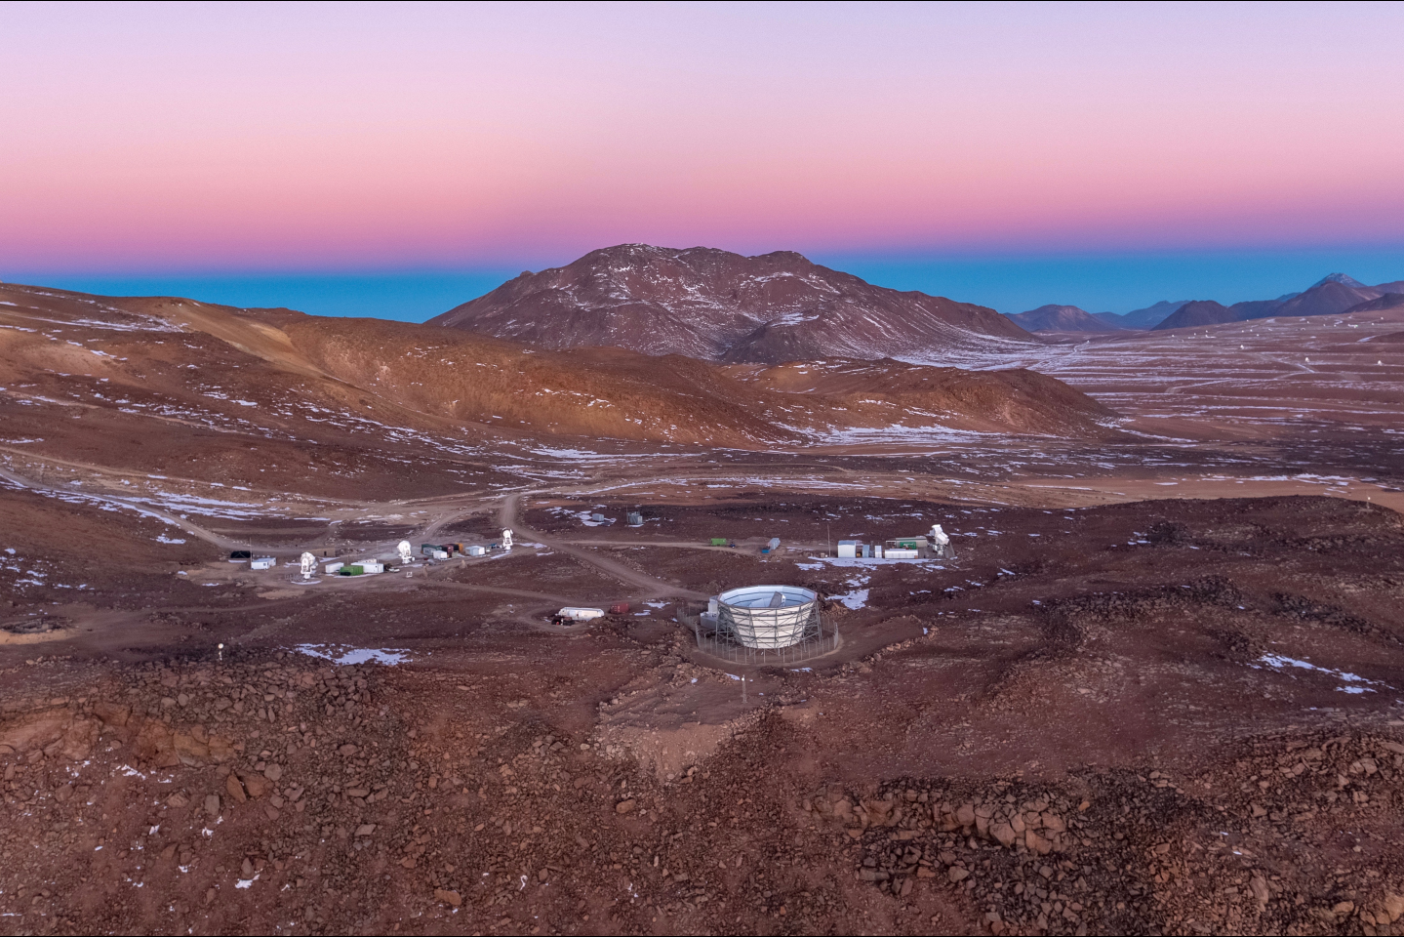
Worlds and Suns in Context
CMB-S4 contributions in this area:
Time domain studies of particle acceleration in nearby stars and implications for the accelerated particle population around close-in exoplanets
Accretion and magnetic reconnection events in young stars

Slide 10
Cosmic Ecosystems
CMB-S4 contributions in this area:
Maps 50% sky, every other day from 0.1- 1 cm with unprecedented sensitivity
Of all the observational diagnostics at our disposal, the SZ effect most directly constrains the energy content of gas in galactic halos produced by the combined effects of gravitational collapse and stellar and black hole feedback
Higher sensitivity and higher resolution CMB observations motivated to a significant extent by cosmology will have a large impact on the understanding of galaxy formation as well

Slide 11
New Messengers and New Physics
CMB-S4 contributions in this area:
CMB-S4 builds on the foundation of decades of CMB measurements to take a major leap, pushing CMB science to the next level
B-mode CMB polarization signatures of primordial gravitational waves and inflation
Broad science including systematic time domain science

Slide 12
Heavy emphasis on the foundations
-- minds, measurements, machines
(people, research, technology) -- needed to make progress
Generational nature of large strategic telescope projects
Synergy of multi-wavelength observations to solving today’s complex astrophysics questions
Notes:
Fiona

