Slide 1
Observing beyond our disciplines:
Erasures, memories and the making of Chile
Magdalena Novoa
Assistant Professor
Urban & Regional Planning
University of Illinois Urbana Champaign
Notes:
Thanks Sara Simon and Felipe Menanteu for inviting me to be here today.
My name is Magdalena Novoa, I’m a Professor in Urban Planning at UIUC. As you can perhaps guess I’m not an astronomer and my work has nothing to do with astronomy or the sky but very much with the ground. So that’s what I’ll talk about today, about the territory that today we know as Chile.

Slide 2
INTRODUCTION
Introduction
Some data about Chile
Silences: Some more data about Chile…
Memories and the (re)making of Chile
DEI: politics of dilution or disruption?
Notes:
•

Slide 3
introduction

Slide 4
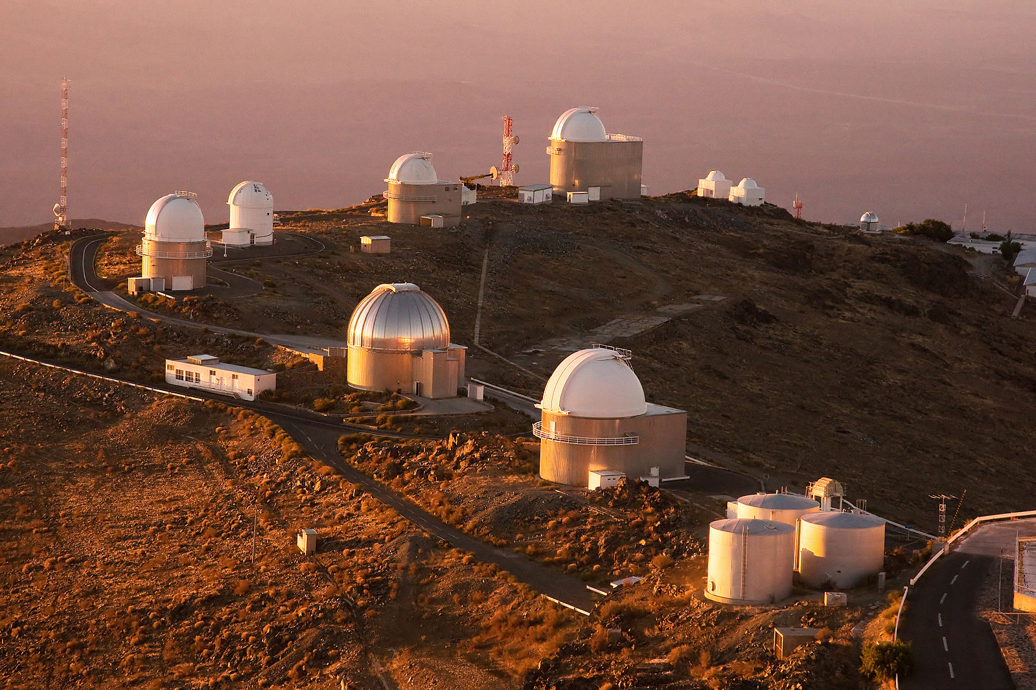
La Silla Observatory. Atacama Desert in the Coquimbo Region, Chile. Source: ESO
Notes:
I’m originally from Chile, but I have been living in the United States for the past 6 years. I came to study my PhD in Architecture and Historic Preservation at the University of Texas at Austin, and 2 years ago I moved to Urbana Champaign to start my position of Assistant Professor at the department of urban and regional planning at UIUC.
When Felipe invited me to give a talk in this conference I was a bit confused to be honest. What in the world a woman that works in cultural heritage, urban planning and community engagement can possibly contribute to a world of Astronomers? What connections can possibly exist between studying the space up there and studying the space down here? Well, actually thinking a little bit deeper it started to make more sense. I though about the importance of interdisciplinarity in academia whether we’re in humanities or physics: I myself identify as an interdisciplinary scholar.
So this presentation is also an invitation to think about the politics of diversity, equity and inclusion from an interdisciplinary perspective.

Slide 5
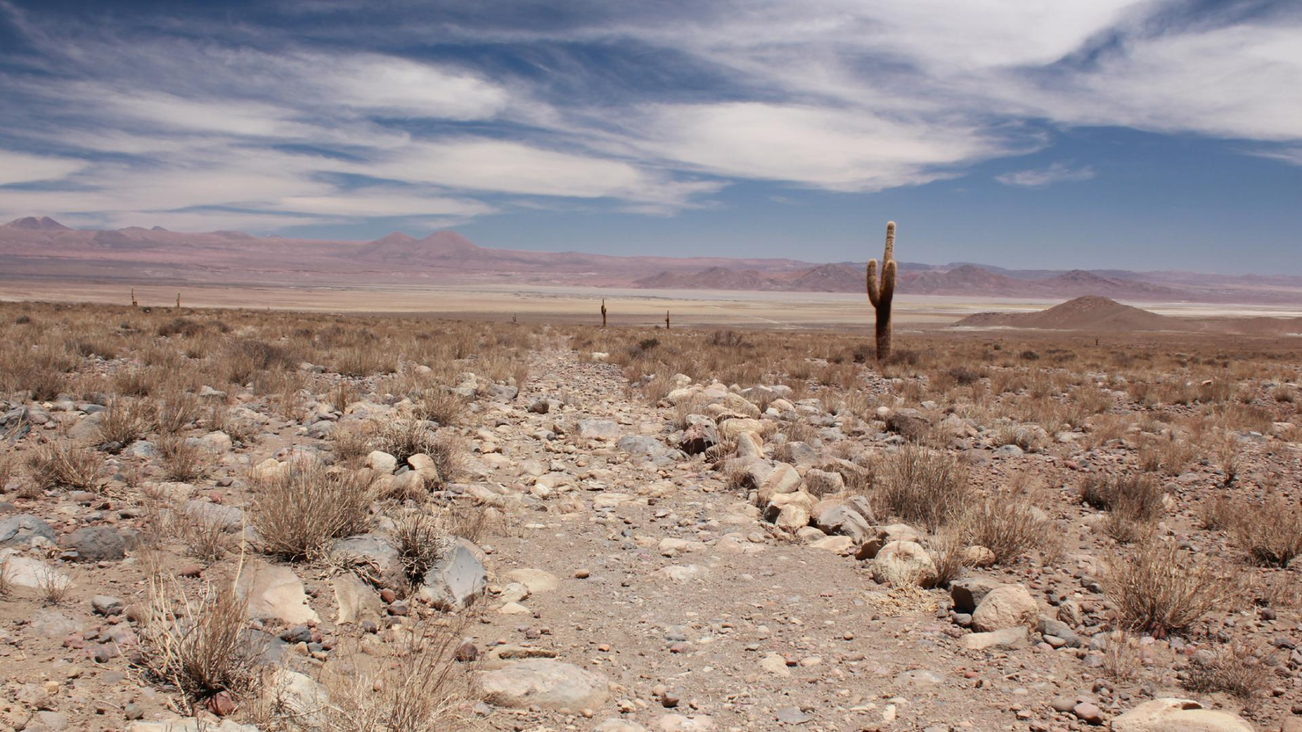
Qhapac ñan, Andean Road System. World Heritage site. Source: National Monuments Council
Notes:
On the other hand, when thinking about the very broad topic of Astronomy and Chile, I begun to recall my memories as a child spending summers in the north of Chile, as a young professional working in the Chilean government and traveling through the Atacama desert supporting the process of designating as world heritage site the qhapaq ñan or the Andean Road System. I thought about the indigenous communities there, how in one of the community meetings I attended an indigenous man contested and challenged the historical narrative about his people that an archeologist was delivering to them in a presentation. I thought about my dream of visiting Alma and its impossibility, because visits for ordinary Chilean people like myself are extremely limited, I thought about the recent controversies in Hawaii and the role of science in oppressing indigenous communities and their cultural heritage, which is actually myfield of research.

Slide 6
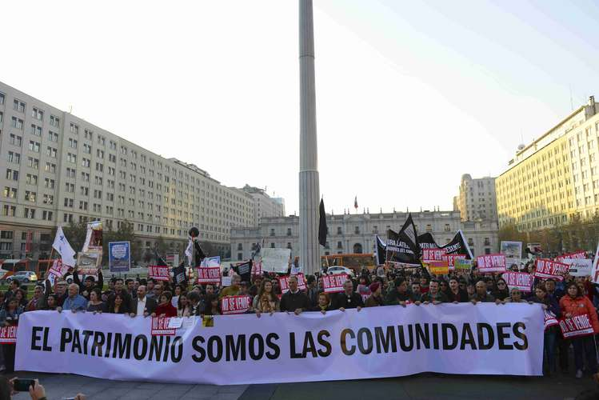
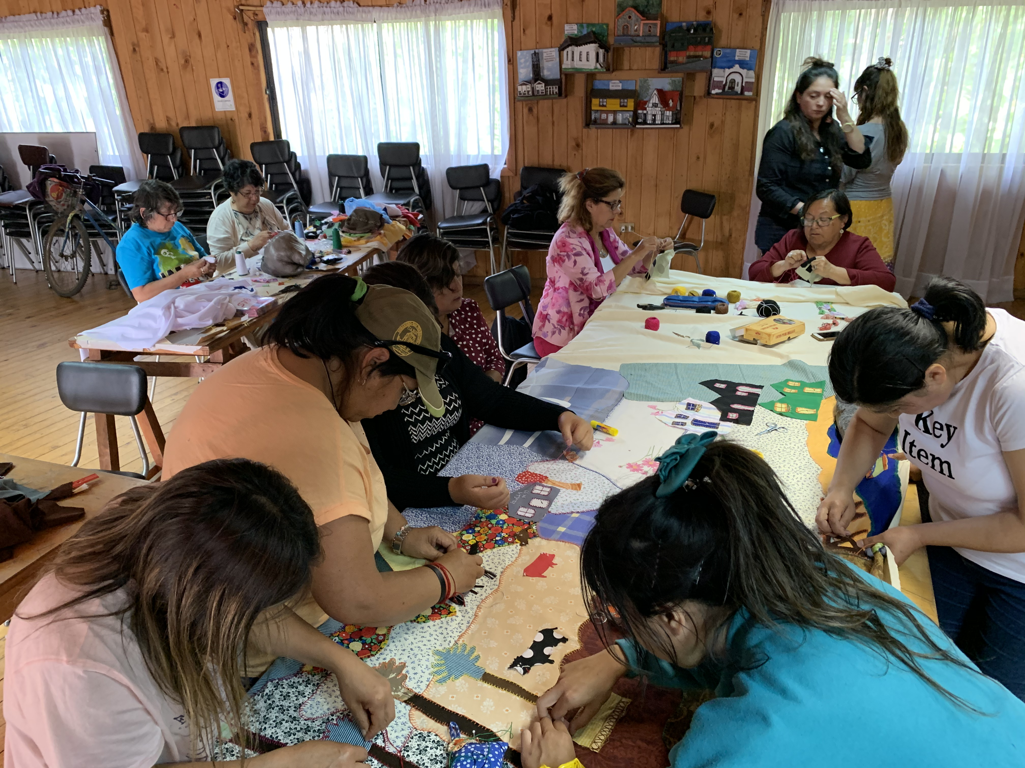
National Heritage March 2014 in front Chilean Government Palace “Heritage is Us the Communities”. Images courtesy of ACBZP.
Recovering the history of Lota from a female perspective using the textile technique “arpillera urbana”. January 2020, Lota, Chile.
Notes:
So, I work in the intersections of cultural heritage, territorial planning and social justice in Chile and identify as an engaged scholars working closely with communities.
I currently work with grassroots and human rights organizations in Chile, focusing on the ways Chilean use heritage and historic sites to create more inclusive stories and memories about the past and decision-making processes in the present. Often the histories, memories and places of marginalized communities are overlooked by cultural and urban policies because they don’t comply with the aesthetical and historical values that the State or experts think of as valid. Through my community engaged scholarship I do an effort to support communities to challenge cultural exclusions and oblivions.

Slide 7
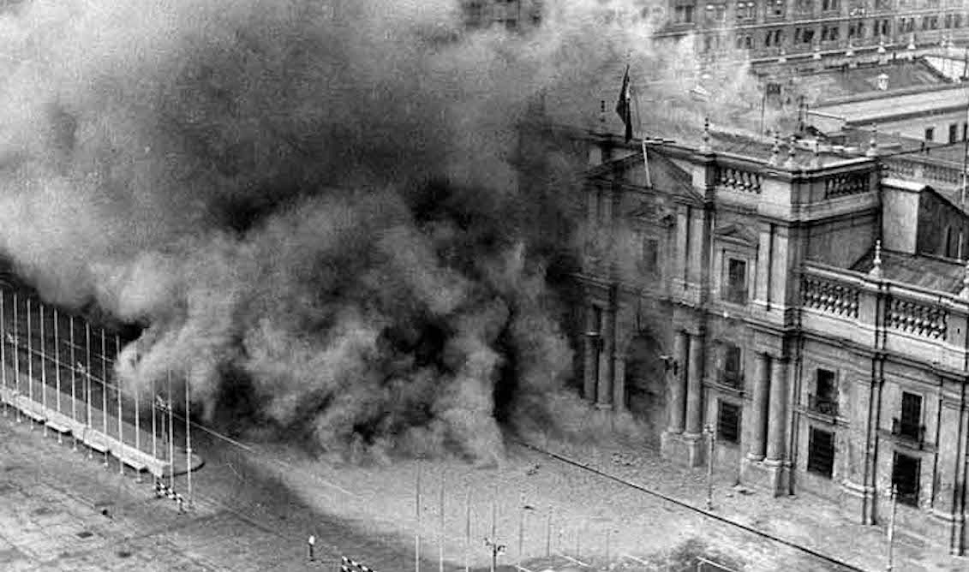
FotoBombardeo de la moneda
11 September 1973, Chilean coup d´état. Military dictatorship in Chile 1973-1990.
Image: Bombardement of La Moneda Goverment Palace.
Notes:
What I think has strongly marked what I do today is Chile’s recent past. I grew up in Chile amidst of a military dictatorship. I come from a priviledge background, from Spanish descendants and I did not suffer the repression than thousands in my country did after our own nineth eleven, that is the coup etad of the September 11 1973 that established a military dictatorship that lasted 17 years.
But as I said, I’ve come to realize that this historical period and the social, cultural, political, and economic restructuration that the regime implemented with the support of the US by the way, has strongly marked what I do today and what I have had to unlearn about my country, its people and its land and the responsibility that as a Chilean, I have with the deep wounds that this history left in our society.
But the point that I want to make by telling this personal story is that during 15 or 18 years of my life I imagined my country, its history, and its people through only one lens, not through the many lens that I’ve come to see now through my work with communities.

Slide 8
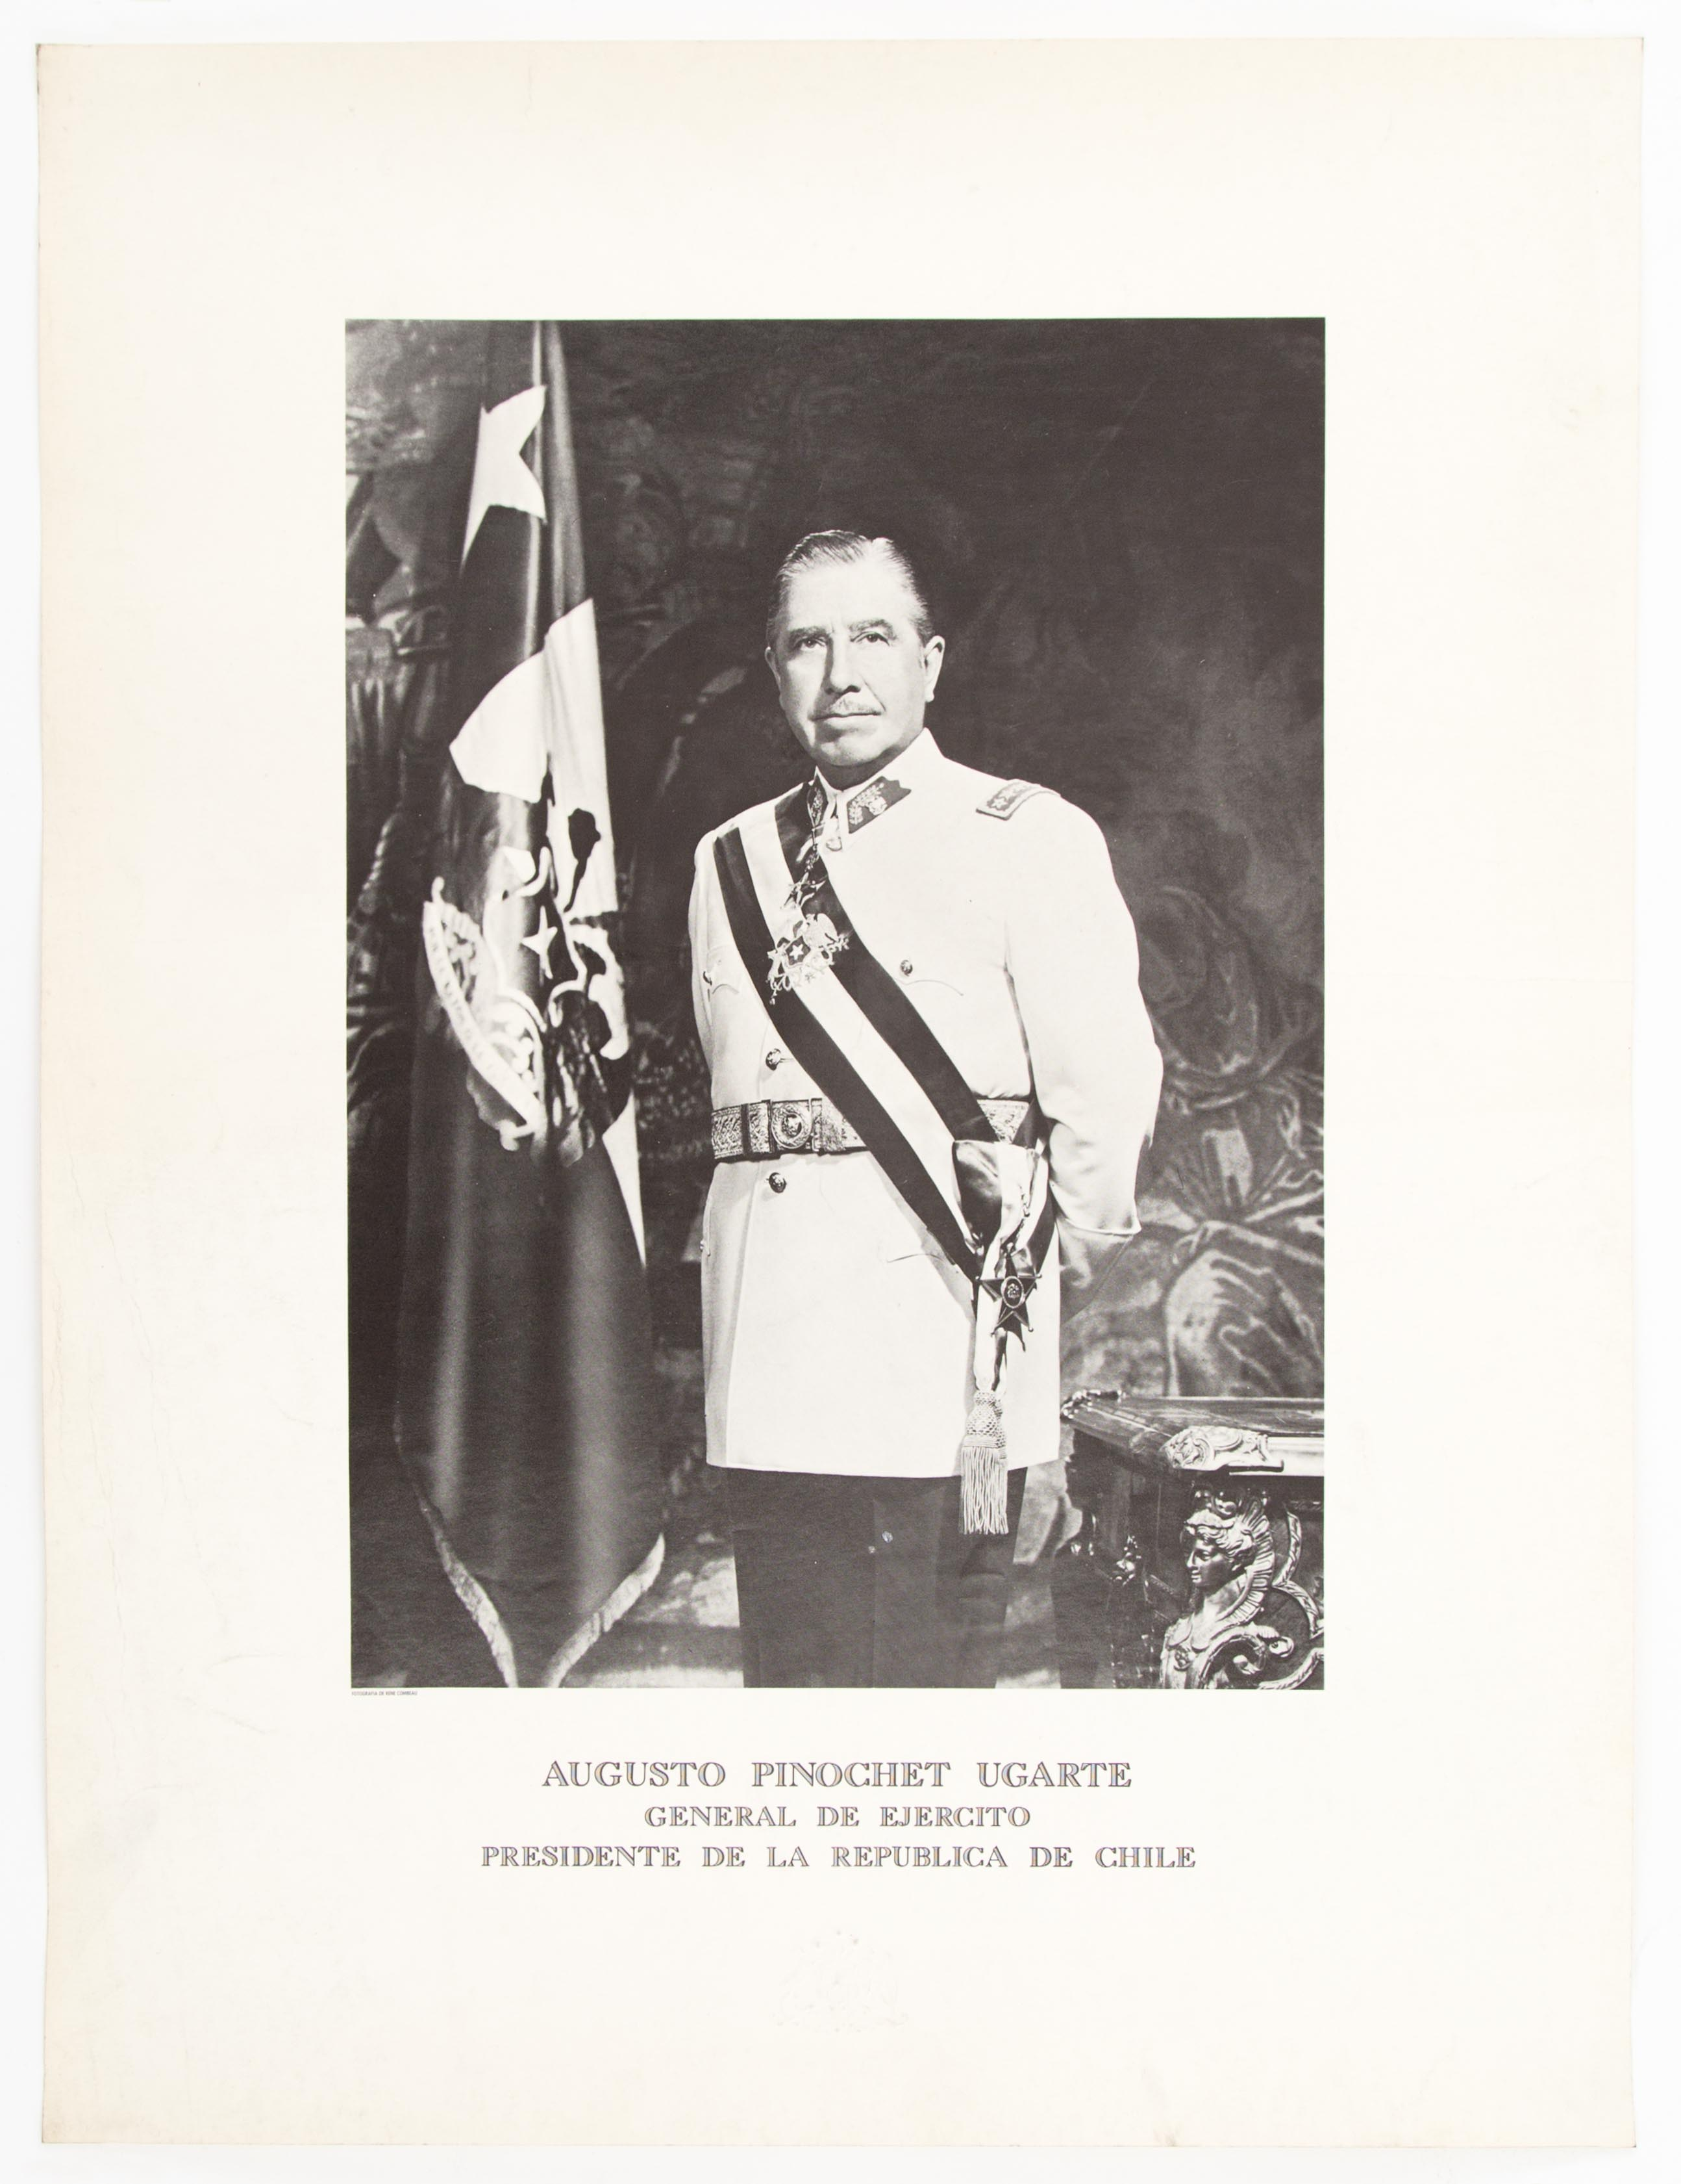
Poster of Augusto Pinochet. It says “Augusto Pinochet Ugarte, General of the Army, President of the Republic of Chile”. Source: Museo de la Memoria, Chile.
Notes:
For example, When I was in school, I thought that having a general as president that never changed was completely normal. I was told that Chile was this beautiful long country with a very diverse landscapes and a very homogenous mestizo population, mostly descendants of Spaniards. I heard soo many times that Chile didn’t have much cultural heritage because the native populations that existed ( and I say existed in past tense I was told) weren’t strong civilizations as the Incas or the Mayas, so there wasn’t much valuable left from them in our land.

Slide 9
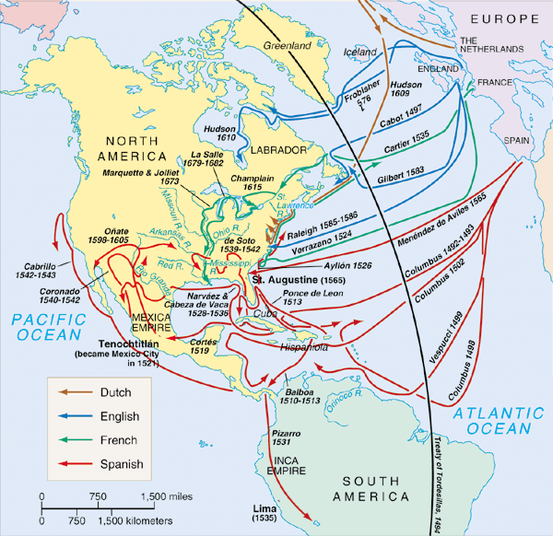
Map representing European colonization in the Americas. Source: The American People: Creating a Nation and a Society through Vox.com
Notes:
Furthermore, I was taught a positive version about the Spanish colonization. I learnt that Christopher Colombus "discovered" an "empty” land when he got to the Americas. These narratives often included maps of the "peopling" or "settling" of this supposedly "virgin" land. They showed these arrows, representing European immigrants, moving westward or south in what is a mostly a blank continent.

Slide 10
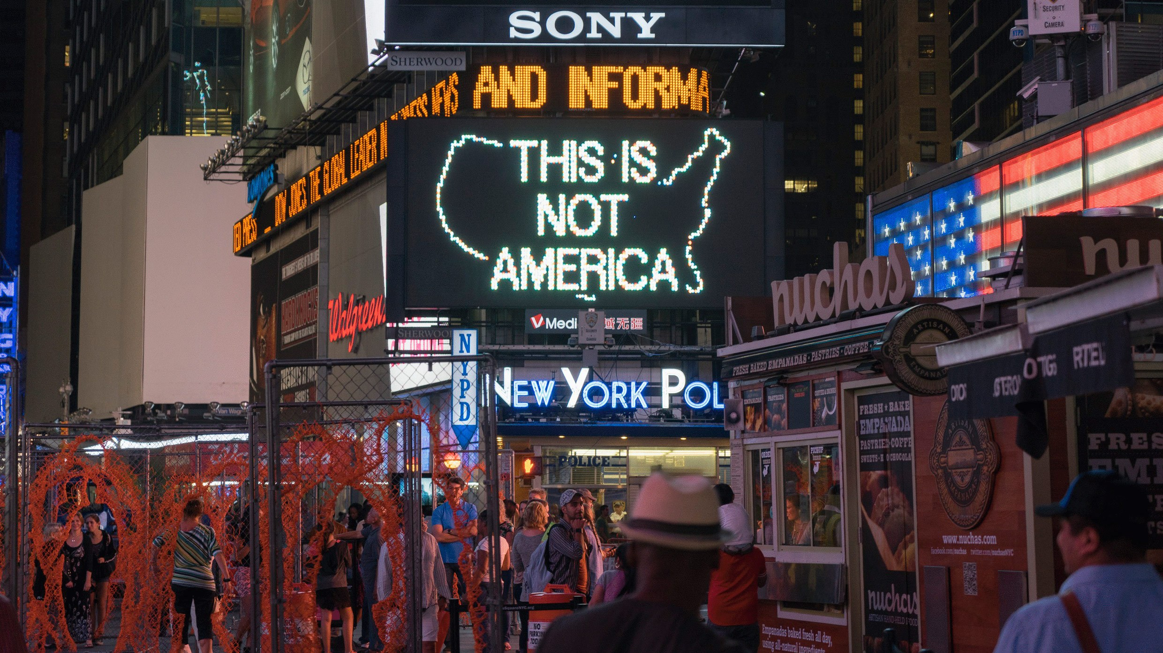
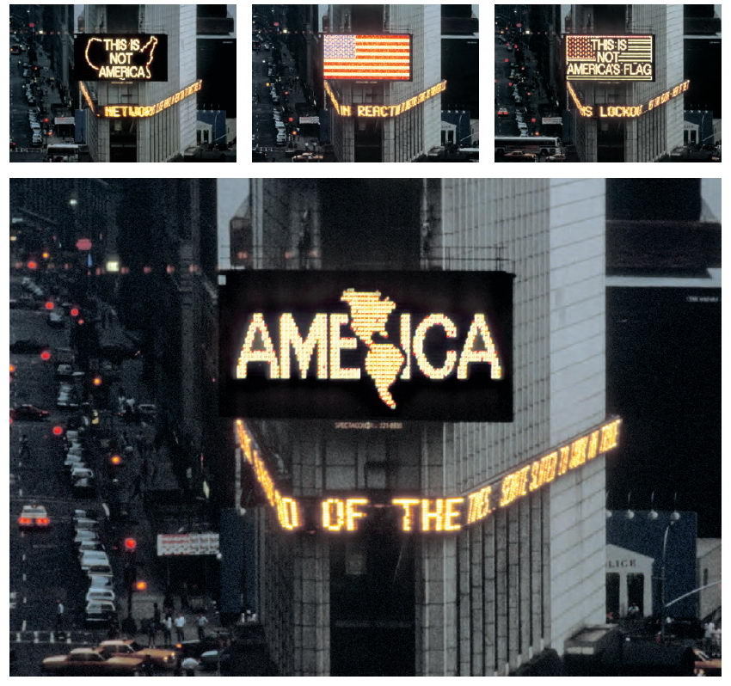
A LOGO FOR AMERICA, Alfredo Jaar, Times Square, New York, 1987
Notes:
And when native people did appear in the story, their representation was of a small group of “savages” that needed to be saved by the progress and modernity brought by Europeans as they “encounter” the few groups of people that inhabit the land. But overall, the Americans (and I refer with this concept not the people from the US but from all the continent) the people who already lived here have remained mostly invisible to later generations. Here in this slide we see a public art intervention on Times Square by Chilean artist and McArthur fellow Alfredo Jarr

Slide 11
Some data about Chile

Slide 12
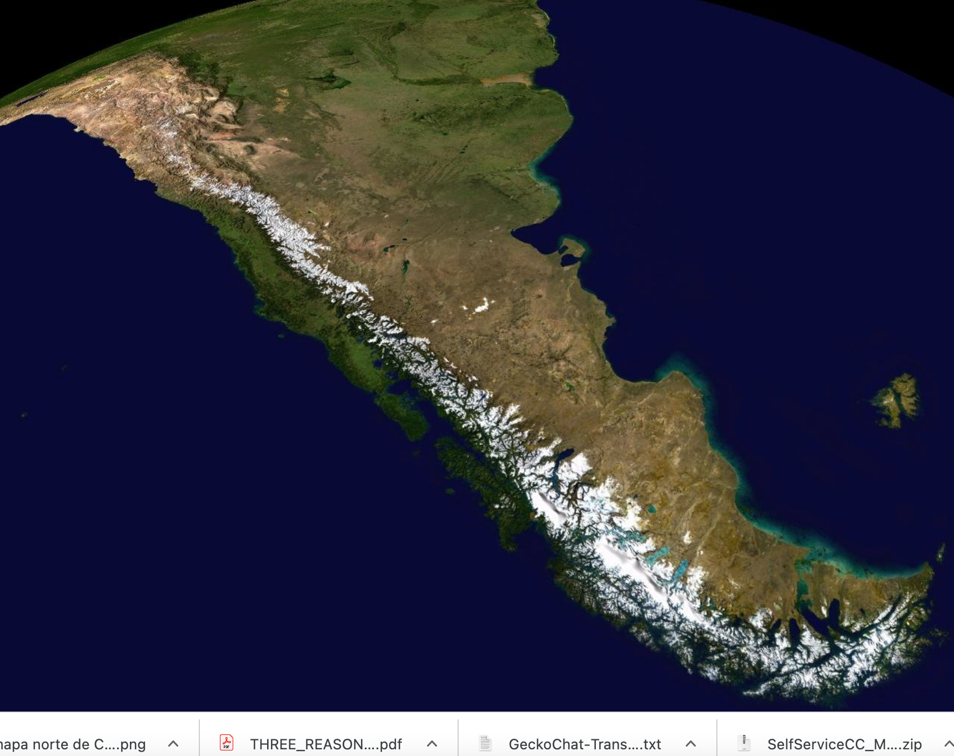
Some data about Chile
4,270 km of coast
19.7 million inhabitants
Official language: Spanish
Chile. Source: Google earth
Notes:
Chile, is the southernmost country in the world, it occupyes a long and narrow strip of land between the Andes to the east and the Pacific Ocean to the west. It has more than four thousand km of coast and its maximum wide is only 445 km. Today almost 20 million people lives in its territory. Chile, has as inmediate neighbors Peru, Bolivia and Argentina and controls several Pacific islands, and Easter Island in Oceania. It also controls a portion of the Antartica.

Slide 13
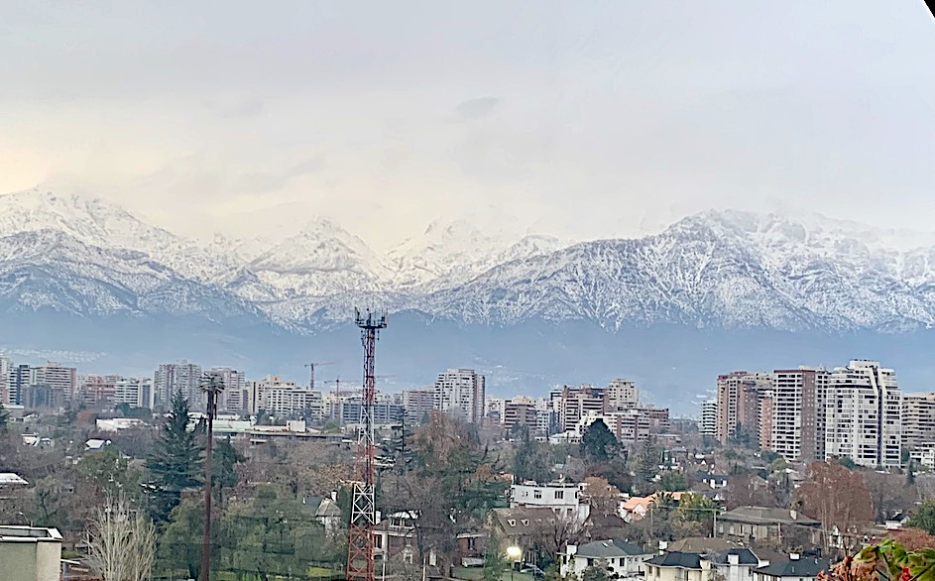
Some data about Chile
Capital of Santiago
Official language: Spanish
Market economy
Santiago, Chile. Photo by the author.
Notes:
The country's capital and largest city is Santiago, and its official language is Spanish.
According to the World Bank and the Organisation for Economic Co-operation and Development Chile is categorized as a “developing country” with a high income economy, it transition to a market economy during the military regime that collaborated with Mitlon Friedman and Arnold Haerberg, Professors at the Department of Economics at the University of Chicago. Today Chile remains as one of the most unequal countries in the world.

Slide 14
Silences: some more data…

Slide 15
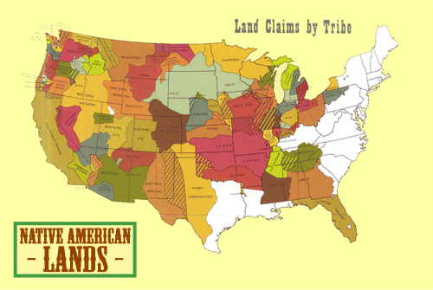
Silences: some more data about Chile
Source: Sam B. Hillard/Sunisup via vox.com
Notes:
But first I want to contextualize the information about Chile I’ll provide in the with some data about the Americas, that is also often not talked about: It is estimated that between 70 and 100 millinon people lived in the continent before the Europeans arrived and that in the century following Christopher Columbus’s initial journey to the Americas and Caribbean in 1492, nearly 90% indigenous people were killed due to the spread of diseases, wars, displacement from their lands and subsequent disruptions in their ways of being and knowing the world. Many refer to these fatalities to the Great American Dying or the American Holocaust.
In the United States alone it is estimated that previous to colonization between 5 and 12 million indigenous people lived in continental US and that by 1800 only about 600,000 Indiegnous People remained in this country. Here we can see a map that shows the cession of Indian Lands (David Michael Smith, Thornton)

Slide 16
Silences: some more data about Chile
Notes:
In the land that is now Chile, Indigenous groups can be traced back at least 10,000 years and the estimates are that between 1 to 1.5 millions lived in the territory. Today they only make up 9% of Chile’s population. Here we see the 12 groups that are officially recognized in Chile, The largest group is the Mapuche, in the south in pink, but today I’ll talk about mainly those located in the north, trh atacamenos in grey in the Atacama desert.

Slide 17
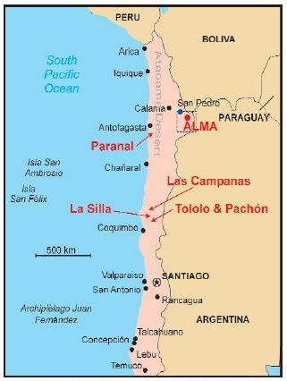
Silences: some more data about Chile
International observatories in the Atacama Desert. Source: NRAO through astrobites.org , Kate Storey-Fisher.
Notes:
The Indigenous communities of the Atacama Desert, where most observatories are located, consist of separate cultures but are collectively known as the Atacameños or the Likan Antai; they now make up 3% of the Indigenous population. In the 15th century the Atacama was conquered by the Incans, and in the 16th century the region was again conquered by the Spanish, after resistance by the Likan Antai people. After centuries of rule by Spain, and later by Peru and Bolivia, the Atacama was taken over by Chile in the Pacific War in 1883. Today the region is still controlled by the Chilean state, with few national reserves co-managed by the government and Indigenous groups.

Slide 18
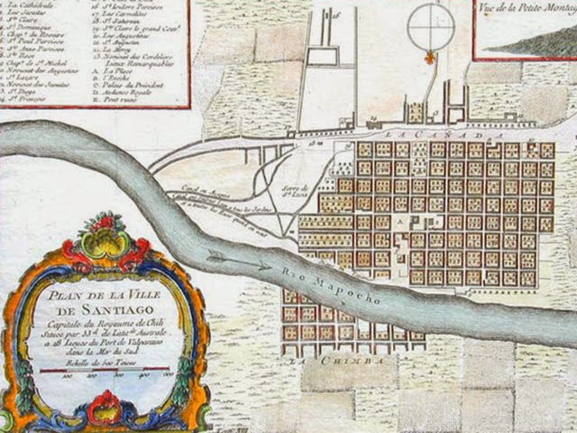
Silences: some more data about Chile
Map of Santiago, 1756. Source: Antique Books Maps
Notes:
Its important to note here, the role of planning, as a spatial practice in colonialism and erasure of indigenous populations. Planning and the ordering of space was used to impose and maintain racial and ethnic segregation and elimination. Native lands were often ceded as we saw in the previous slide to colonizers or the state, colonial cities in the Americas were often divided between European and Indigenous zones, or indigenous people were limited to particular portions of land. In words of Yasminah Beebeejahun, ordering space in the American colonies was an enactment of the politicis of dispossession and the dispossessory activities were aimed at erasing the lived spaced of indigenous peoples. These practices of erasure were coupled with processes of racialization that are integral to the development of planning, and I would argue of science and Western knowledge production in general.

Slide 19
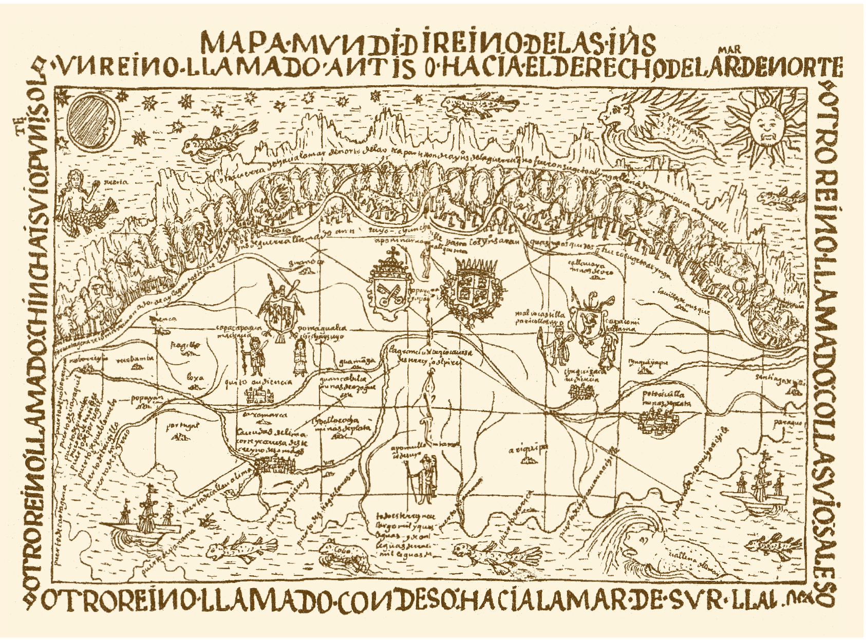
Silences: some more data about Chile
Cosmological notions of the Andean world. Mapamundi of the Peruvian Indias showing the division of the Inca empire, Tawantinsuyu. Felipe Guamán Poma de Ayala,Lima, 1612/1615. Source: El cielo en la cosmovisión de Atacama
Notes:
We just have to pay attention to how the ancestral cosmological knowledge of the Indigenous People that lived in the Atacama Desert, where most Western Astronomical activities take place in Chile, has remained mostly invisible to the public eye despite that their knowledge and astronomical practices precedes the research and knowledge of the state-of-the-art observatories installed in the Atacama desert. Atacameno people have their own observation techniques and their own way of understanding the sky and connecting it to the earth, through a different lens that Western Astronomy but not less valid, this is not science versus culture, they are both knowledge that continue to be central in the ways of lives of this people.

Slide 20
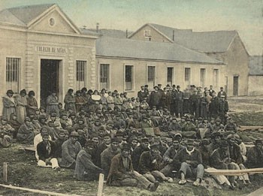
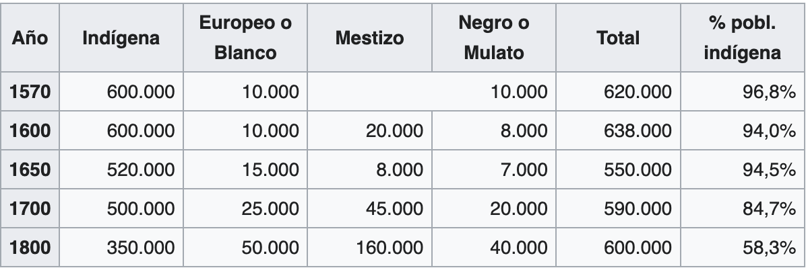
Silences: some more data about Chile
Indigenous population during the Colonial period in Chile
The last Selknam people in the Salesian Mission at Dawson Island in early twentieth century. Source: Memoria Chilena
Notes:
Chile then, has a history of oppression against Indigenous communities, from colonial times until these days. We see in this chart the decreasing of indigenous population during the colonial period but this violence has continued over time. For example, during the dictatorial regime of Augusto Pinochet beginning in the 1970s the state engaged in the acquisition and reselling of land to foreign entities, granting them extraterritorial jurisdiction and diplomatic immunity without prior consent of its original inhabitants. According to Kate Storey-Fisher In the 1990s, the European Southern Observatory faced land and labor conflicts at Cerro Paranal and enjoys extraterritorial governance at the observatory sites of Paranal and La Silla. Indeed, many astronomical institutions in Chile have negotiated exemption status from taxes, environmental regulations, Chilean labor laws, and even hold the right to water. All rights that are extremely limited to Chilean citizens and especially to indigenous people.
And what is even more interesting is that despite the presence of leading international scientific investment and infrastructure in indigenous land, Indigenous people in Chile, including the Likan Antai in the Atacama Desert continue to face one of the highest rates of poverty in the country and systemic discrimination. For example, according to Storey-Fisher, the communities that surround Alma observatory in Atacama Desert, have lower educational achievement than the rest of Chile, and this gap is significantly pronounced for local Indigenous students.
Throughout the 20th and early 21st century, Western astronomy has expanded its presence in the Coquimbo and Atacama regions of Chile, and although most observatories operate outreach and local education programs, none except Alma explicitly engage indigenous people.

Slide 21
Is Colonialism about the past?
Silences: some more data about Chile
Notes:
So, is colonialism really about the past? Is colonialism limited to an historical period only? How complicit are our disciplines with continuing and deepening the coloniality of power by validating certain knowledges over others?
I believe that coloniality, that is the logic of colonialism that continues to rule today, is built in our power structures, and we know that knowledge is power right? Therefore, our disciplines hold power and we, as scholars, as scientists have the power to exclude or to include other non-western knowledges into the structures that hold our own disciplines

Slide 22
mEMORY AND THE (RE)MAKING OF chile
Notes:
Ok, As we have seen, our places and landscapes have memories. Memories that communities hold and that are inscribed in the land, sometimes in very subtle ways. The memory of our land and the collective memory of the different groups that inhabit our territory are essential to sustaining communities, their identities and the ways of being, but is also essential in the way we produce knowledge today.

Slide 23
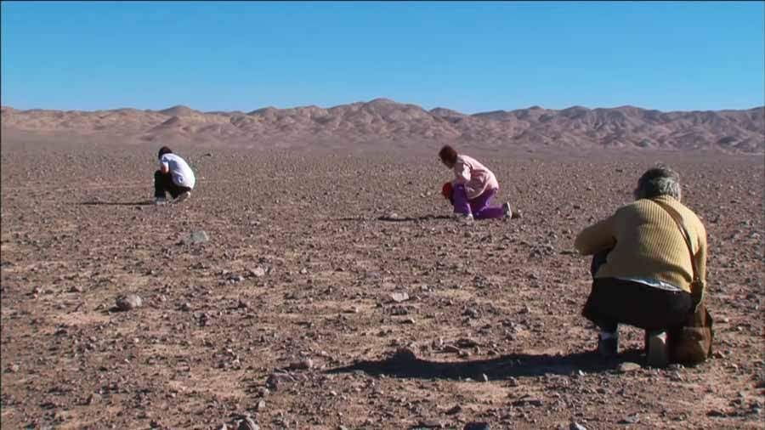
Memory and the (re)Making of Chile
Women searching pieces of bones in the Atacama Desert. Source: Nostalgia from the Light, Patricio Guzmán, 2010.
Notes:
The Atacama desert, where the new observatory is planned to be built, holds multiple layers of histories and memories. It holds the bones of dinosaurs and pregistoric wahles. It Holds the knowledge of indigenous communities as I have discussed, the memories of mining communities that migrated after processes of deindustrialization, and It holds as well, the memory of the disappeared, the traces of the bodies of political prisoners that the military repression hid somewhere in the desert.
Here in this picture, we see the widows and daughters of the disappeared searching for the bones of their loved ones in the sands of the Atacama desert. The image is from the documentary Nostalgia for the Light from Patricio Guzman.

Slide 24
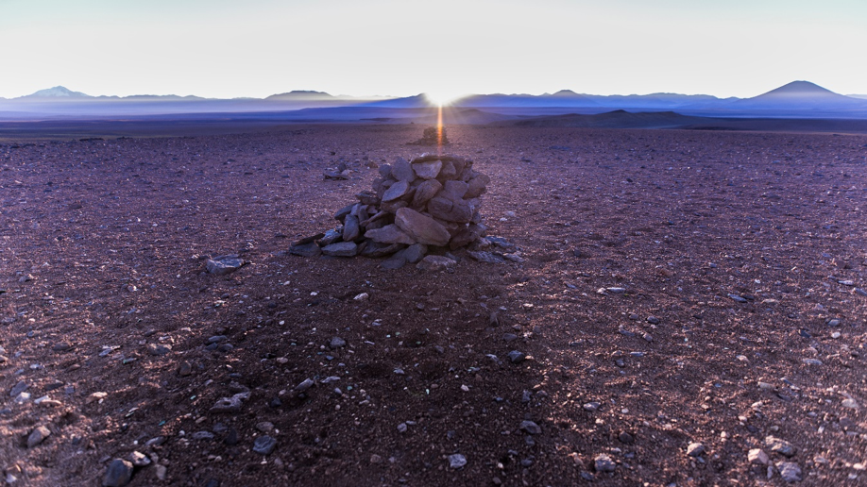
Memory and the (re)Making of Chile
Alignment of sunrise and Saywas (stone structures build by the Inca). Source: A. Silber - ALMA (ESO/NAOJ/NRAO)
Notes:
All these memories make up the context where you will work or are working and that are in a constant battle with forgetting, because ultimately forgetting is a tool of exlcusion and coloniality. It is part of the strategies of how Western knowledge is legitimized. But if forgetting is a tool to exclude, then what I’ve seen in my work is that memory is precisely a tool for communities to challenge those exclusions.

Slide 25
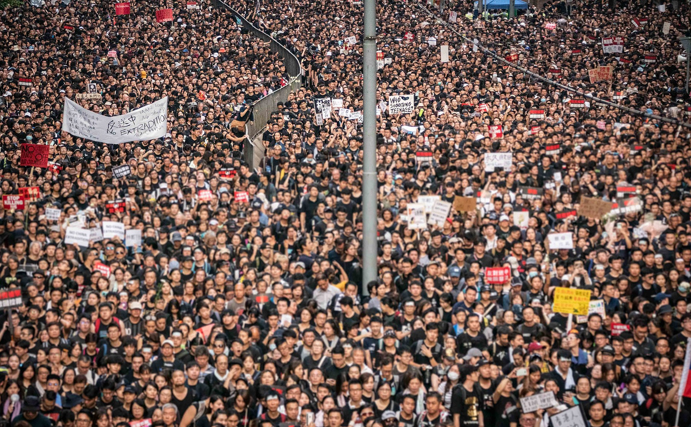
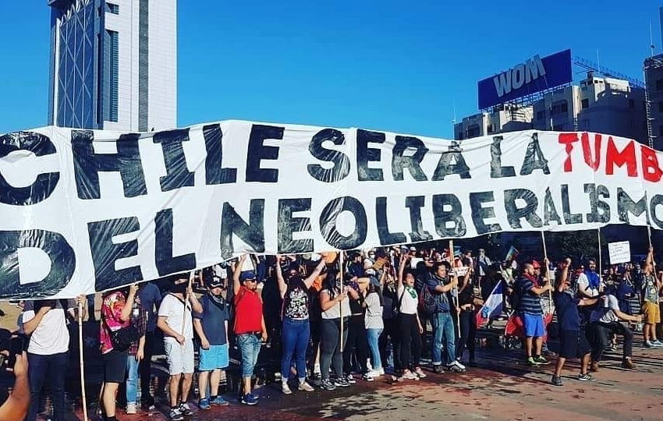
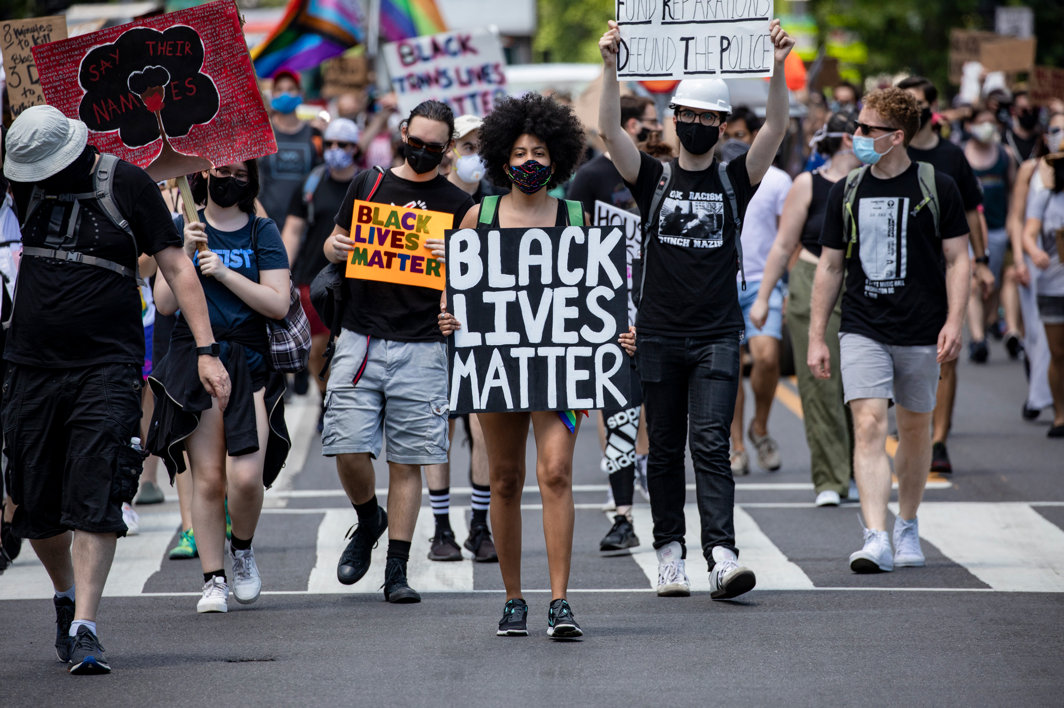
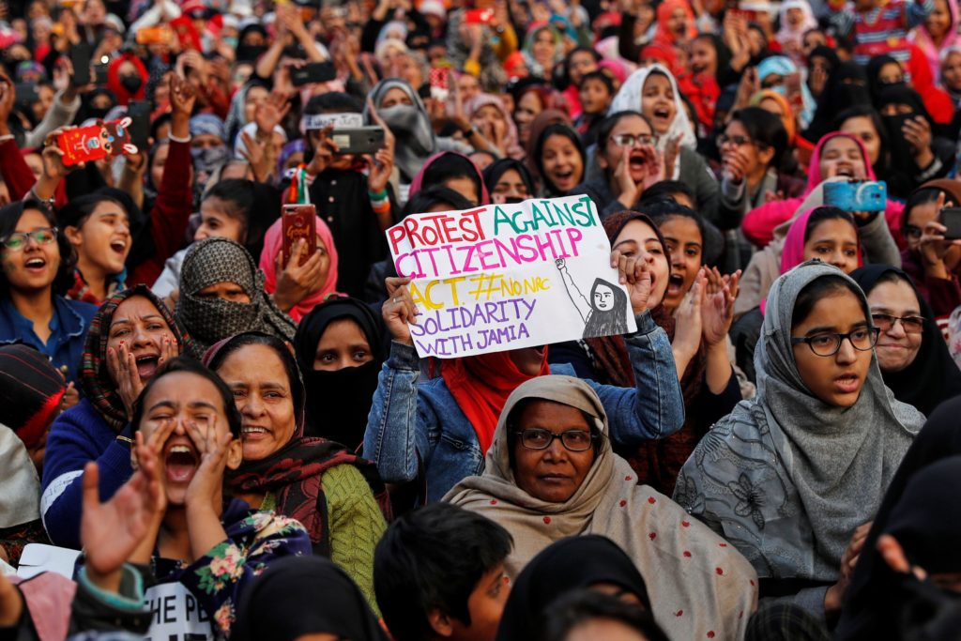
Memory and the (re)Making of Chile
Hong Kong, June 2019 Source: Wikipedia.org
Chile, October 2019 Source: Author
United States, June 2020 Source:CNN
India, December 2019 Source: PBS
Notes:
In recent years we have witnessed hundreds of thousands of people globally marching in the streets asking radical changes to systems of power that has failed them and has deepened inequalities in every corner of the world.

Slide 26
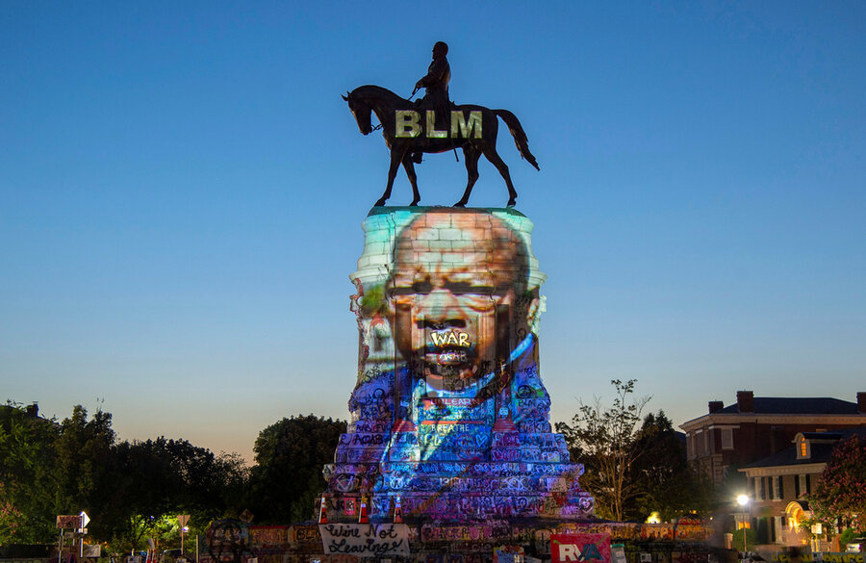
Memory and the (re)Making of Chile
An image of late Rep. John Lewis, Pioneer of the civil rights movement, is projected in the statue of the Confederate Robert E. Lewis in Richmond, Virginia, July 2020.
Notes:
We saw here in the United States the wave of protest following the murder of George Floyd, and the monuments struggle that followed that in my view, was really a struggle about memory. People around the world questioned the historical narratives and representations that fill our lived spaces, what memories are legitimized through the structures that are built in our landscapes?.

Slide 27
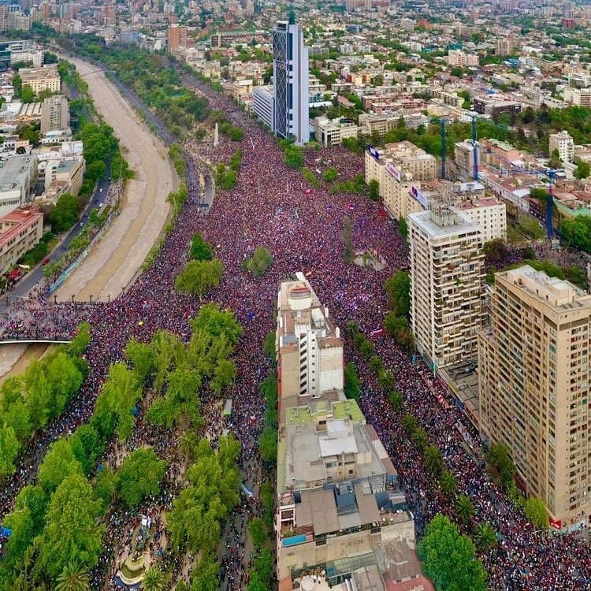
Memory and the (re)Making of Chile
”The Greatest March of Chile”. On Friday, 25 October, approx 1.5 million people marched in the streets of Santiago after the social uprising that started on 18 October 2019. Thousands of people also marched in cities across the country.
Photo by Samir Vivieros, AgenciaUno.
Notes:
In Chile in October 2019, a few months earlier than the Black Lives Movement in the US, erupted a wave of popular protests against inequality, radical neoliberal policies and poor public services. Basically, an extreme unequal system installed and inherited from the military dictatorship. Millions of Chileans filled the country’s streets and public squares to demand change of a system installed and inherited from the military dictatorship.

Slide 28
Memory and the (re)Making of Chile
Monument to Spanish colonizer Francisco De Aguirre was replaced by an indigenous diaguita women names Milanka in La Serena downtown, region of Coquimbo, northern Chile. Photo by Lautaro Carmona.
Notes:
This was also a claim to recover the memory of what had been forgotten : that is coexisting with each other, debating about what constitutes our past, occupying public spaces again, and beginning to recover our social fabric.

Slide 29
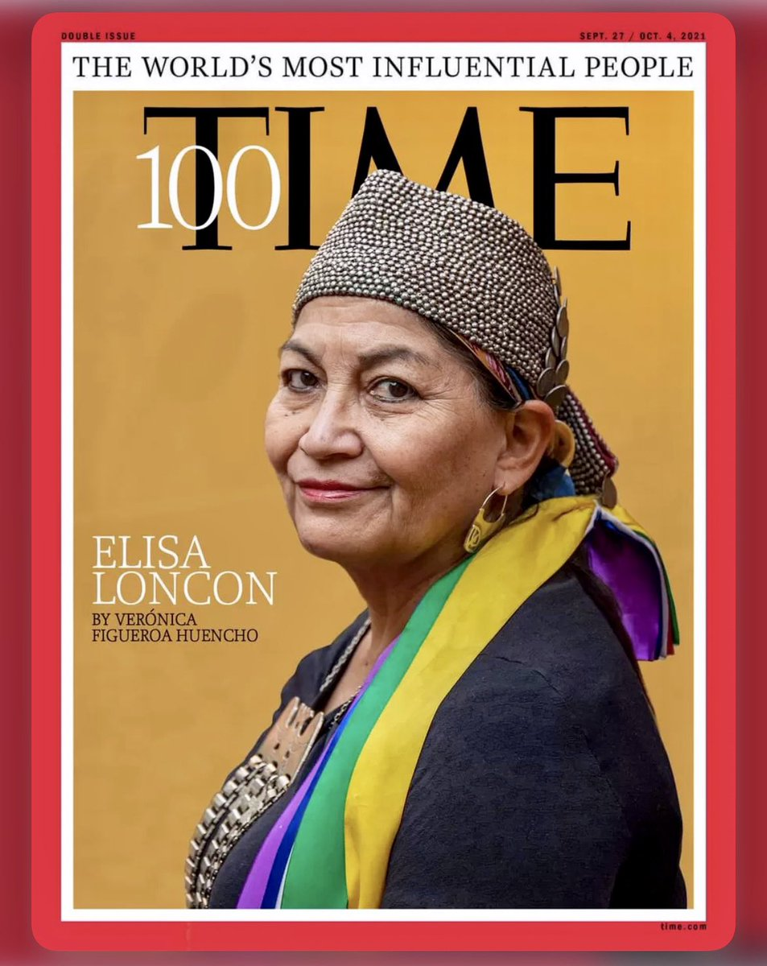
Memory and the (re)Making of Chile
Notes:
The protests resulted in important political, cultural and social changes. A year later, Chileans voted in favor of drafting a new constitution that will hopefully replace the 1980 constitution of the Pinochet dictatorship.
The constitutional process was co-chaired by Elisa Loncon, an indigenous Mapuche woman that we see in this picture, putting in the center for first time in history Indigenous people and their struggles in the making of our social contract. In a couple of weeks we will vote to approve or reject the draft of the new constitution.
So this is the current moment and the context in which new observatories will be built in Chile. What can we learn from these processes? How do we ensure that we individually and collectively are attuned to these local transformations and converge in the struggle for social and cultural justice?
How can we support the struggles of the communities where we are working to recover and preserve their knowledges and to live lives in dignity and in connection with their lands?

Slide 30
DIVERSITY, EQUITY & INCLUSION pOLITICS OF DILUTION OR DISRUPTION?
Notes:
Often the response in academic environments to these conflicts have been to develop Diversity, Equity and Inclusion Policies and values declaration.

Slide 31
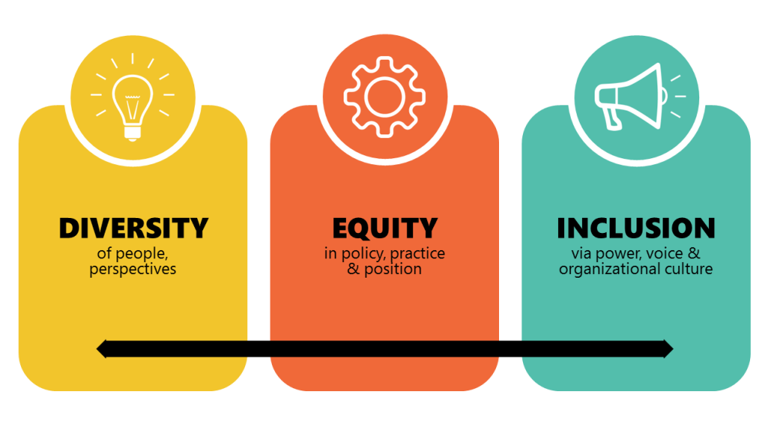
Dei: Politics of dilution or disruption?
Source: University of Florida
Notes:
This is certainly a big important first step, at least in recognizing the historical wrong doings of our disciplines and in thinking how we can do better. But we still need to do better and ask ourselves are these initiatives really aimed at renegotiating power relations in knowledge production and advance social justice, not only within our disciplines but in the places where we work and built infrastructure? Are we willing to go beyond the politics of outreach to advance politics of collaboration?

Slide 32
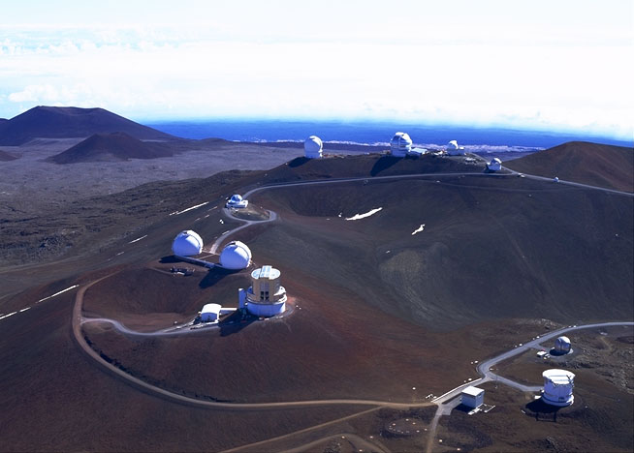
Dei: Politics of dilution or disruption?
Telescopes at Mauna Kea, Hawaii. Source: University of Hawaii
Notes:
After all it is not our land where we are settling in with our projects, we are operating in someone else’s ancestral land, often stolen lands. Therefore, are outreach and education programs enough? Or are these policies contributing to dissipate and conceal some of the problematic foundations of our disciplines and our present responsibility?

Slide 33
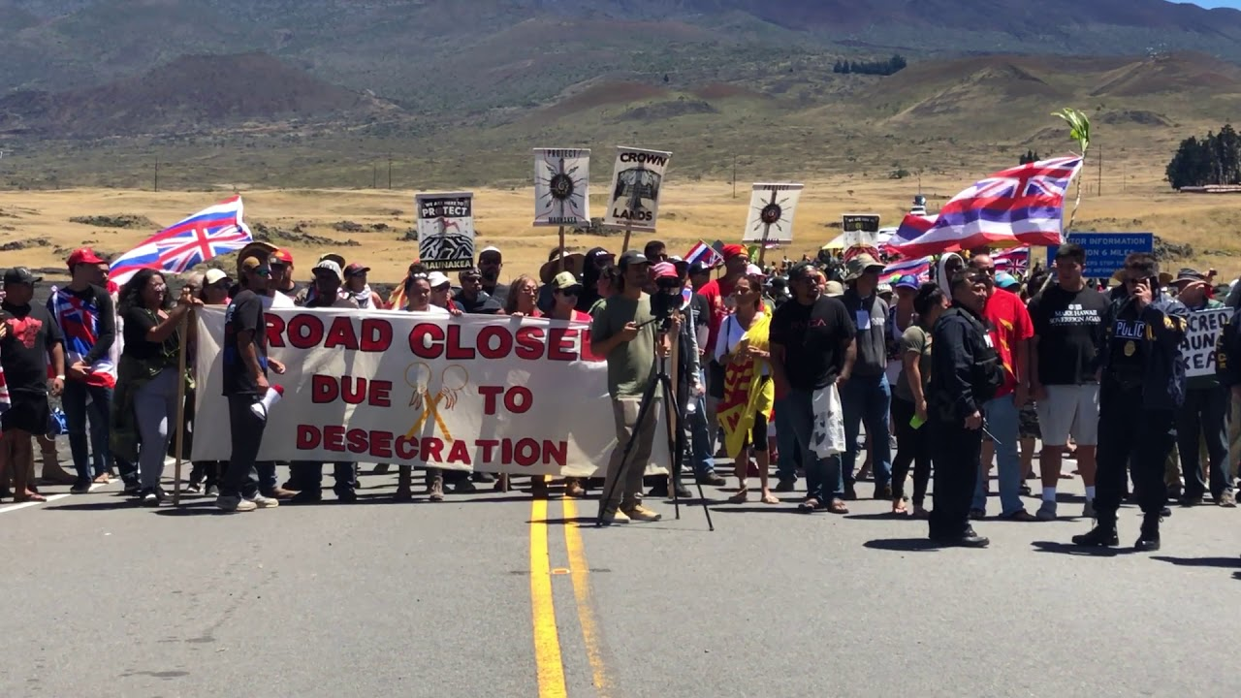
Colonialisms is not about the past
Dei: Politics of dilution or disruption?
Protesters blocking a road the road to the summit of Mauna Kea when construction of the Thirty Meter Telescope was due to begin, July, 2019. Source: CNN
Notes:
We have to ask ourselves for example, how DEI policies and values would have prevented what is happening in Mauna Kea Hawaii?
As I said before, while colonization was supposed to be a matter of the past, more and more movements, including Indigenous movements, women movements, intellectuals, artists, and activists are identifying the presence of coloniality everywhere.
Because even amidst various crisis, the world is still going through the globalization and solidification of a civilization and its knowledge system that has coloniality as its basis
This is reflected in contemporary “development” policies, nation-state building practices, widespread forms of policing, the increasing concentration of resources in the hands of a few, the expression of hate and racial discrimination, various forms of extractivism including the ways that we extract knowledge in Western science, and liberal initiatives of inclusion and diversity.

Slide 34
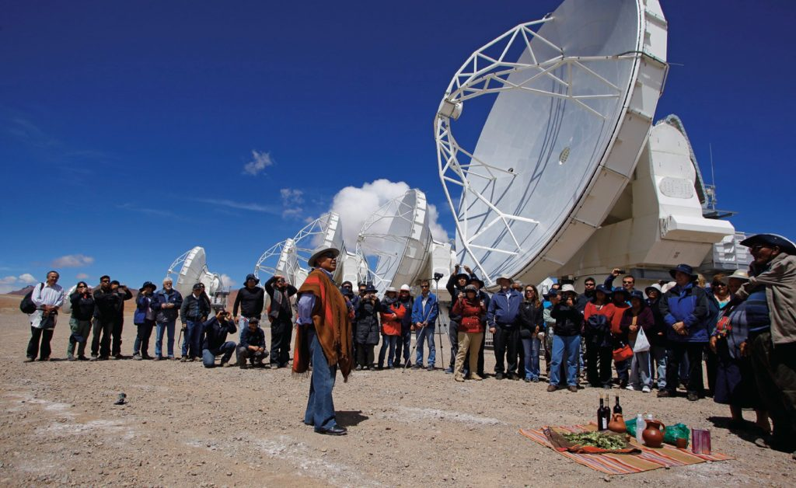
Dei: Politics of dilution or disruption?
Likan Antai people performing a traditional ceremony for the construction of the ALMA telescope on Chajnantor. Source: ESO through astrobites.org , Kate Storey-Fisher.
Notes:
While DEI reflects a broad-spectrum concept that is supposed to influence policies and practices that foster representation and participation among diverse groups of peoples, it runs the risk of diluted impact, of never really dealing with power dynamics, of being all things to everyone and often staying in the realm of discourse but never translate into actions.
So we need to ask ourselves, are we committing today to DEI values of dilution or of disruption? I hope that the later.

Slide 35
Some resources:
Astronomical Observatories and Indigenous Communities in Chile. Kate Storey-Fisher, 2019, Astrobites.org
The universe of our elders. Etnoastronomy Atacameño project, 2013. Almaobservatory.org
Nostalgia for the light. Documentary by Patricio Guzmán, about the Atacama Desert and the disappeared, 2010.
Chile is updating its constitution for the 21st century. The US should follow its lead. David Adler, The Guardian, 28 July 2022.

Slide 36
¡gRACIAS!
Thank you!
Magdalena Novoa
Assistant Professor
Department of Urban and Regional Planning
University of Illinois Urbana Champaign

