Slide 1
Office of High Energy Physics (HEP)
Cosmic Frontier
CMB-S4 Collaboration Mtg
May 10, 2022
Kathy Turner
Experimental Research at the Cosmic Frontier
Office of High Energy Physics, Office of Science (SC)

Slide 2

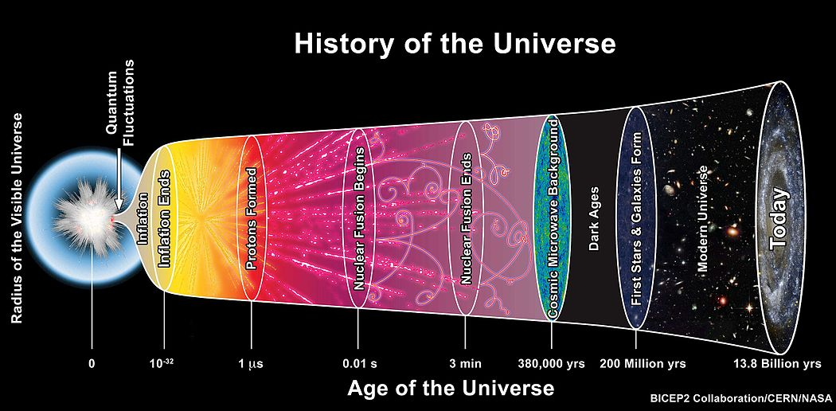
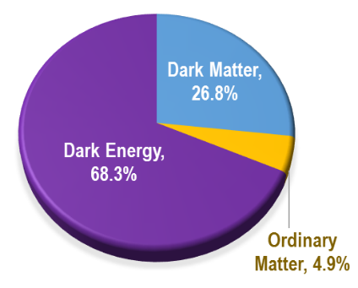
The Office of High Energy Physics (HEP) Program Mission
DOE is a mission-oriented agency → mission includes maintaining a vibrant U.S. effort in science and engineering as a cornerstone of our economic prosperity with clear leadership in strategic areas.
HEP’s mission is to understand the universe at the most fundamental level:
  Discover the elementary constituents of matter and energy
  Probe the interactions between them
  Explore the basic nature of space and time
➔Scientific Areas are intertwined: High Energy/Particle Physics, Cosmology, Astrophysics, and Astronomy.
DOE supports ~ 85% of the U.S. HEP effort (in $) at Universities + National Labs
Notes:
→HEP is primarily a Particle Accelerator based program; The Cosmic Frontier subprogram, using naturally occurring phenomena to study Cosmology and Astrophysics, is an increasingly important area for discovery.
➔Scientific Areas are intertwined: High Energy/Particle Physics, Cosmology, Astrophysics, and Astronomy.

Slide 3
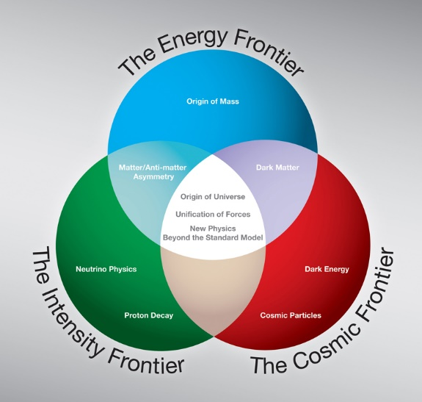
HEP Program Layout
HEP is carried out along 3 Frontiers: Advancements at all 3 frontiers are needed to achieve the long-term goals of the field.
→HEP is primarily a Particle Accelerator based program: Energy & Intensity Frontiers
→Cosmic Frontier is an increasingly important area for discovery. Experiments use naturally occurring data to provide additional input to the Standard Model picture: Cosmic Acceleration (Dark Energy, Inflation), search for Dark Matter particles, Neutrino properties, New Physics (e.g. relic particles, etc)
Crosscutting HEP subprograms:
Theoretical research, High Performance Computing & Computational HEP, Advanced Detector R&D, Quantum Information Science (QIS).

Slide 4
HEP Program Guidance
FACA panels & subpanels provide official advice:
High Energy Physics Advisory Panel (HEPAP)
Advises DOE & NSF: Provides the primary advice for the HEP program
Subpanels: The Particle Physics Project Prioritization Panel (“P5”) provides the Strategic Plan for HEP
Astronomy and Astrophysics Advisory Committee (AAAC)
Advises DOE, NASA, & NSF on issues of overlap, mutual interest and concern
Subpanels: CMB-S4 Concept Definition Taskforce (2017), Gemini-Blanco-SOAR Telescopes roles (2019)
Advice Also Provided by: National Academy of Sciences (NAS)
  Decadal Surveys in Astronomy & Astrophysics (Astro2020)
  Decadal Survey of Elementary Particle Physics being planned
  Board on Physics & Astronomy (BPA), Committee on Astronomy & Astrophysics (CAA)
Other Input & Coordination
Community studies & input, e.g. Snowmass, APS/DPF
  Basic Research Needs (BRN) studies to start development of new HEP initiatives

Slide 5
Astro2020 – Pathways to Discovery in Astronomy and Astrophysics for the 2020s
National Academies Decadal Survey of Astronomy and Astrophysics released Nov. 4, 2021. Charged & supported by DOE, NSF and NASA
➔DOE appreciates all the hard work the community and the National Academies have done in carrying out the study and providing the report.
Astro2020 recommended:
DOE/NSF partnership on CMB-S4
Efforts on diversity, equity, inclusion, demographics, data, etc. (joint with NSF & NASA)
We have started internal discussions on the recommendations; will engage with NASA and NSF regarding joint recommendations

Slide 6
Cosmic Frontier Experimental Research Program
Cosmic Frontier researchers use naturally occurring cosmic particles and phenomena to reveal the nature of dark energy and dark matter, comprising ~95% of the universe, understand the cosmic acceleration caused by dark energy and inflation, infer neutrino properties, and explore the unknown.
→Carrying out program with specific projects recommended by P5:
Cosmic Acceleration:
Study the nature of Dark Energy using imaging & spectroscopic surveys
Use the CMB to study the Inflation
Dark Matter
Direct Detection searches for Dark Matter particles using a variety of methods and technologies
Neutrinos
Constrain properties using dark energy & CMB measurements
Always interested in Exploring the Unknown and New Physics!
2

Slide 7
Cosmic Frontier – Program Planning & Execution
  Astro2010 recommended DOE/NSF partnership on LSST (Rubin)
  P5 (2014) recommended Cosmic Frontier science & project priorities in Dark Energy, Dark Matter (direct detection) & CMB
  Dark Energy: build LSST (Rubin) & DESI
  Dark Matter: suite of “generation 2” direct detection experiments – ADMX-G2, LZ, SuperCDMS SNOLAB
  CMB: support as part of the core program within multi-agency context; carry out multi-agency CMB-S4 project later in the decade
  Maintain a portfolio of small projects: e.g. we are carrying out ADMX-G2, SPT-3G, Dark Matter New Initiatives
  Notes:
  Most Experiments are done in partnership with NSF-PHY, NSF-AST, NSF-OPP, NASA, and/or International agencies/institutions.
Significant contributions & support from other HEP areas, e.g. Theory, Advanced Detector Development, Computational HEP, QIS, AI/ML
Contributions from other SC areas → ASCR Supercomputing resources
2
Notes:
Dark Matter - Also indirect searches using cosmic-ray & gamma-ray data

Slide 8
Cosmic Frontier – Cosmic Acceleration
Cosmic Acceleration:
Imaging & Spectroscopic surveys to determine the nature of Dark Energy
  Stage 3
    extended Baryon Oscillation Spectroscopic Survey (eBOSS), Dark Energy Survey (DES)
  Stage 4
  Dark Energy Spectroscopic Instrument (DESI)
  Vera C. Rubin Observatory, w/DOE’s LSST Camera MIE project, Rubin Facility Operations, & the Dark Energy Science Collaboration (DESC)
Study the Inflationary era using its imprint on the cosmic microwave background (CMB) at energies near the Planck scale (with NSF)
  South Pole Telescope 3rd Generation (SPT-3G)
  CMB-stage 4 (CMB-S4)
2
Notes:
Dark Matter - Also indirect searches using cosmic-ray & gamma-ray data

Slide 9
Astro2020 Science Theme:
New Messengers and New Physics
Scientific questions associated with inquiries ranging from astronomical constraints on the nature of dark matter and dark energy, to the new astrophysics enabled by combined observations with particles, neutrinos, gravitational waves, and light.
The needed capabilities include:
• Facilities to discover and characterize the brightness and spectra of transient sources as they appear and fade away
• Ground-based ELTs to see light coincident with mergers
• A next-generation radio observatory to detect the relativistic jets produced by neutron stars & black holes
• Next generation CMB telescopes to search for the polarization produced by gravitational waves in the infant universe
• Upgrades to current ground-based gravitational wave detectors, and development of next generation technologies
• Improvements in the sensitivity and angular resolution of high energy neutrino observatories
Astro2020 recommended DOE/NSF partnership on CMB-S4 (p. 7-26)
  NSF & DOE should jointly pursue the design & implementation of the next generation ground-based cosmic microwave background experiment.
HEP is having internal discussions & will talk with NSF at the appropriate time.
Notes:
Comments on the DOE Budget (p. 7-41)
The CMB-S4 observatory is the only new facility where the project assumed a formal commitment of funding from the DOE. Adopting the total cost estimate from the TRACE analysis, the 60 percent DOE share for construction results in a total commitment of $408 million. The operations costs are also assumed at 60 percent for DOE and 40 percent for NSF.

Slide 10
Astro2020 Report: Realizing the Opportunities
CMB-S4 builds on the foundation of decades of CMB measurements to take a major leap, pushing CMB science to the next level, with scientific goals:
B-mode CMB polarization signatures of primordial gravitational waves and inflation
Maps 50% sky, every other day from 0.1-1 cm with unprecedented sensitivity
Broad science including systematic time domain science
Key Attributes
Balanced program between DOE (60%) and NSF (40%) for all phases
Brings wide range of technical & scientific expertise from community & national labs
Total design, development and construction cost: $660M
First observations could begin by 2030
"An important requirement for our strong endorsement is that the project broadly engage astronomers beyond the traditional CMB community. CMB-S4 will produce data sets of unprecedented sensitivity, cadence and spectral coverage that will advance general astrophysics and open discovery space opportunities for diverse scientific communities. Previous CMB experiments have not had the charge or funding to make data rapidly available and generally usable.”
“Because of its great potential to advance general astrophysics and open discovery space, it is essential that CMB-S4 produce transient alerts, as well as calibrated maps in all bands and on all angular scales that are openly usable and accessible on as rapid a cadence as practical”
Notes:
Comments on the DOE Budget (p. 7-41)
The CMB-S4 observatory is the only new facility where the project assumed a formal commitment of funding from the DOE. Adopting the total cost estimate from the TRACE analysis, the 60 percent DOE share for construction results in a total commitment of $408 million. The operations costs are also assumed at 60 percent for DOE and 40 percent for NSF.

Slide 11
CMB-S4 Planning & Status
2014 HEPAP/P5 strategic plan recommended CMB-S4 as a joint DOE/NSF project
2016-2017 AAAC subpanel: CMB-S4 Concept Definition Taskforce study
2019 – DOE approved CD-0; HEP Cosmic Frontier’s next Flagship Project
2020 – LBNL chosen as DOE’s lead lab
FY2021 - Congress approved as an MIE “project start”
Goal: cross critical science thresholds, including definitive tests of Inflation
Science | Stage 2 | Stage 3 | Stage 4 | Top Level goal for CMB-S4
Inflation “r” | ≤0.1 | ≤0.01 | ≤0.001 | Detect/rule out classes of inflationary models
s(Neff) | 0.14 | 0.06 | 0.03 | Detect/rule out light relic particles w/ spin
s(Mn) | 0.15eV | 0.06eV | 0.02eV | 3s detection
# detectors | ~1000 | ~10,000 | ~500,000 | Deployed on multiple telescopes
Sensitivity (mK⁻²) | 10⁵ | 10⁸ | 10⁸ | 2° to 1’ angular scales
In planning phase as a joint DOE & NSF project:
21 telescopes, in 2 aperture scales, at 2 sites:
2 large aperture (6m) in Chile
  Deep & wide N_{eff} & Legacy Survey ~60% of sky
1 large (5m), 18 small (0.5m) at South Pole
  Ultra-deep survey ≥ 3% of sky + delensing
Total 500,000 cryogenic sensors, superconducting readout; scale up of over x10 from all stage 3.
Collaboration > 300 members!
Notes:
Reviews:
May 2021 – NSF status review
CMB: Gain insight into inflationary epoch at the beginning of the universe, dark energy & neutrino properties by studying oldest visible light
CMB-S4:
Recommended by P5 in all scenarios
HEP/Cosmic Frontier next flagship project
Goal: cross critical science thresholds, including definitive tests of Inflation

Slide 12
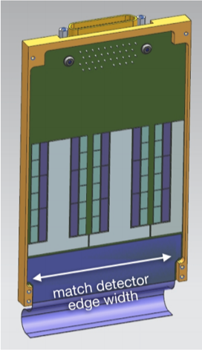
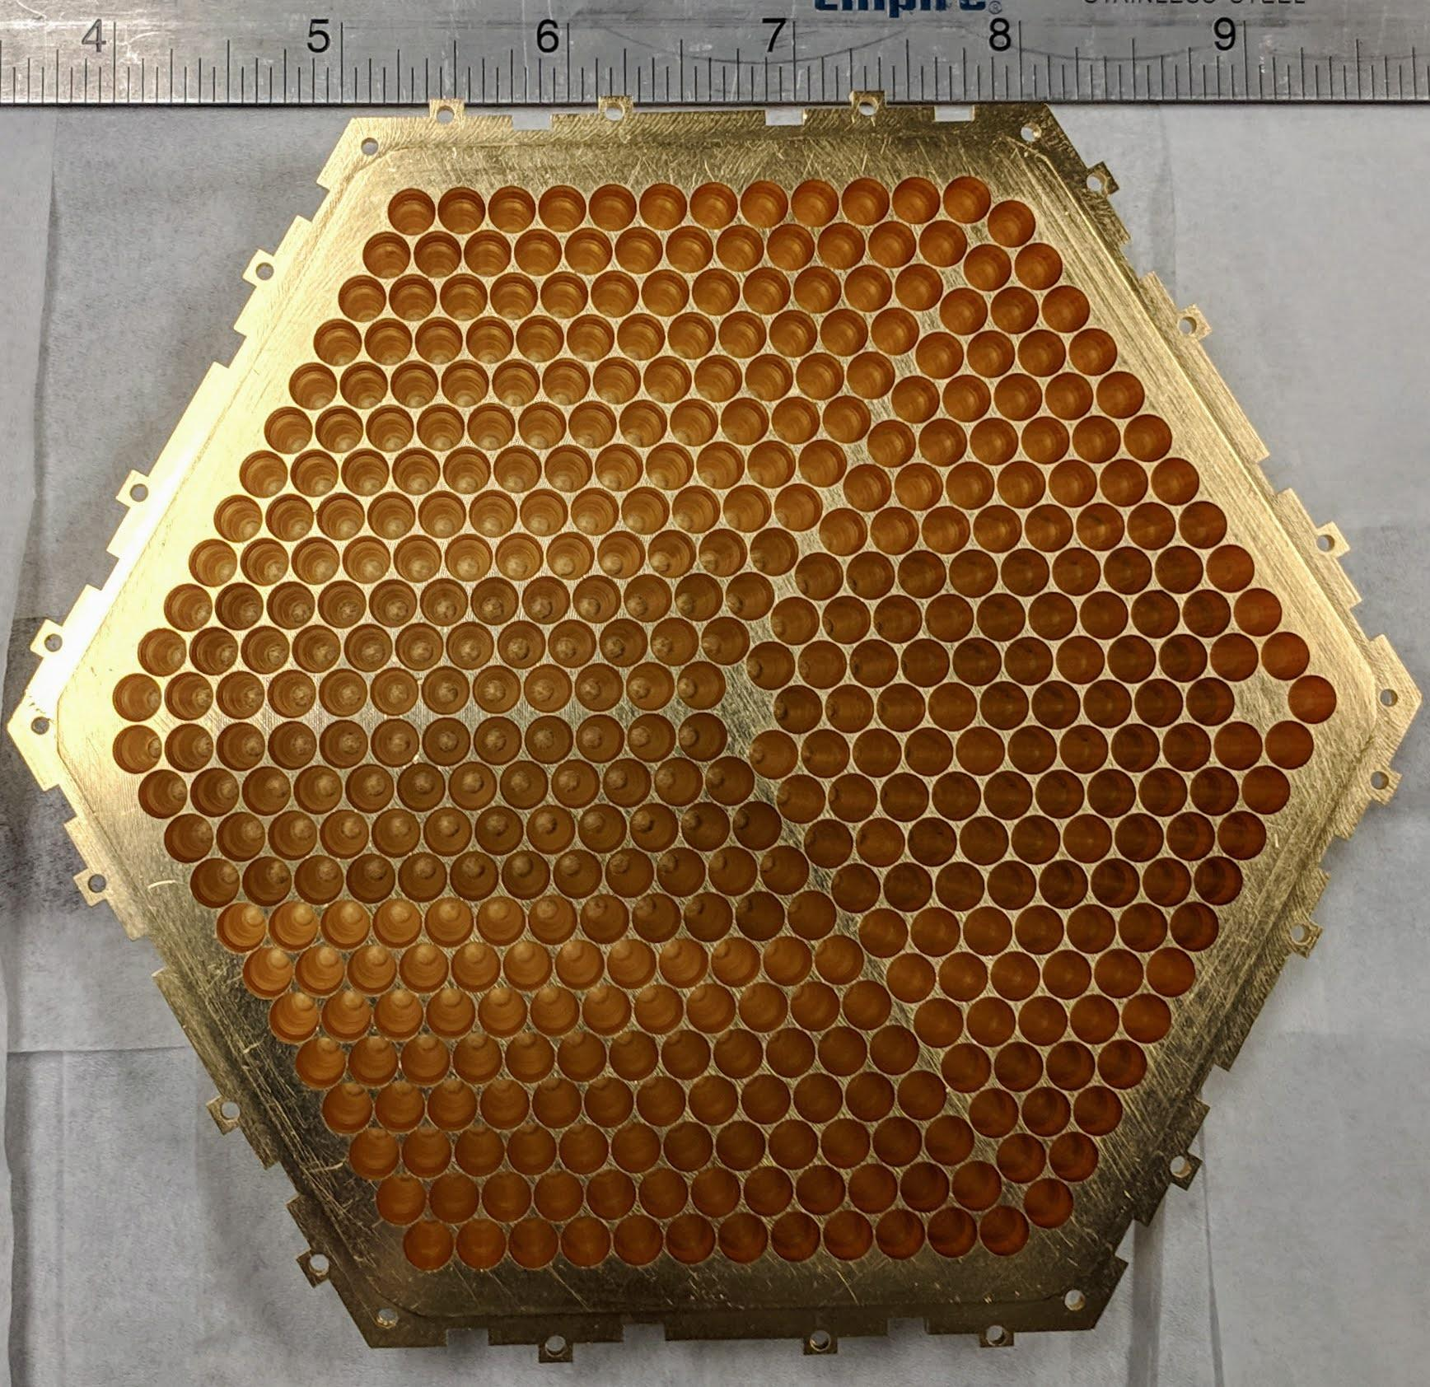
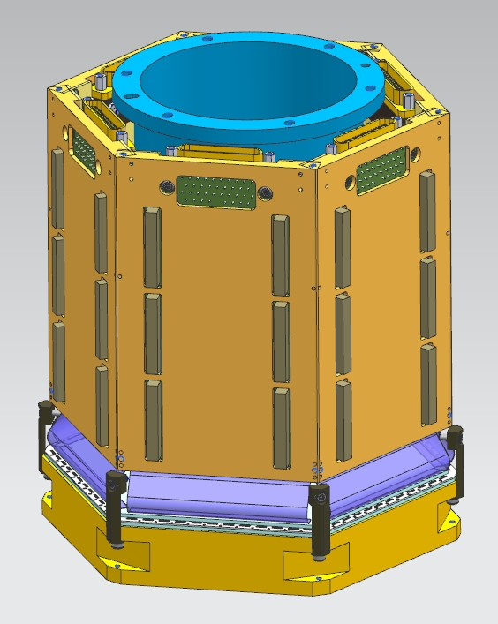
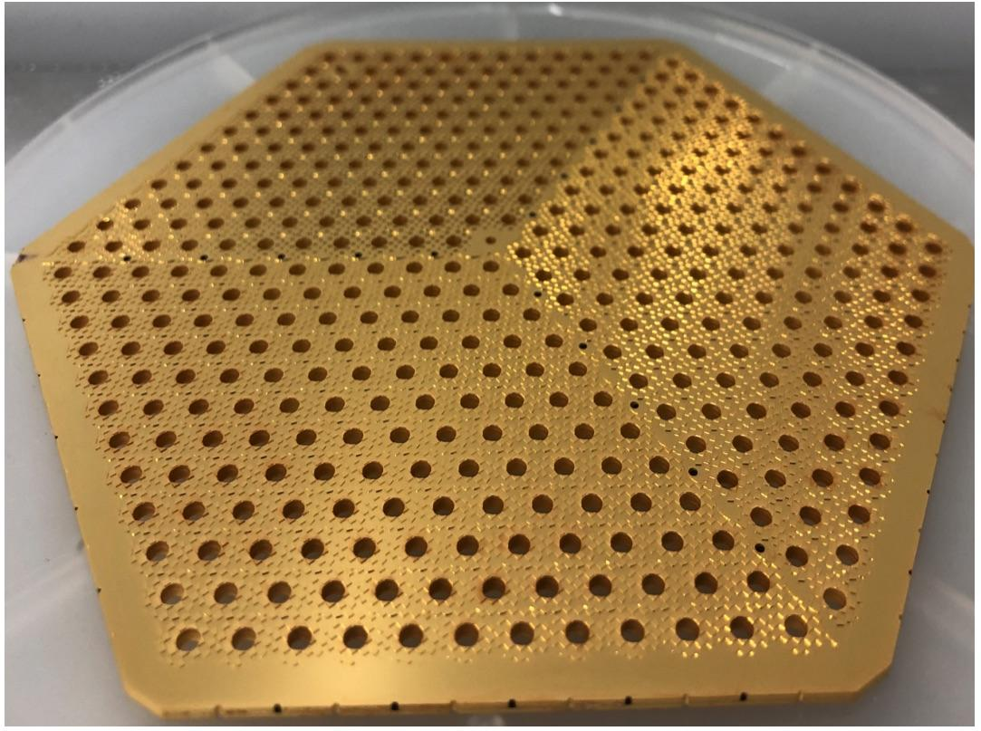
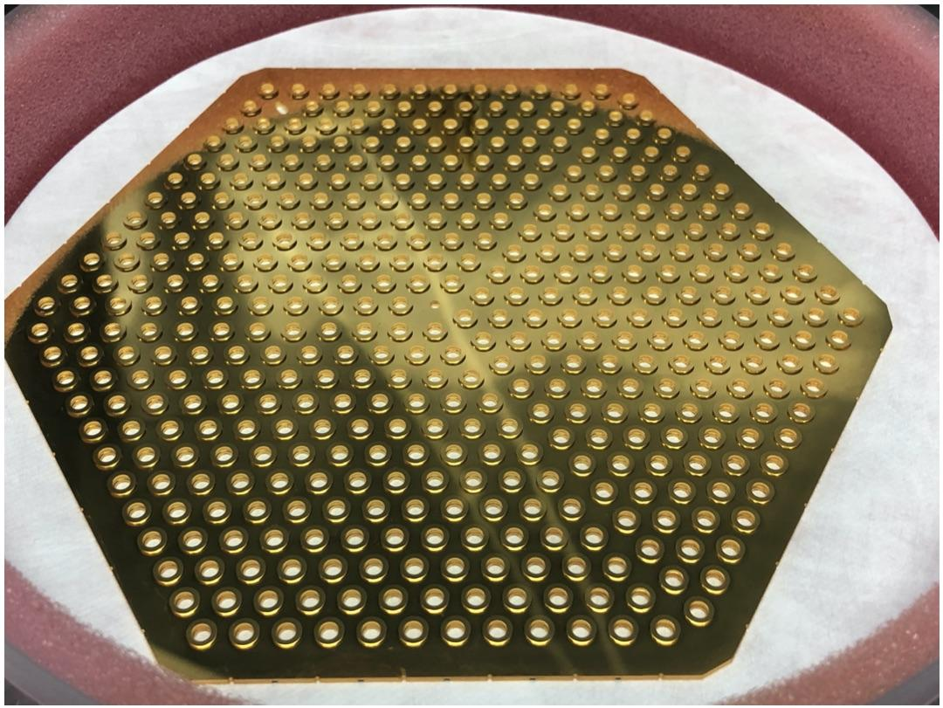
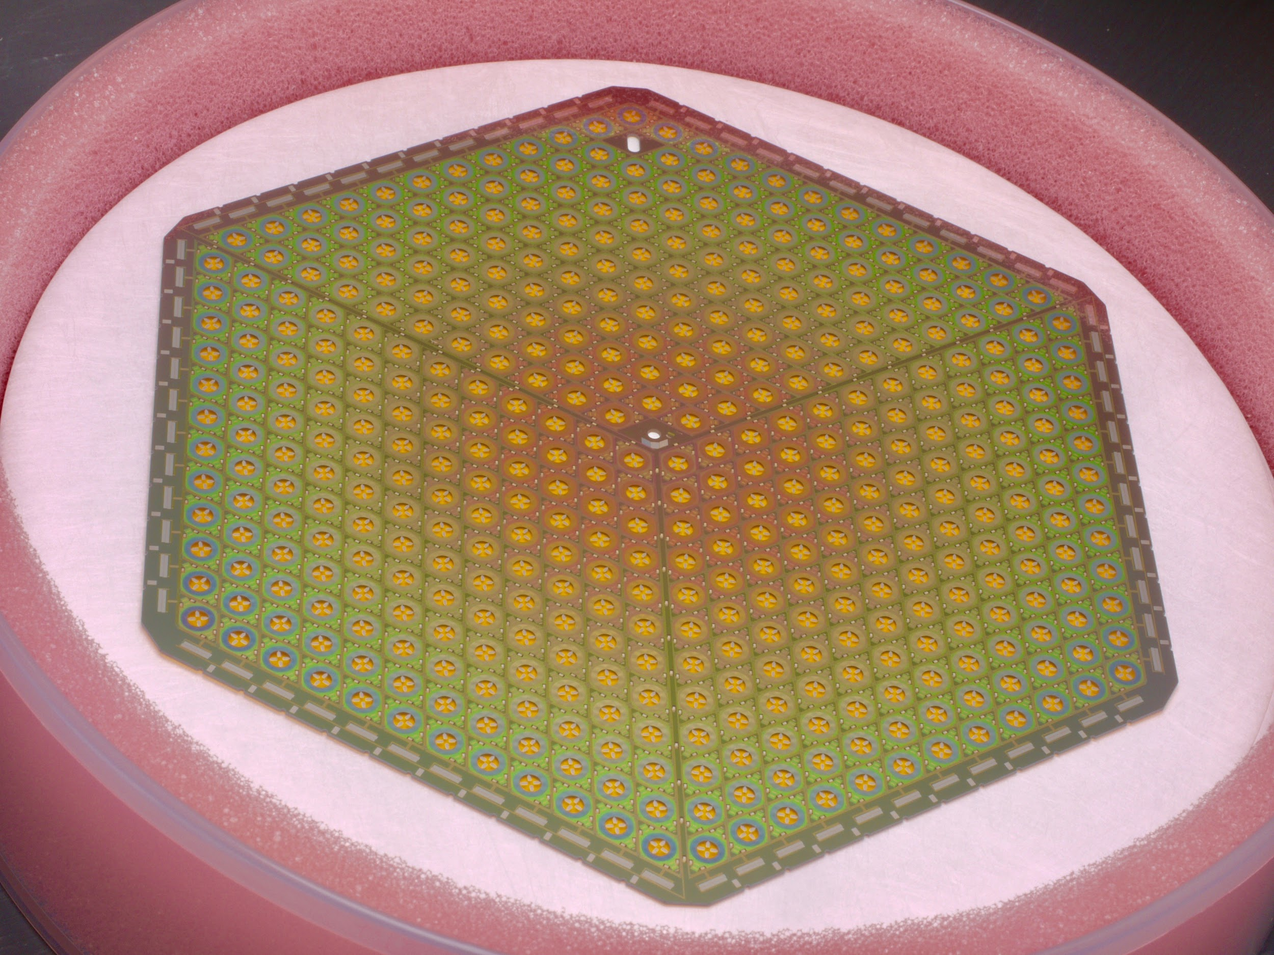
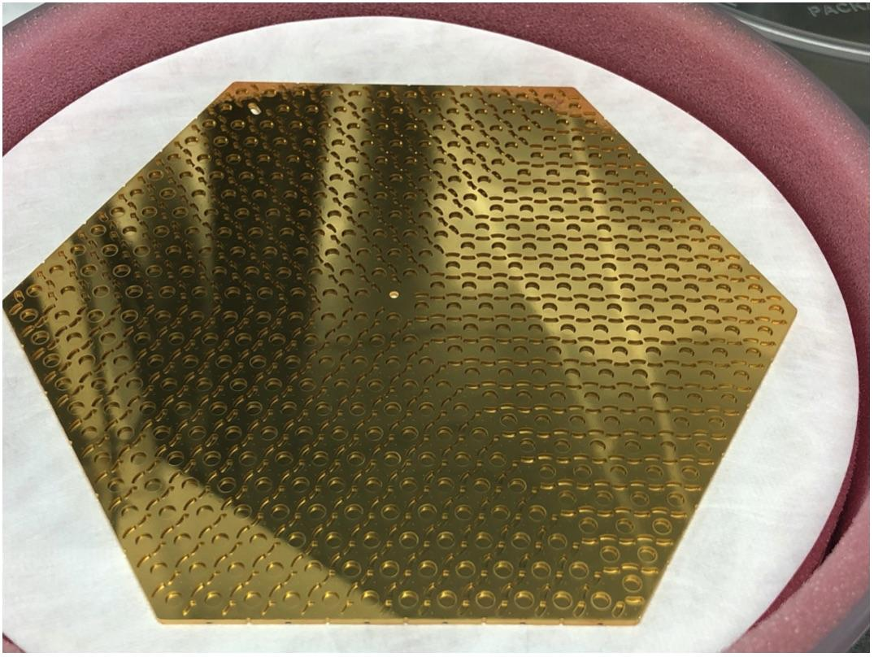
CMB-S4 Planning & Status
Short-term funding gap is limiting progress, particularly for Detectors, Readout, and Modules which require continued R&D before production can start
Strong recommendation from Astro2020 for DOE and NSF to partner in CMB-S4 development.
Status and plans updated and presented at the Director’s Review November 2021; DOE Office of Project Assessment status review in February 2022
Module Assembly
Readout module
Horn Array
Interface
Wafers
Caption goes here
Detector wafer

Slide 13
DOE’s SC and HEP – DEI efforts
The DOE Office of Science (SC) is fully committed to fostering safe, diverse, equitable, and inclusive work, research, and funding environments that value mutual respect and personal integrity.
https://www.energy.gov/science/diversity-equity-inclusion
DOE SC-wide effort to implement DEI 2019 Report Recommendations. See report to Nov. 2021 HEPAP by Dr. Julie Carruthers, head of DOE SC Office of Diversity, Inclusion & Research Integrity.
https://science.osti.gov/-/media/hep/hepap/pdf/202111/SC_DEI_Initiatives-Carruthers_HEPAP_202111.pdf
SC has added language to its Funding Opportunity Announcement’s (FOA) to remind the community of prohibition of harassment & discrimination by awardees and recipient institutions.
SC now includes diversity-promoting program policy factors in all of its FOA’s which allow the selection official to make award decisions based on other factors when all other things such as merit are considered equal, including e.g. promoting diversity of PI’s, institutions, etc.
Notes:
Minority Serving Institutions
Under Represented Groups

Slide 14
DOE’s SC and HEP – Funding Opportunities
https://science.osti.gov/Funding-Opportunities
HEP Research Opportunities FOA (our primary research FOA) for Six HEP research subprograms
  Energy, Intensity, and Cosmic Frontiers
  HEP Theory, Accelerator R&D, and Detector R&D
Letter of Intent (strongly encouraged) due ~ August
Final Proposal deadline ~ October
Review and Selection processes: Winter/Spring
Please read the FOA carefully and comply with all requirements! There is an associated FAQ.
See https://science.osti.gov/hep/Funding-Opportunities FOA # 2546
FY2022 added an appendix on the PI’s Recruitment and Mentoring Plan:
  Included in research efforts is training of junior scientists (students & postdocs) to enable them successfully complete their research and move to next career step.
  Further, we want to broaden and diversify the HEP research community and increase opportunities for everyone to contribute.
  A new merit criterion was added for proposal evaluation:
  Quality and Efficacy of Recruitment and Mentoring Plan
Notes:
Minority Serving Institutions
Under Represented Groups

Slide 15
DOE’s SC and HEP – Funding Opportunities
https://science.osti.gov/Funding-Opportunities
Data Management Plan (DMP)
All Research proposals submitted to DOE SC must have a DMP
Data management involves all stages of the digital data life cycle: capture, analysis, sharing, and preservation. The SC Digital Data Management Statement focuses on sharing and preserving digital research data.
SC Early Career Program (PI’s within 10 yrs of PhD and awards are for 5 years) continues to promote diversity of PI’s and Institutions. Program supports over 80 PI’s/year.
The recently-closed 2022 (FOA) strengthened review criteria consideration of promotion of diversity of PI’s and Institutions.
Specific opportunities in:
US-Japan HEP
SciDAC in HEP
HEP has graduate student traineeships in Instrumentation, Accelerator R&D and Computational HEP, e.g. see
https://science.osti.gov/-/media/grants/pdf/foas/2021/SC_FOA_0002496.pdf
Notes:
Minority Serving Institutions
Under Represented Groups

Slide 16
DOE Funding Opportunities – WDTS & SC
Workforce Development (WDTS) programs: https://science.osti.gov/wdts
  Office of Science Graduate Student Research fellowships (SCSGR)
    Supports grad student research at a DOE lab, 3 to 12 months
    Two calls per year, usually Feb/Aug
    Applications typically due May/Nov for following Fall or Summer start
  Science Undergraduate Laboratory Internships (SULI)
    Supports undergraduate research at a DOE lab, 10 to 16 weeks
    Three calls per year, for following Spring/Summer/Fall terms
  Visiting Faculty Program
    Summer research support for faculty/students from historically underrepresented institutions
    One call per year, usually in Oct. Applications due in Jan.
    A FOA is in progress for SC-wide Reaching a New Energy Sciences Workforce (RENEW) program to support undergrad and graduate student fellowships targeted at MSI/URG
Office of Science programs:
  Early Career Research: https://science.osti.gov/early-career
  SC “Open Call” [DE-FOA-0002414] – new version posted annually
    HEP uses this primarily for conferences, supplements, experimental operations, and emergencies (e.g. equipment failure).
Available funds have been increasing!

Slide 17
HEP PI mtg, Code of Conduct, Reviews
HEP holds an annual PI meeting geared towards university PI’s, and specifically to help junior PI’s to navigate the program and have direct contact with DOE program managers.
Talks by HEP staff on overall program, budget, new initiatives, DEI, funding opportunities, and details of each area, e.g. Cosmic Frontier.
We encourage you to read over these talks and contact the relevant program manager regarding program details and opportunities.
For 2021 see https://www.orau.gov/heppi2021 -- go to agenda & linked talks
➔Most of the HEP Cosmic Frontier projects and collaborations have developed Codes-of-Conduct. This is a promising practice within the community
  ➔HEP specifically considers diversity when setting up review panels for proposals as well as projects, experimental operations and facilities.
Notes:
Minority Serving Institutions
Under Represented Groups

Slide 18
Strategic Planning Timeline
HEP community-wide “Snowmass” study process organized by the Division of Particles and Fields (DPF) of the American Physical Society (APS) has restarted (https://snowmass21.org/start)
  Paused due to the COVID; resumed full activities as of September 2021
  “Community Summer Study” will take place July 17–27, 2022 at UW-Seattle.
  Full Snowmass reports will be available by the end of October 2022
New National Academy of Sciences (NAS) Elementary Particle Physics (EPP) Decadal Survey will run concurrently with and complement the Snowmass process
Next P5 process to begin after Snowmass and NAS Decadal Survey, circa late 2022: P5 report by May 2023 will inform FY 2024 Congressional actions & FY 2025 U.S. budget formulation
Notes:
Astro2020 guidance: →Guidance will inform HEP on compelling, high impact opportunities that align with our science priorities and make use of critical, leadership roles for our community and capabilities; need to ensure adequate Research support, Experimental Operations, Computing resources, technology development, etc.
“Snowmass” process led by APS/DPF & DPB for High Energy/Particle Physics community
To identify science questions and directions for the coming decade.
Process started summer 2019; paused due to COVID to ensure broad engagement and the fullest possible participation of the HEP community. Restarted Sept. 2021; and culminates in a workshop in summer 2022.
DOE & NSF charged the National Academy of Science to carry out an Elementary Particle Physics (EPP) decadal survey; starting soon
Assess the current state of the field, identify the fundamental questions that motivate research and tools necessary to answer these questions in context of international landscape; consider cross-disciplinary aspects and societal benefits
The multi-year community-driven processes culminates in the HEPAP Particle Physics Project Prioritization Panel (P5) to lay out a strategic plan.
Input includes: Astro2020, European Strategy for Particle Physics, Japanese planning, “Snowmass” community workshops, NAS EPP, etc.

Slide 19
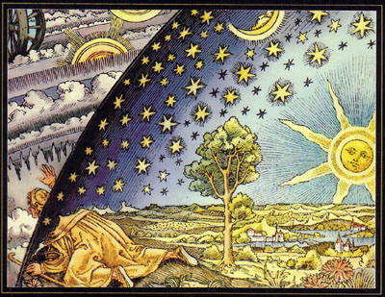
Summary
HEP continues to carry out the 2014 P5 strategic plan; Strong support from the scientific community and the Hill
→Cosmic Frontier continues to produce excellent, world-leading science results
DES completing data analyses
DESI has started it science survey operations (May 2021)
LSST Camera complete, Commissioning ongoing
Rubin Observatory Facility Ops planning to be ready for data in 2024.
DESC planning dark energy studies
CMB-S4 – LBNL selected as lead DOE lab; Approved as a fabrication project for DOE in the FY2021 budget; working towards planning for CD-1 and beyond. Recommendation by Astro2020
Future Planning – Astro2020, Snowmass → P5

Slide 20



