Slide 1
Conveners: Clarence Chang & Scott Dodelson

Slide 2
Snowmass leads into P5: Particle Physics Project Prioritization Process
The equivalent of the Decadal Survey (i.e., P5’s recommendations get translated into what gets funded and what does not) for all DOE High Energy Physics (LHC, LHC+, Fermilab, muons, theory, cosmic). So, there will be intense competition for funding.
P5 in 2014 wrote: “ Support CMB experiments as part of the core particle physics program. The multidisciplinary nature of the science warrants continued multiagency support.” (This was new for DOE.) However, CMB-S4 is at the earliest stages (in the DOE process) of any project recommended by P5 in 2014.
Very, very likely that the 2022-3 P5 will recommend CMB-S4 … but physics/cosmology has changed, and – in any event – it is important to articulate an updated science case for CMB-S4.

Slide 3
Snowmass21 organization: connecting science to reports
Snowmass summary & book
Snowmass Steering Group
Summaries
Frontier 1
Frontier 2
…
Frontier N
Frontier reports
Chapter
TG1
TG2
…
…
TGN
Topical Group reports
References
Science ideas
Contributed papers

Slide 4
Overall Snowmass Structure
Snowmass Frontiers
Energy Frontier
Neutrino Physics Frontier
Rare Processes and Precision
Cosmic Frontier
Theory Frontier
Accelerator Frontier
Instrumentation Frontier
Computational Frontier
Underground Facilities
Community Engagement Frontier
CF1. Dark Matter: Particle-like
CF2. Dark Matter: Wave-like
CF3. Dark Matter: Cosmic Probes
CF4. Dark Energy and Cosmic Acceleration: The Modern Universe
CF5. Dark Energy and Cosmic Acceleration: Cosmic Dawn and Before
CF6. Dark Energy and Cosmic Acceleration: Complementary Probes and New Facilities
CF7. Cosmic Probes of Fundamental Physics
Each Frontier has subgroups (7 on average)

Slide 5
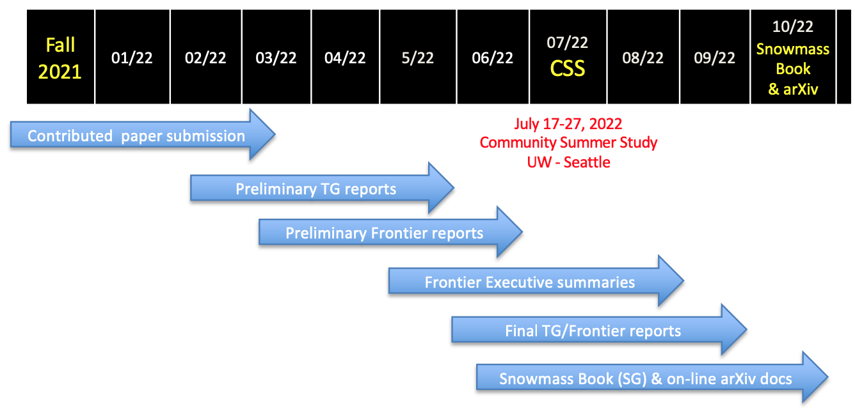
Snowmass21 Timeline
All of the Topical Groups are soliciting specific white papers from the community.
Other contributions are also accepted, but encouraged to contribute to solicited papers if possible.

Slide 6
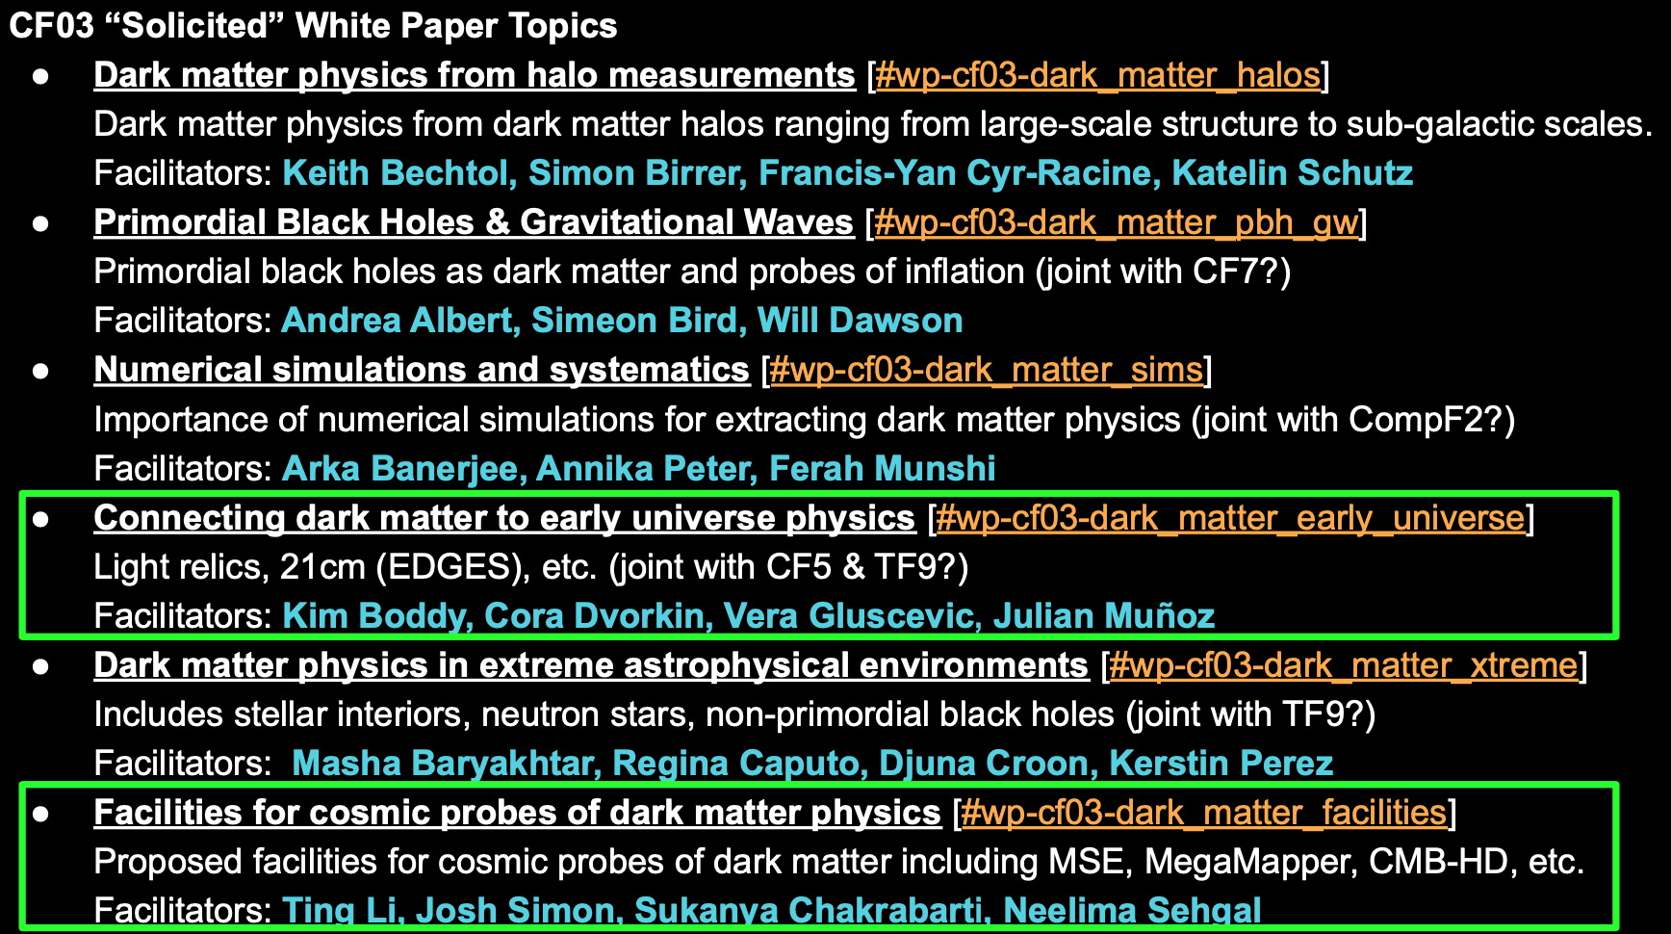
Cosmic probes of Dark Matter

Slide 7
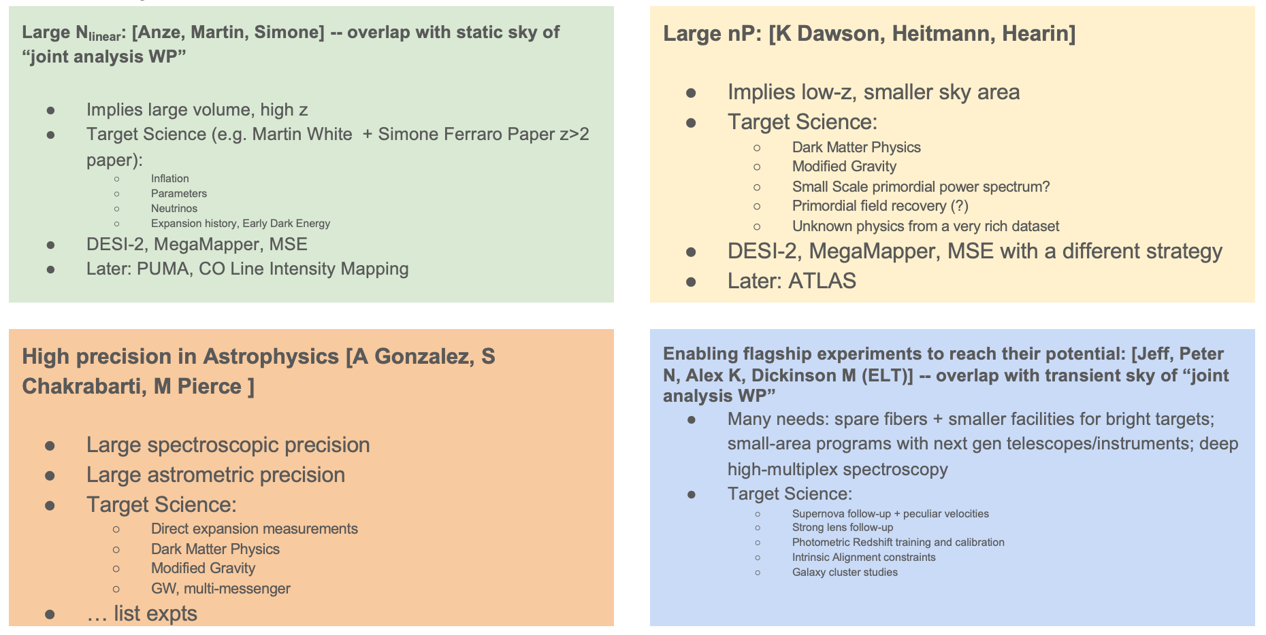
Late universe cosmic accel.

Slide 8
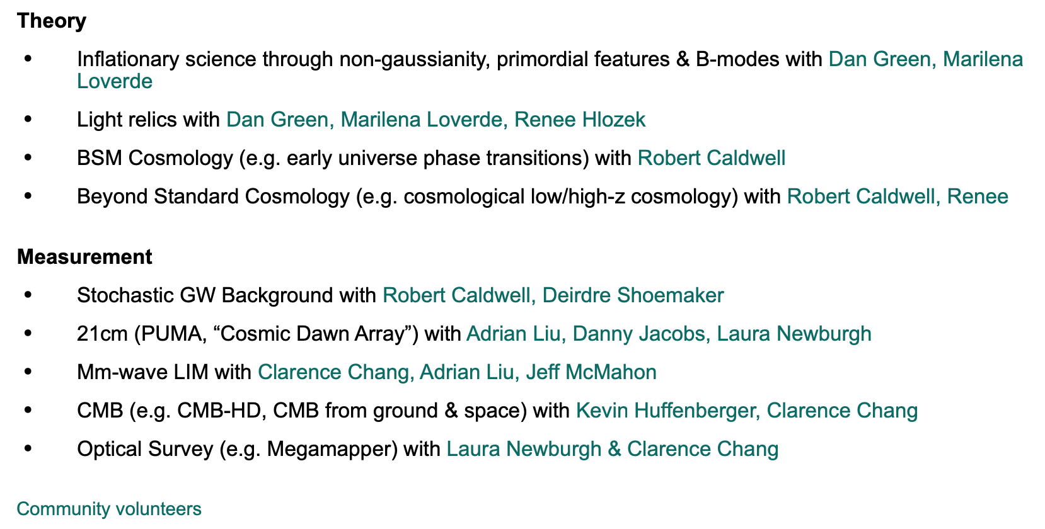
Early universe cosmic accel.

Slide 9
Dark Energy complementarity

Slide 10
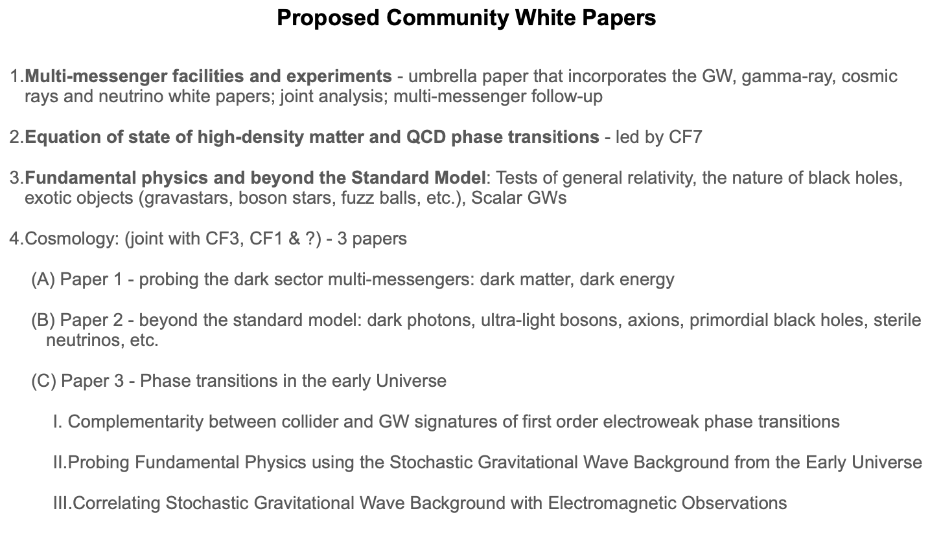
Cosmic Probes of Fund. Phys.

Slide 11
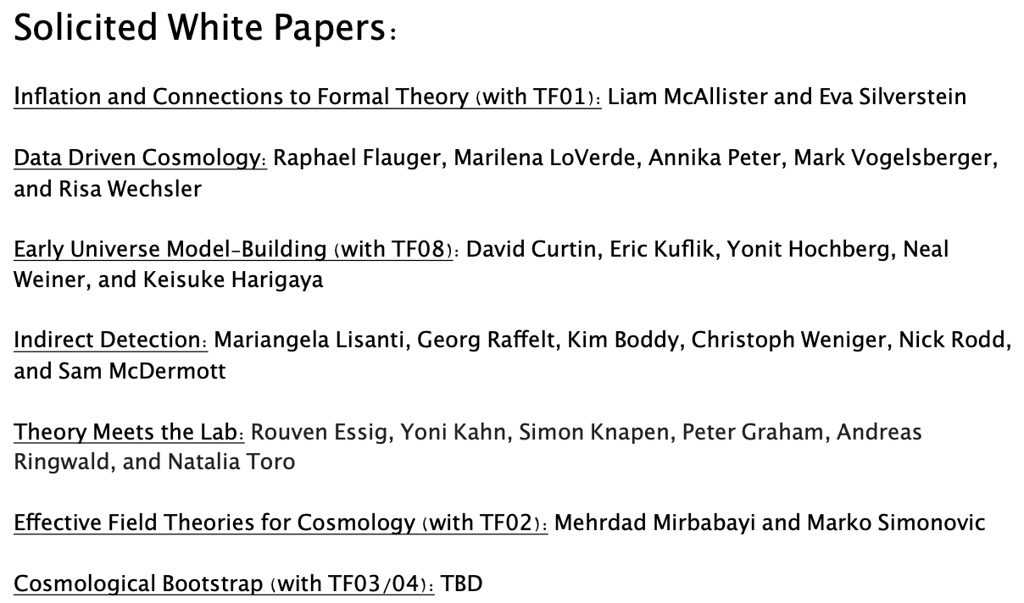
Astro. Part. Phys & Cosmo. Theory

Slide 12
Physics & cosmology have changed, and – in any event – it is important to articulate an updated science case for CMB-S4.
Context: There is now a Fiducial Model of cosmology (LCDM) as well as a Standard Model of particle physics. Many scientists feel that neither is complete or even correct, but it has proven very difficult to disprove either of these or to find new physics.
Hints of Tension: g-2, H₀, ..
Dark Energy: w = -1 within a few percent. There remain many precision tests of LCDM (e.g., P(k,z)); this is similar to precision tests of the SM
Dark Matter: The WIMP paradigm is being squeezed, opening up a vast landscape of possibilities. Depending on your tastes, this may be very exciting or sound similar to particle physicists advocating for larger collider to find new particles with N theories, each of which predicts something different.
Theoretical developments in the importance of N_{eff}
New exciting cosmic messengers (GW, HE neutrinos, multi-messenger)
Second Quantum Revolution
AI
SD’s personal opinions, formed in part by the discussion yesterday

Slide 13
Physics & cosmology have changed, and – in any event – it is important to articulate an updated science case for CMB-S4.
Context: There is now a Fiducial Model of cosmology (LCDM) as well as a Standard Model of particle physics. Many scientists feel that neither is complete or even correct, but it has proven very difficult to disprove either of these or to find new physics. Much of the exciting science that will emerge from CMB-S4 is clearly outside the scope of DOE.
Hints of Tension: g-2, H₀, ..
Dark Energy: w = -1 within a few percent. There remain many precision tests of LCDM (e.g., P(k,z)); this is similar to precision tests of the SM
Dark Matter: The WIMP paradigm is being squeezed, opening up a vast landscape of possibilities. Depending on your tastes, this may be very exciting or sound similar to particle physicists advocating for larger collider to find new particles with N theories, each of which predicts something different.
Theoretical developments in the importance of N_{eff}
New exciting cosmic messengers (GW, HE neutrinos, multi-messenger)
Second Quantum Revolution
AI
Clearly, inflation still a key science driver.
Make a strong case for N_{eff} . (4)
How much should the case emphasize looking for cracks in the LCDM egg (1,2)?
How much of the case rests on DM (3)?
Do you want to advocate for 5,6,7 becoming more of a part of the DOE program?
SD’s personal opinions, formed in part by the discussion yesterday

Slide 14
Theory ←→ Cosmic Frontier
Sense that 2014 P5 report not strong enough
Also, theorists work on CMB-S4 (and get dinged for it)
Dan Green is co-convening one of the TF09 – Astroparticle physics and cosmology -- in Snowmass

Slide 15
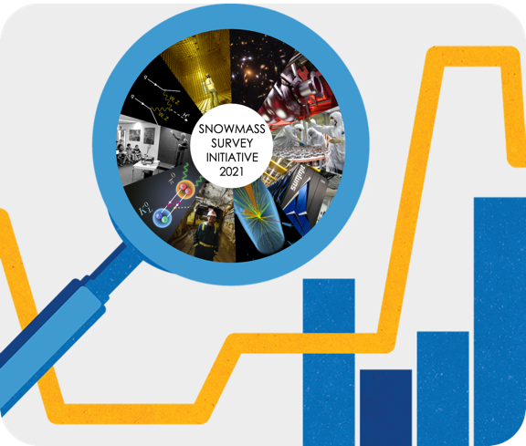
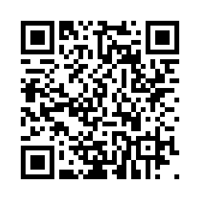
An Opportunity to Make Your Individual Voice Heard
Take the Survey HERE
Encourage full HEPA community to participate in survey
Deadline of August 15th (~1 week left)!
Collects opinions & experiences across
Careers
Physics Outlook
Workplace Culture
Harassment/Racism
Visa Policies
COVID-19
Demographics
Fermilab News Article
Any questions? Suggestions? Ping us at SNOWMASS21-SURVEY@fnal.gov

Slide 16
Snowmass Day: September 24, 2021
CSS@UW-Seattle: July 17-27, 2022
Visit the Snowmass 2021 webpage to
learn about Frontiers, white papers, and SEC!
We hope to see you on the
#welcome-to-snowmass Slack channel!

