Slide 1
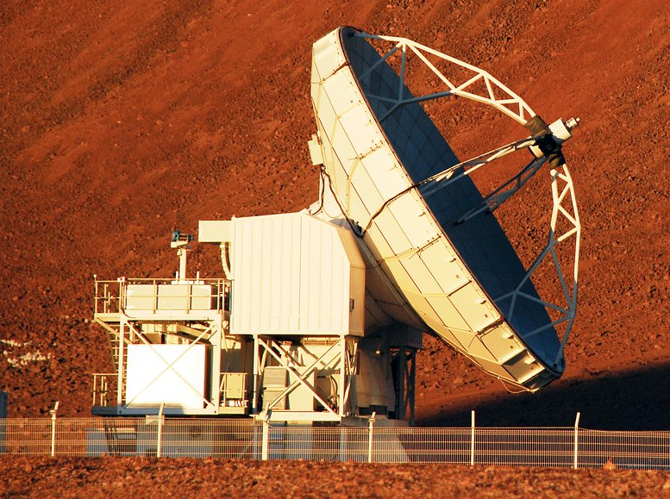
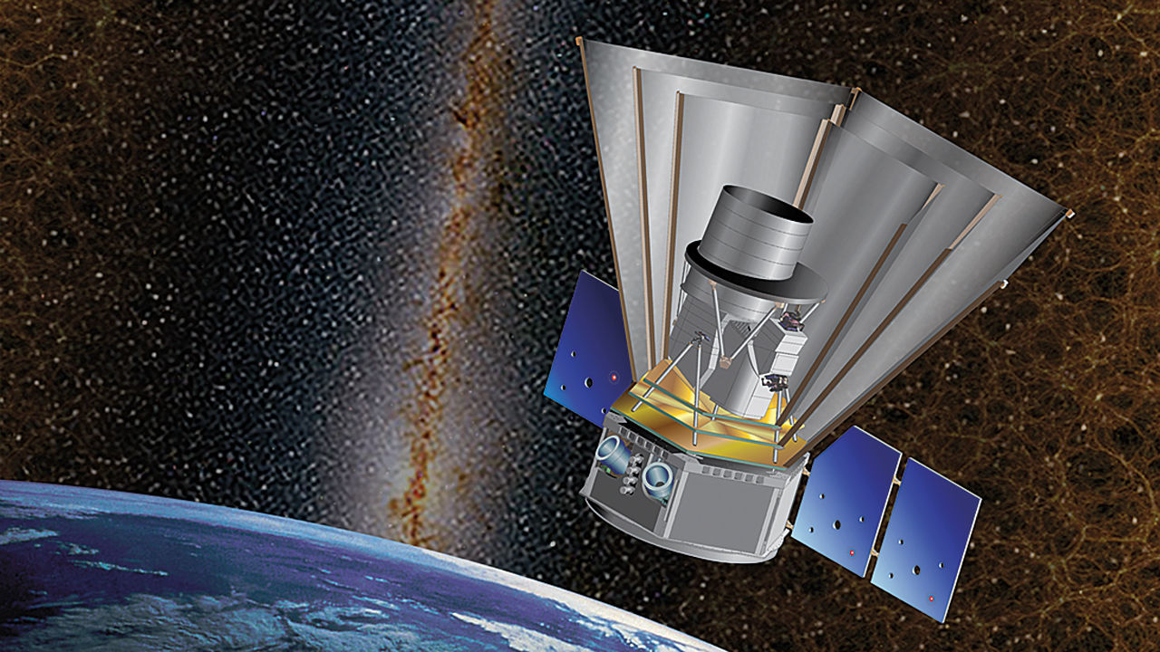
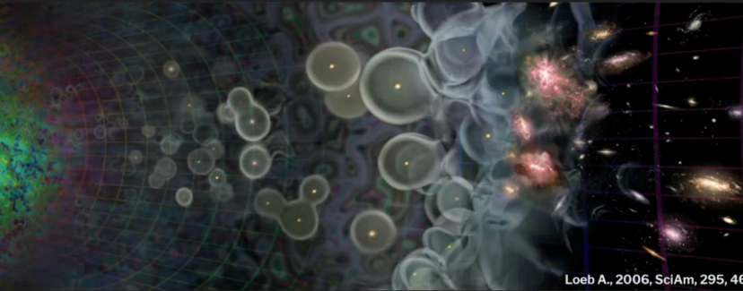
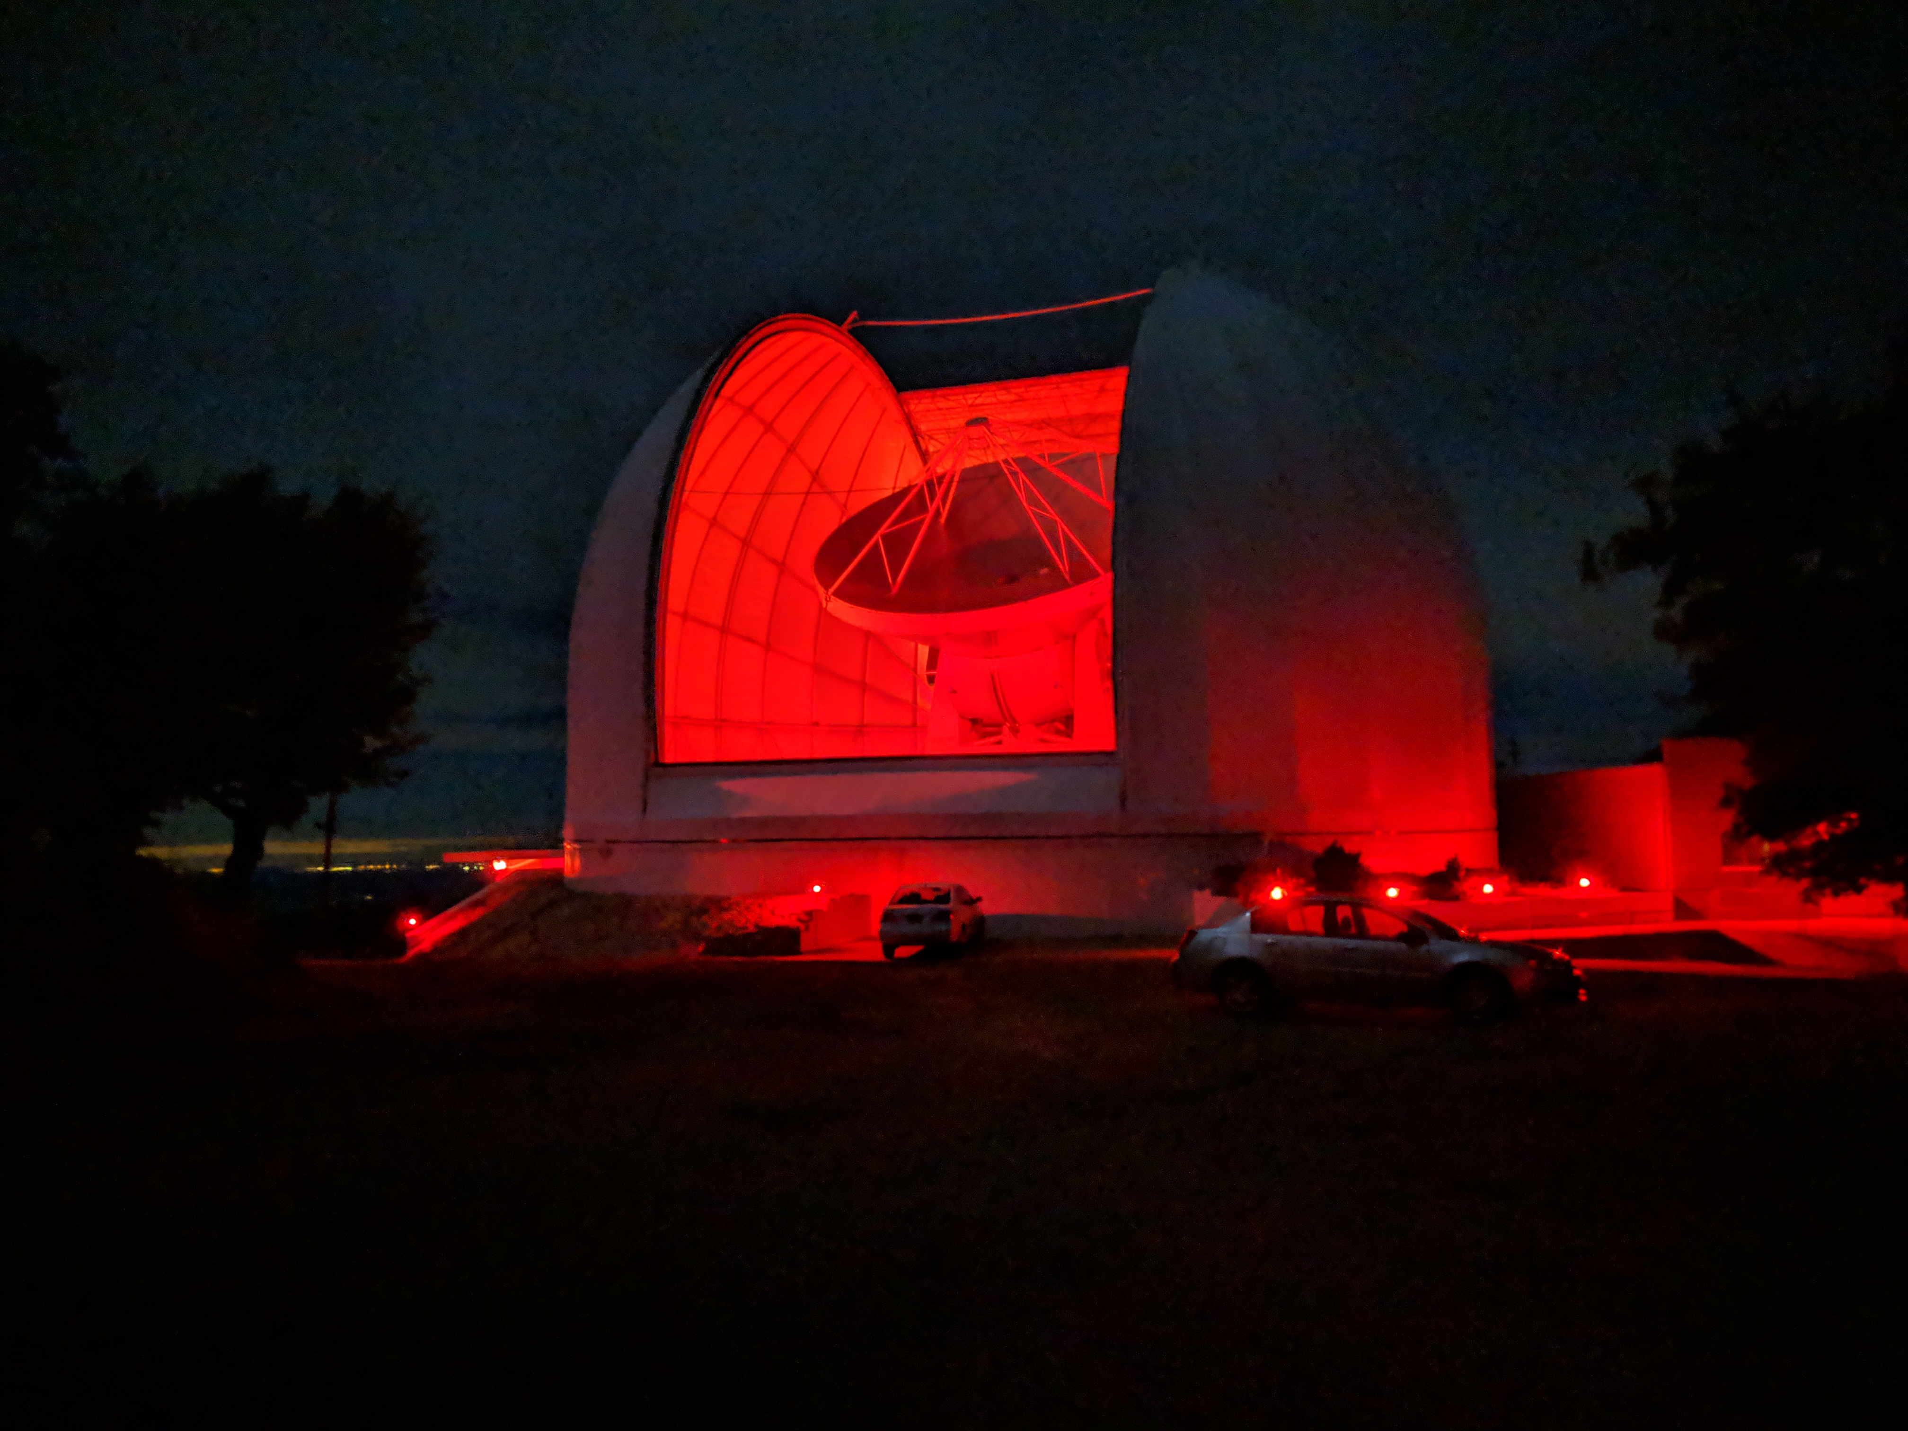
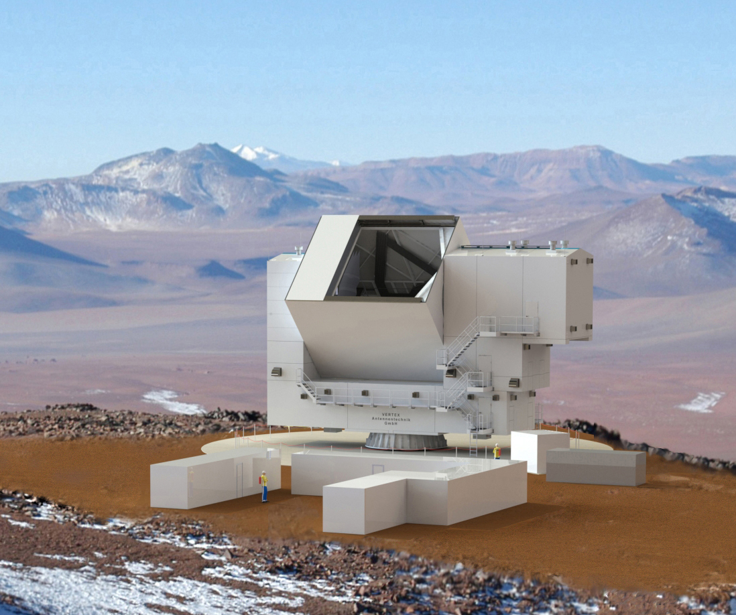
Line Intensity Mapping at Reionization
Patrick C. Breysse (NYU)
CMB-S4 2021 Summer Collaboration Meeting

Slide 2
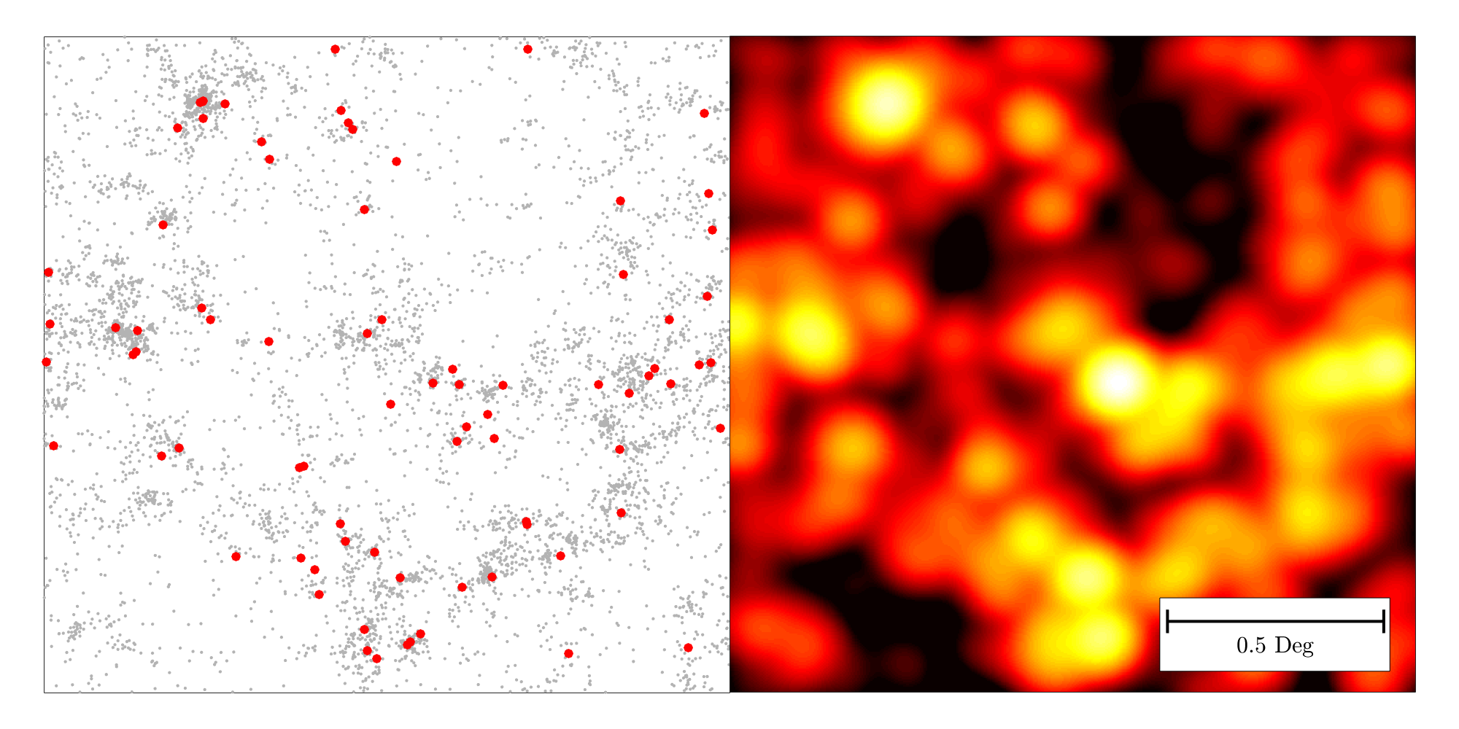
Line Intensity Mapping
Consider a blind spectroscopic survey of line emitters
Example- CO(1-0) at z~3 over 2.5 deg² with VLA
With ~4500 hours, can detect red points (<1% of all sources)
Faint Galaxies Bright Galaxies

Slide 3
Line Intensity Mapping
Faint Galaxies Bright Galaxies Line Emission

Slide 4
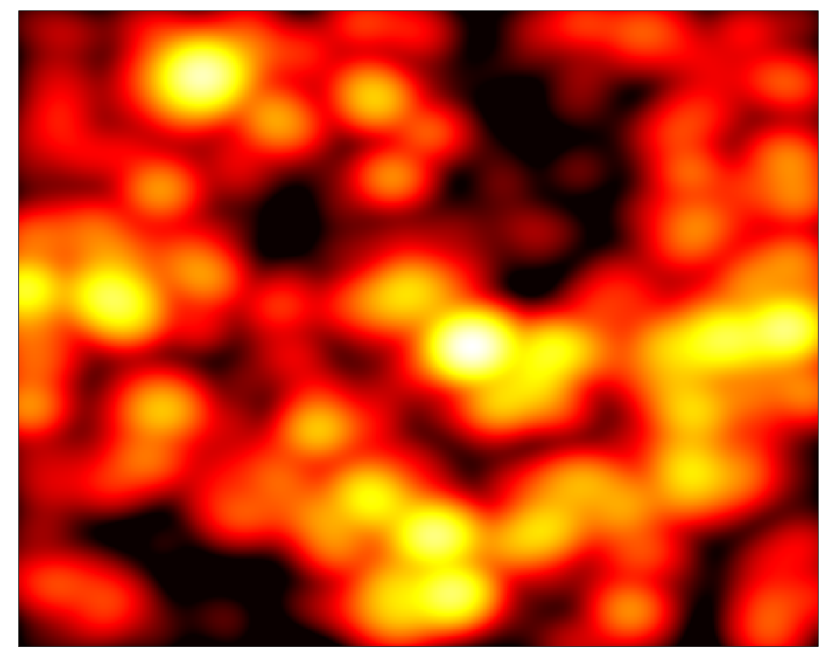
Line Intensity Mapping
Frequency
Observing Frequency
Redshift
Can make 3D measurements by observing at many, closely-spaced frequencies

Slide 5
Galaxy surveys give detailed properties of brightest galaxies
Intensity maps give statistical properties of all galaxies

Slide 6
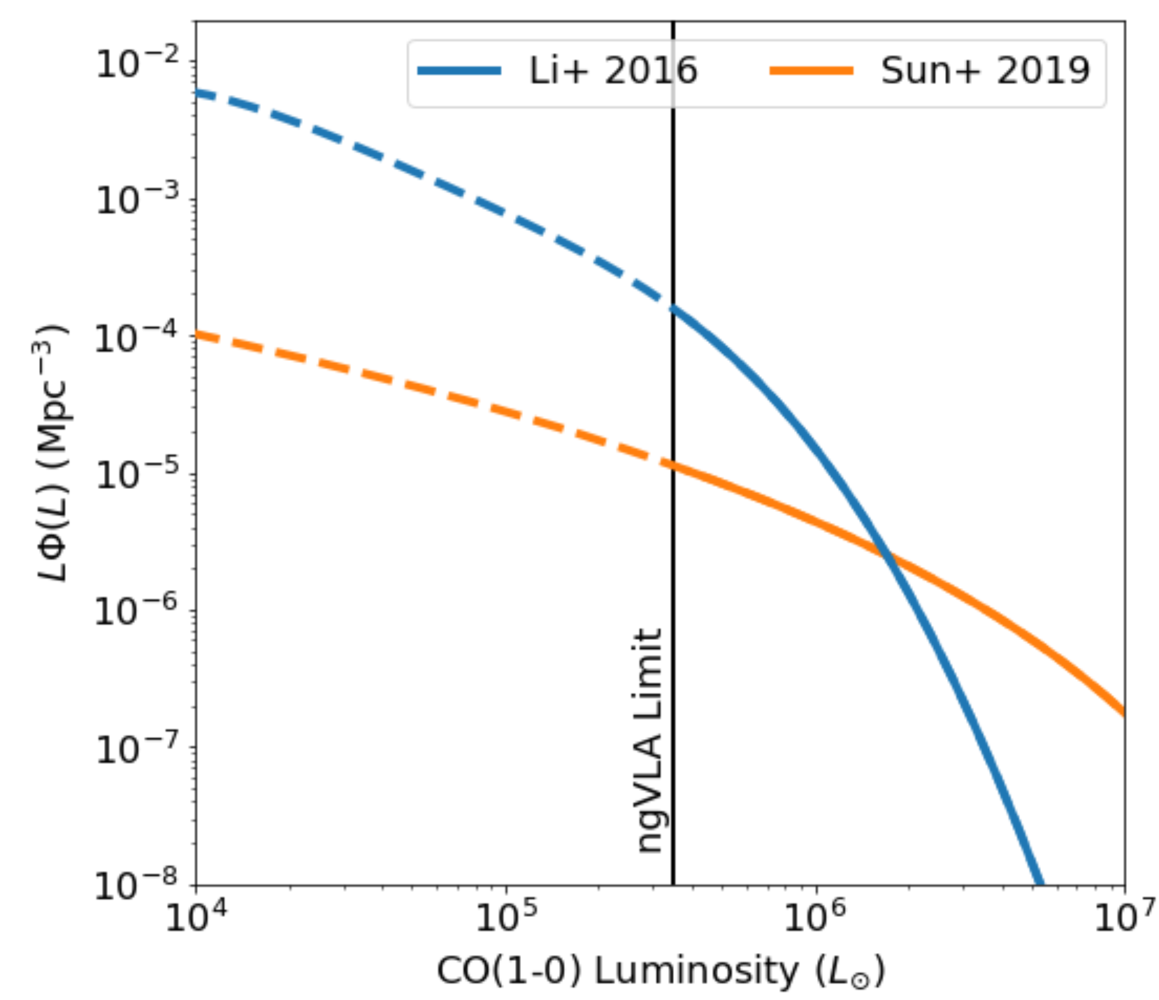
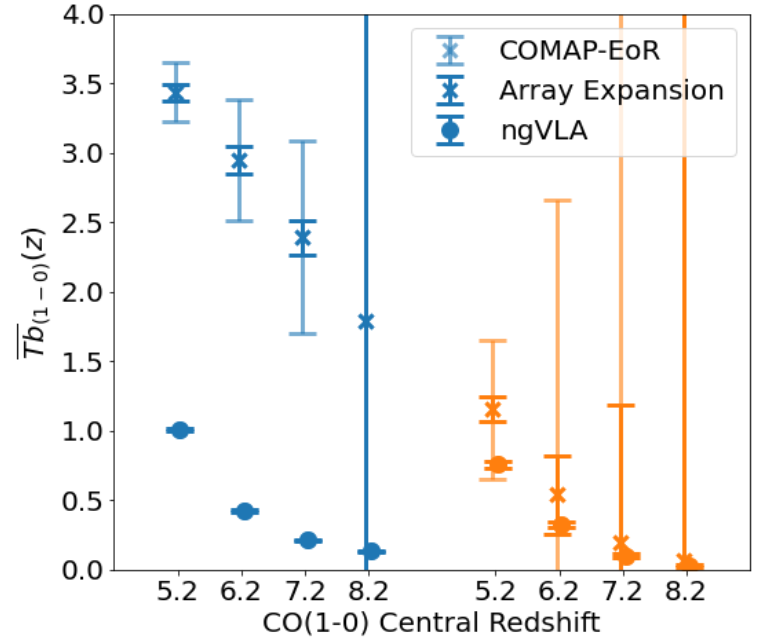
Faint Galaxies at EoR
LIM Data
CO Luminosity Function (Mpc⁻³)
Total Emission (μK)
ngVLA Data
CO Luminosity (L☉)
Redshift

Slide 7
LIM Experiments at EoR

Slide 8
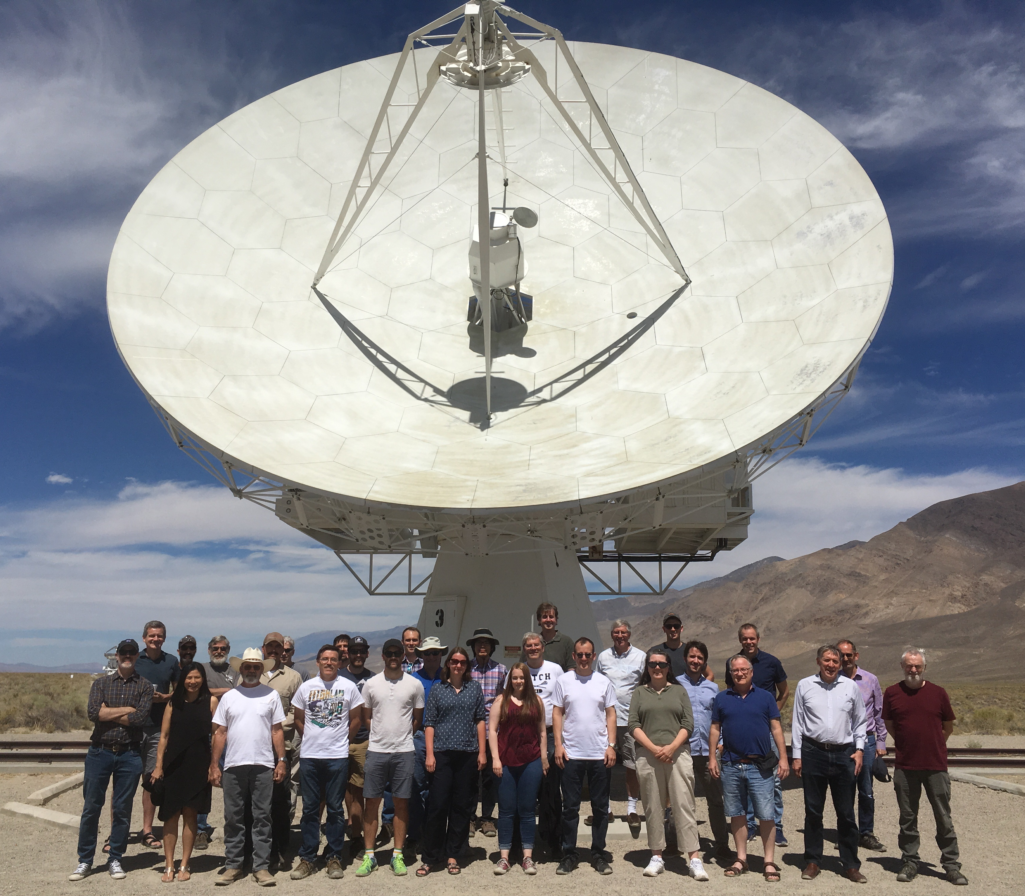
CO Intensity Mapping
Carbon Monoxide Mapping Array Project (COMAP)
Currently mapping CO at z~3
Partially funded extension to z~7 upcoming
Maps molecular gas, star formation

Slide 9
CII Intensity Mapping
CONCERTO, TIME, and FYST
All targeting CII 158 μm at z~7
Widely different spectrograph technologies
Brighter than CO, but has several foreground lines

Slide 10
Lyman-⍺ Intensity Mapping
SPHEREx midEx Mission
IR spectrum at every point on the sky, deep fields at poles well-suited for LIM
Accesses several different lines, inc. EoR-era Ly⍺

Slide 11
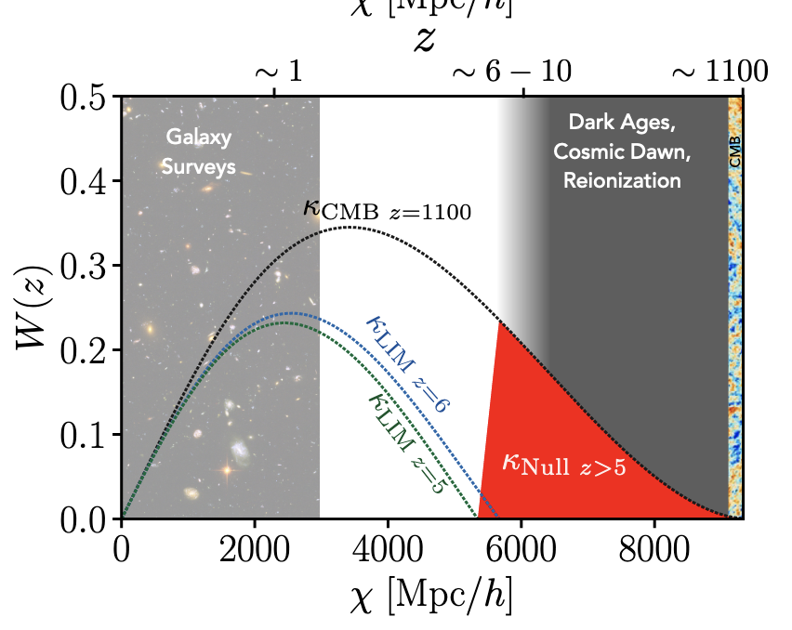
Modeling Limitations
Huge need for theory/modeling effort to understand cross-experiment synergies!
Example- Dark ages lensing with LIMxCMB
  Maniyar+ 2021, arXiv:2106.09005
What other synergies are there?
  CIB? kSZ? 21cm? ???

Slide 12
Lots of intensity mapping data are coming soon!

