Slide 1
Ground-based Measurements of Primordial non-Gaussianity with μ-distortions
David Zegeye and Thomas Crawford

Slide 2
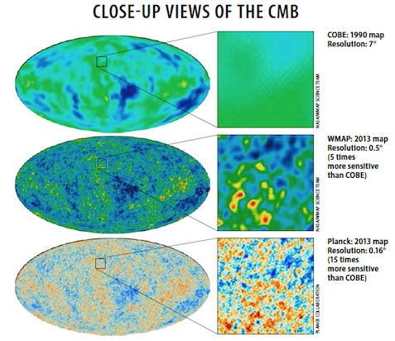
Early Universe Gaussianity
Early Universe observables are statistically homogenous and isotropic
Any observed perturbations believed to be quantum-scale fluctuations stretched to macroscopic scales by inflation

Slide 3
Early Universe Gaussianity
Those perturbations should follow a Gaussian distribution, for non-interacting quantum fields
Some level of non-gaussianities expected in slow roll inflation
Can characterize based on how much they deviate from Φ_{G} ~ 10⁻⁵
Φ = Φ_{G} + f_{NL}Φ_{G}²

Slide 4
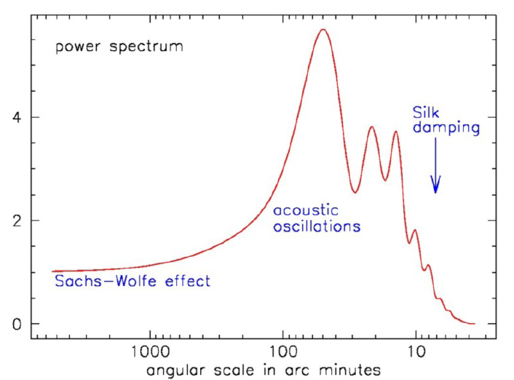
CMB at small scales
Planck 2018 places constraints large-scale f_{nl} < 10
Acoustic (Silk) damping of CMB oscillations suppresses power at small scales
Want new methods and more statistics to probe non- gaussianity
Bartelmann (2002)

Slide 5
Early universe as a Photon-baryon plasma soup
Calories (energy) of our soup:

Slide 6
Photon-baryon plasma soup: z > 2*10⁶
Energy thermalized by double Compton scattering and thermal Bremsstrahlung
Photons # can change without changing total energy
Calories:

Slide 7
Photon-baryon plasma soup: 5*10⁴ < z < 2*10⁶
Double Compton and Bremsstrahlung are inefficient
Single Compton preserves photon #, blackbody distribution is distorted.
Calories:
Notes:
*show plot*

Slide 8
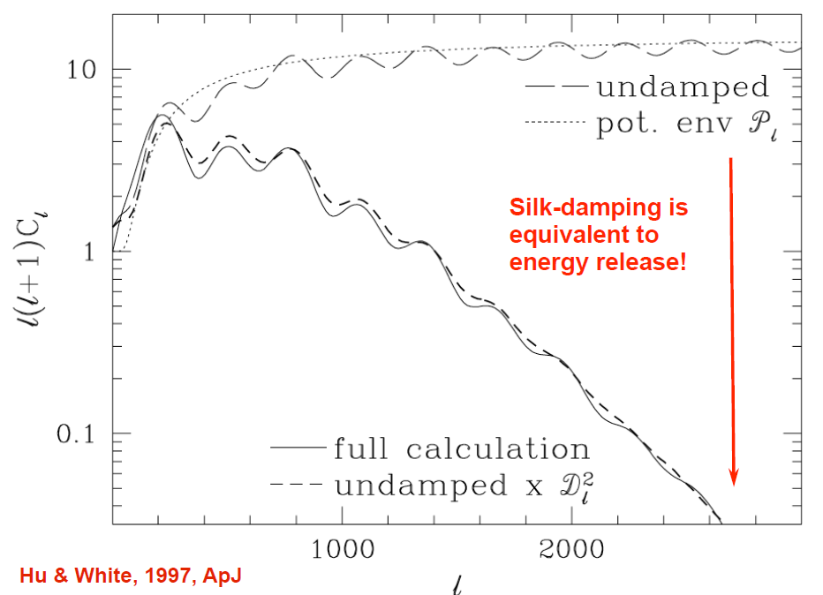
Since we are not at equilibrium, fewer photons than in a blackbody → energy release
Energy injection relates μ to density anisotropies of photons

Slide 9
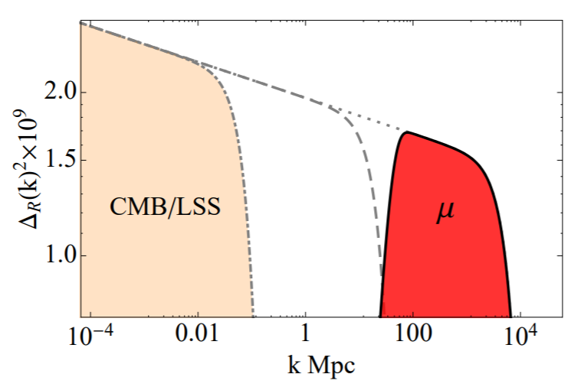
μ-distortion scale
From μ being related to the primordial power spectra, μ-distortions probe damping on scales from: k ~ 50 - 10⁴ Mpc⁻¹
21 cm
Pajer & Zaldarriaga (2012)

Slide 10
Non-Gaussianity from μ-distortions
Anisotropies in μ exist if there’s long-wavelength enhancement of the amplitude of small-scale power, (i.e. a squeezed-limit NG.”)
μ-distortions are useful for probing non-gaussianity at small scales, they can be a way to test inflation
k₃
k₁
k₂

Slide 11
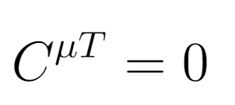
Testing inflation from μ-distortions
Temperature anisotropies and μ are only correlated for squeezed limit non-gaussianities beyond consistency relationship (Cabass et al. 2018)
Single field inflation

Slide 12
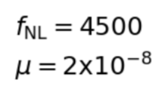
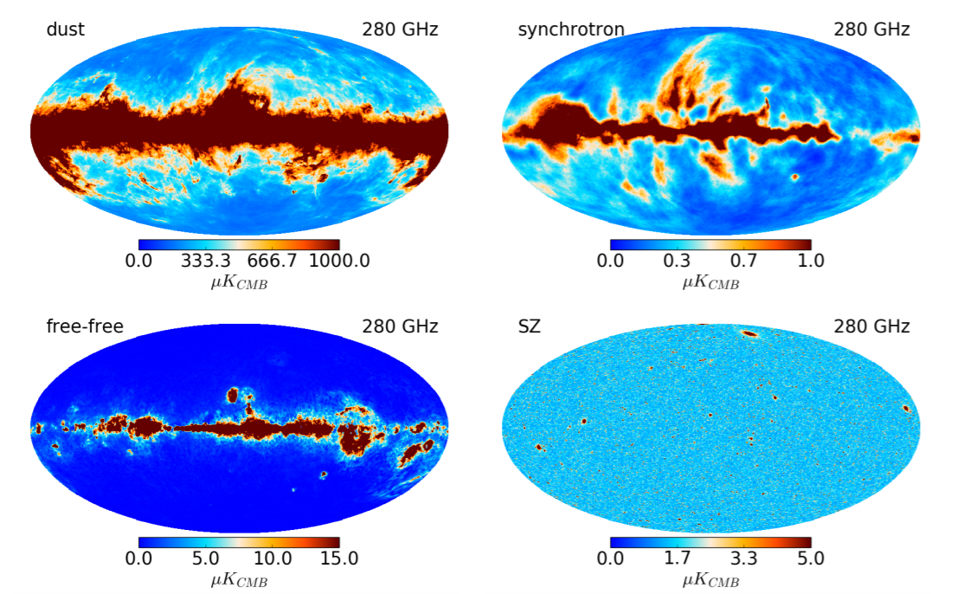
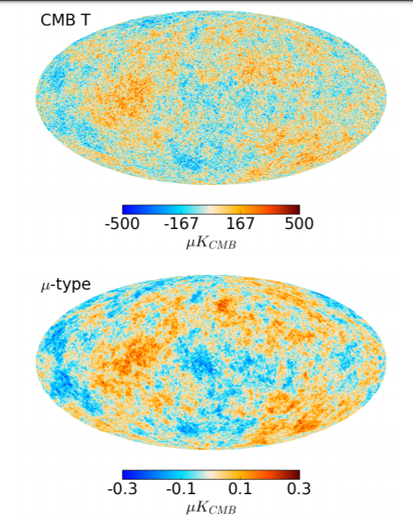
Foregrounds strongly obscure μ-distortions

Slide 13
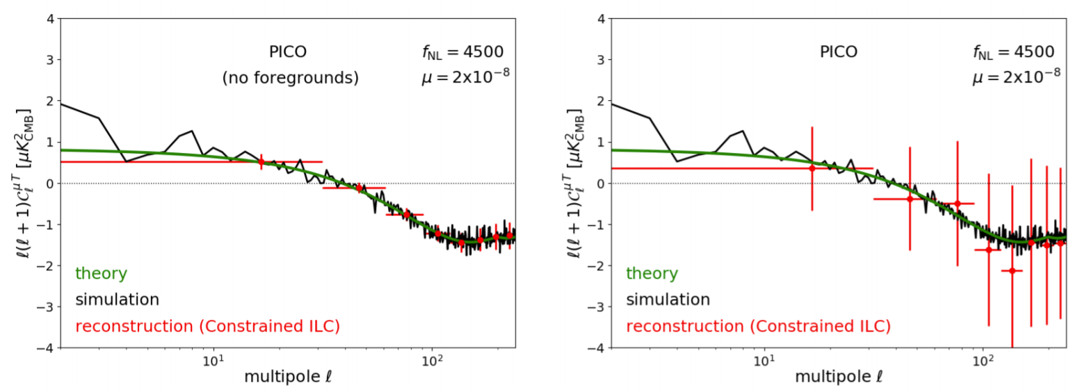
Observation with space-based instruments
Remazeilles and Chluba (2018)
σ(f_{nl}) = 371
σ(f_{nl}) = 2929

Slide 14
Observation with Ground-based instruments
Benefits:
Cheaper
Easier to build/upgrade
Concerns:
Atmosphere

Slide 15
Observations with a Ground-based instrument
Add frequency bands

Slide 16
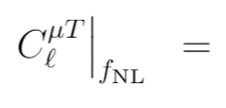
Cross-spectra

Slide 17
Calculating C^{μμ} noise using Constrained ILC
Remazeilles & Chluba (2018)

Slide 18
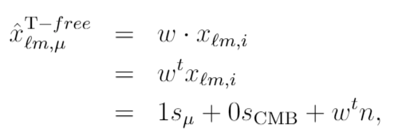
Calculating C^{μμ} noise using Constrained ILC

Slide 19
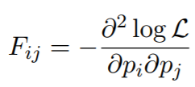
Fisher Matrix
We use the Fisher Matrix method to measure signal-to-noise of C^{μT} and its dependence on f_{nl}

Slide 20
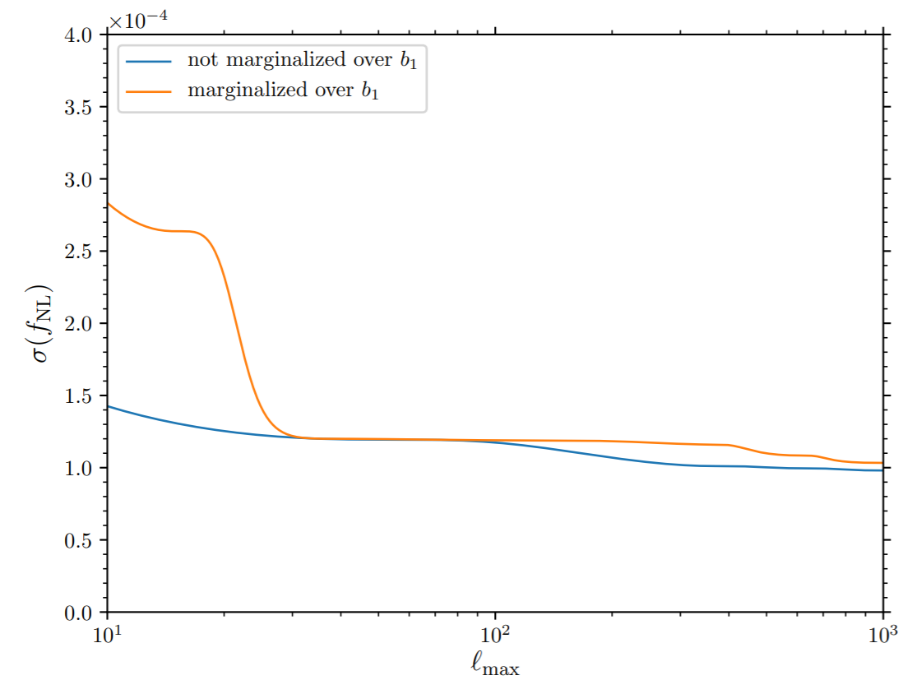
Cosmic-variance limits on f_{nl} with μ
Cabass et al. (2018)
σ(f_{nl}) ~ 10⁻⁴

Slide 21
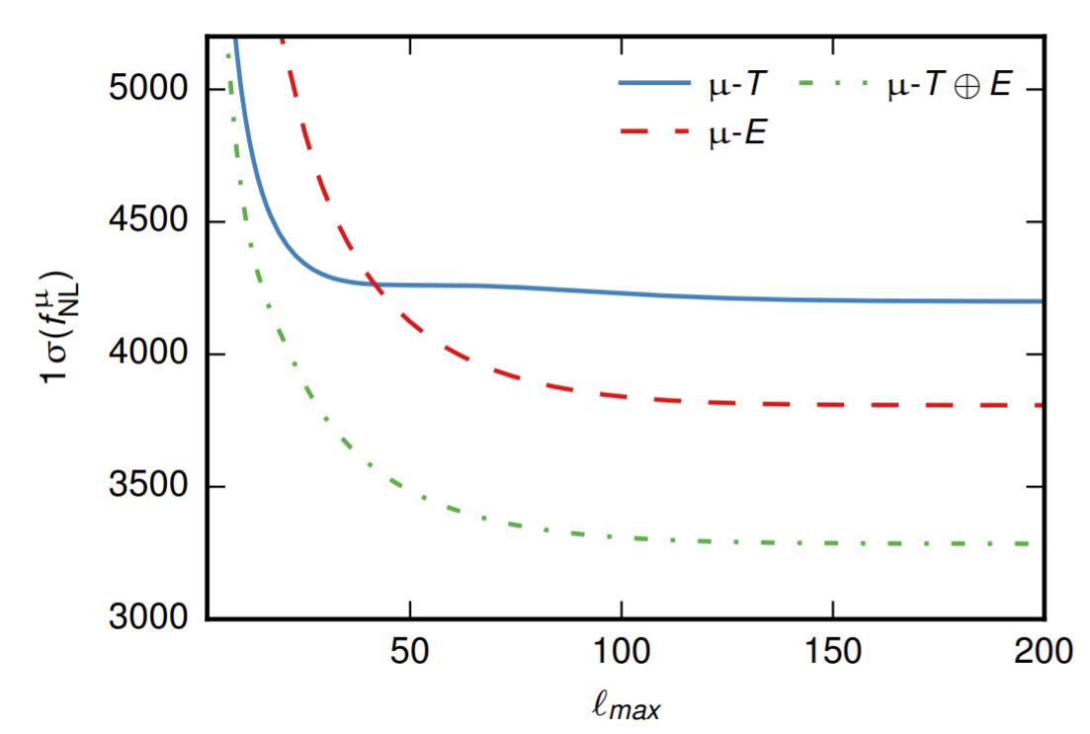
μT and μE cross-correlations

Slide 22
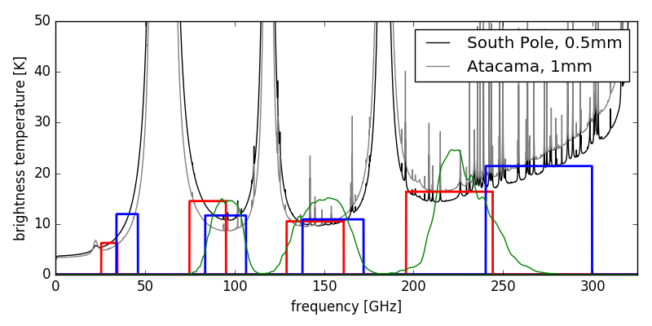
Atmosphere increases noise at low-ℓ
Atmosphere is present in all frequency bands
Correlates detectors, implying atmosphere can be separated out of observation

Slide 23
CMB-S4 constraints on fnl
No foregrounds or atmosphere:
CMB-S4: σ(f_{nl}) ~ 33
Foregrounds & atmosphere is 99.9% correlated:
CMB-S4: σ(f_{nl}) ~ 1700
Foregrounds & atmosphere is 100% correlated
CMB-S4: σ(f_{nl}) ~ 980

Slide 24
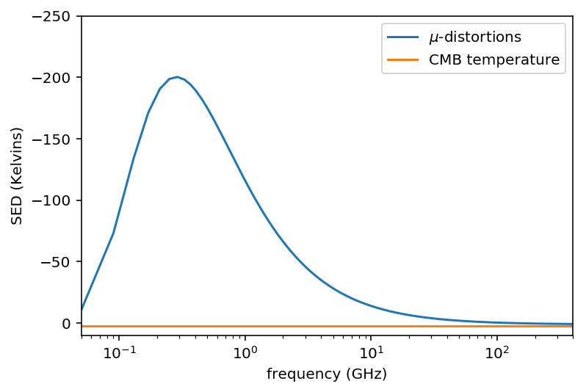
μ peaks at lower frequencies
Additional detectors at lower frequencies should have better observations of μ and constrain the foreground degrees of freedom

Slide 25
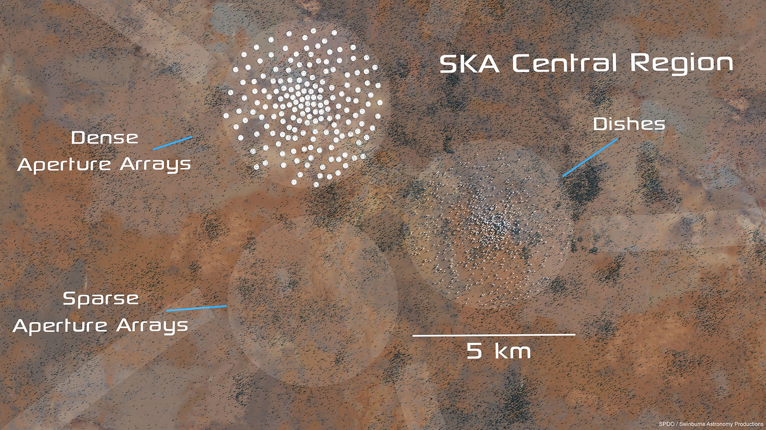
SKA is expected to observe from 50 MHz - 20 GHz!

Slide 26
CMB-S4 + SKA
CMB-S4 | σ(f_{nl}) w/ no foregrounds | σ(f_{nl}) w/ foregrounds
CMB-S4 Alone | ~ 33 | ~ 980
S4+SKA1-MID | ~ 33 | ~ 40
S4+SKA2 | ~ 0.5 | ~ 1.1

Slide 27
ℓ_{min} cutoffs
S4+SKA2 | σ(f_{nl}) w/ no foregrounds | σ(f_{nl}) w/ foregrounds
ℓ_{min} = 2 | ~ 0.5 | ~ 1.1
ℓ_{min} = 10 | ~ 0.8 | ~ 1.7

Slide 28
Future Work
Constraints on f_{nl} from μ-distortions will be better than Planck, and comparable to future measurements from LSS & 21cm
Investigate models that generate measurable fnl at the scales μ-distortions probe
Suggest optimal instrument specifications for sigma(f_{nl}) < 1 detection

Slide 29
Extra Slides
For acoustic damping of small power:

Slide 30
μ-distortions
μ is proportional to density anisotropies of photons

Slide 31
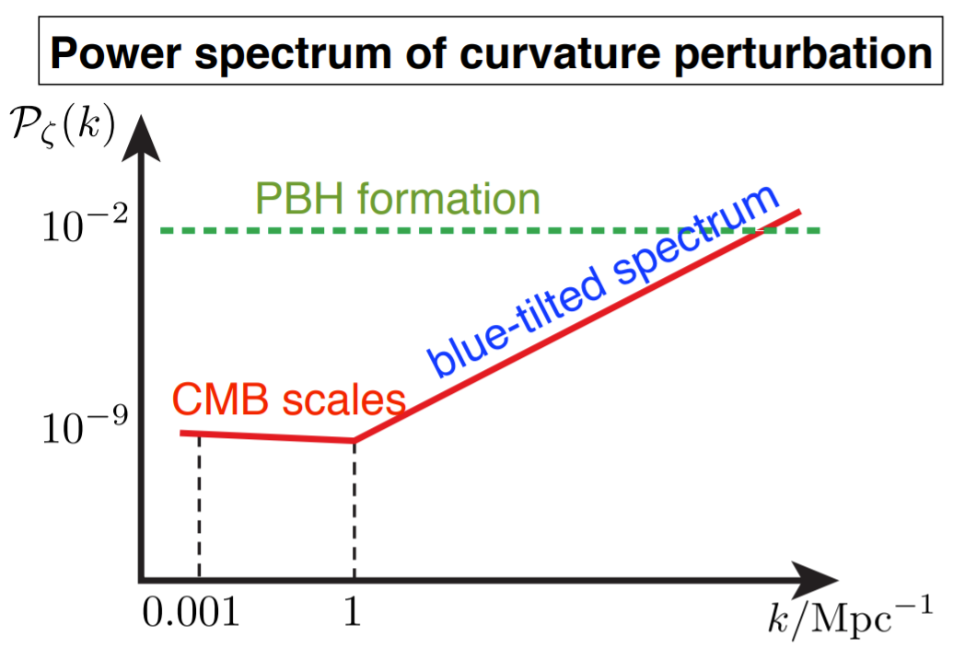
μ is proportional to the power spectrum
If power increases on small scales, μ-distortions will be larger, better f_{nl} constraints
Borrowed from Kitajima (13th Rencontres du Vietnam)

Slide 32
Reducing Atmosphere
Since atmosphere is present in all frequency bands, detectors are correlated, implying atmosphere can be separated out of observations

Slide 33
Using the official CMB-S4 numbers
Add frequency bands

